Slide 1


learning in higher education, adult learning, effective study skills

Slide 2

أهلا بحضراتكم

Slide 3

التعارف
1st Y

Slide 4
Anticipations

Slide 5
Learning Objectives

Slide 6
Learning Objectives
By the end of this session you should:-
Define andragogy.
Define learning as a change in behavior or cognitive process.
Describe characteristics of adult learners.
Describe principles of adult learning.
Apply principles of adult learning to training.
©SHRM 2009
Notes:
Objectives for Unit #3

Slide 7
Learning Objectives (continue)
By the end of this session you should:-
Be aware of the policies effecting change in higher education
Understand why an accredited teaching qualification in necessary for a career in HE
Appreciate the context within which HE teaching is undertaken
Identify some implications for teaching in the future
Notes:
As a number of us may be new to lecturing, new to Queen’s or indeed new to the UK higher education framework I felt that a contextual perspective of teaching in higher education would be useful and, hopefully, interesting.
We will be travelling back in time 20 or so years and then projecting a short way forward – a bit like Back to the Future but without the De Lorean car? As we travel we will see that the profession we have chosen is full of uncertainty with change being the only constant

Slide 8
Adult Learning Principles
©SHRM 2009

Slide 9
Learning
A relatively permanent change in human capabilities that is not a result of growth processes.
Noe, 2008
©SHRM 2009

Slide 10

Adult Learning Principles
Adult learners are different.
It’s not like working with children.
©SHRM 2009

Slide 11
Learning Is Change
Learning is a change in behavior or cognitive process.
In training it is a change in knowledge, skill or attitude.
©SHRM 2009
Notes:
Acquiring new information and knowledge is part of everyday adult life.
Learning is an individual process.

Slide 12
Characteristics of Adult Learners
Control over learning.
High motivation to learn.
Pragmatic in learning.
Learning may be a secondary role.
Resistant to change.
Adult learners are more diverse.
Draw on past experiences in learning.
Learning is often self-initiated.
Learning is aimed at an immediate goal.
        Houle, 1984 Ball, 1996
©SHRM 2009
Notes:
Control over learning: Adult learners tend to be self-directed in their lives. To meet this need, training programs should try to include adult learners in the planning of the training program.
High motivation to learn: Since most adult learning is voluntary or optional, adult learners make personal choices to attend training even when such training is tied to professional development of job skills. Trainers do not need to spend a lot of time trying to motivate adult learners but can concentrate on facilitating the learning that adults are already motivated to pursue.
Pragmatic in learning: Adult learners are motivated to learn information that is immediately applicable to their situation and needs. To meet this need, program content must be relevant to the application needs of the learners.
Learning may be a secondary role: For most adult learners, the student role is a minor and/or secondary aspect of their lives. Because of multiple roles, most adults have far less time and energy to read, study or learn. Adult education programs require flexibility and more learning time.
Resistant to change: Learning often involves changes in attitudes or actions. Adults tend to be somewhat resistant to such change and may be comfortable doing things the way they have done them in the past.
Adult learners are more diverse: Adult learners are diverse in terms of age, background, training and experience, much more than traditional age learners. Training programs must allow for a variety of learning styles and use different training methods, allowing more time for interaction between adults to allow learners to network to share perspectives and experiences.
Draw on past experiences in learning: Adult learners tend to link any new learning to their previous experience. They evaluate the validity of new ideas and concepts in light of how the idea or concept “fits” their experience. Trainers should take advantage of adult learner experience and help the adult learner link new ideas to previous learning and encourage discussion on how new ideas fit the experience of learners.
Learning often self-initiated: Adults often recognize a need and will initiate learning on their own without stimulus from outside sources.
Learning aimed at an immediate goal: Adults often engage in learning to solve a problem or to achieve a solution. They are often not interested in the broad picture but instead want specific information from training that they can apply immediately in the workplace.
Sources:
Houle, C. O. (1984). Patterns of learning. Jossey-Bass,
Ball, C. L. (1996). Demystifying adult literacy for volunteer tutors: A reference handbook and resource guide. Retrieved from www.nald.ca/library/learning/demyst/demyst.htm.

Slide 13
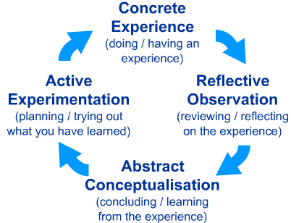
The Learning (Kolb) Cycle
Now What?
What?
So What?
Kolb, David A., (1984)
Notes:
Kolb developed a theory of experiential learning that can give us a useful model by which to develop our practice. This is called The Kolb Cycle, The Learning Cycle or The Experiential Learning Cycle. The cycle comprises four different stages of learning from experience and can be entered at any point but all stages must be followed in sequence for successful learning to take place. This suggests that there are four stages which follow from each other: Concrete Experience is followed by Reflection on that experience on a personal basis. This may then be followed by the derivation of general rules describing the experience, or the application of known theories to it (Abstract Conceptualisation), and hence to the construction of ways of modifying the next occurrence of the experience (Active Experimentation), leading in turn to the next Concrete Experience. All this may happen in a flash, or over days, weeks or months, depending on the topic, and there may be a "wheels within wheels" process at the same time. The Learning Cycle suggests that it is not sufficient to have an experience in order to learn. It is necessary to reflect on the experience to make generalisations and formulate concepts which can then be applied to new situations. This learning must then be tested out in new situations. The learner must make the link between the theory and action by planning, acting out, reflecting and relating it back to the theory..

Slide 14

Learning Styles
What Learning Style Are You?
Diverger
Assimilator
Converger
Accommodator
©SHRM 2009
Notes:
The learning styles combine each of the four elements of the learning cycle.
Diverger: Generates ideas and understands multiple perspectives. Based on concrete experience and reflective observation.
Assimilator: Good at inductive reasoning, can create theoretical models and explanations. Based on abstract conceptualization and reflective observation.
Converger: Good deductive reasoning, decision making and application of ideas. Based on abstract conceptualization and active experimentation.
Accommodator: Involved in new experiences, implements decisions and carries out plans. Based on concrete experience and active experimentation.
www.coe.iup.edu/rjl/instruction/cm150/selfinterpretation/kolb.htm
www.businessballs.com/kolblearningstyles.htm

Slide 15
أنماط التعلم learning styles
إدارة التدريب

Slide 16

Words of Wisdom
I hear, I forget
I see, I remember
I do, I understand
(Confucius)

Slide 17

المتعلم البصرى
  Visual.
65%
من المتعلمين

Slide 18

المتعلم السمعى
  Auditory.
30%
من المتعلمين
إدارة التدريب

Slide 19

المتعلم الحركى
  Kinesthetic.
5%
من المتعلمين
إدارة التدريب

Slide 20

Models of Learning & Teaching in Higher Education

Slide 21

3 Types of people/lecturers
Those that make things happen,
Those that watch things happen,
Those that wonder what happened!
Prof. Frank Pantridge
Notes:
As we shall learn later it is important to start a lecture or indeed, any presentation, with an opener that will create interest. During a break in preparing this presentation I was reading the life story of a famous Queen’s graduate, Professor Frank Pantridge. Prof. Pantridge graduated in medicine in 1939, served in WW 2 and was awarded a military cross. After the war he was a lecturer in pathology at QUB and later became a cardiac consultant at the RVH. He invented the portable defibrillator which has saved countless thousands of lives. In his book he says there are three types of people and I wonder if this could be also applied to lecturers!

Slide 22
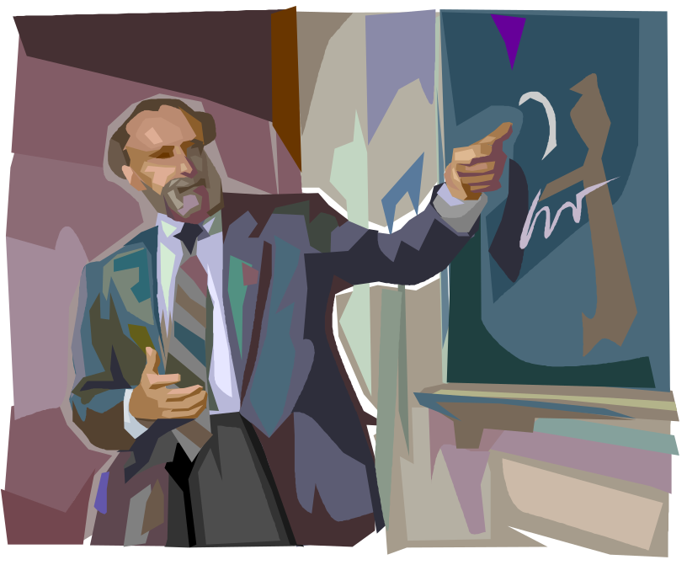
Teaching
I do not wish to be a teacher,
I am employed as a lecturer
Students attend my lectures but the onus to learn is on them.
It is not my job to teach them.
(Guardian 1991)
Notes:
I wonder if any of us still share this view or indeed perhaps know colleagues who do.
While it might have been acceptable in 1991 moves were already under way to change things and in 2008 changes are still happening

Slide 23
Curriculum model
Specified
Enacted
Experienced

Slide 24
Teaching and Curriculum 1960s
Specified
Enacted
Experienced

Slide 25
Teaching and Curriculum 1980s
Specified
Enacted
Experienced

Slide 26
Teaching and Curriculum 2000
Specified
Enacted
Experienced

Slide 27
Teaching and Curriculum today
Specified
Enacted
Experienced
Hidden
(Postmodernism vs Professionalism in Higher Education – J. Milliken)

Slide 28
Conditions for learning
Clear objectives: expressed as learning outcomes;
Students feel a need to achieve those objectives;
Motivation: a PRODUCT of good teaching;
Students engage with the material;
Students can work collaboratively in dialogue with others;
Students receive positive feedback.

Slide 29

Frameworks for student learning
Bloom’s taxonomy of learning
Notes:
Behaviorist theories of learning seek scientific, demonstrable explanations for simple behaviors. For these reasons, and since humans are considered to resemble machines, behaviorist explanations tend to be somewhat mechanical in nature. "They make use of one or both of two principal classes of explanations for learning: those based on contiguity (simultaneity of stimulus and response events) and those based on the effects of behavior (reinforcement and punishment)"
You will often find stimulus-response techniques used in computer courses.
NB For each ‘school’ only one model will be presented – see web page below for more models, University of Bristol.

Slide 30
Bloom’s Taxonomy
Taxonomy of Cognitive Objectives
1950s- developed by Benjamin Bloom
Means of expressing qualitatively different kinds of thinking
Adapted for classroom use as a planning tool
Continues to be one of the most universally applied models
Provides a way to organise thinking skills into six levels, from the most basic to the higher order levels of thinking
1990s- Lorin Anderson (former student of Bloom) revisited the taxonomy
As a result, a number of changes were made
(Pohl, 2000, Learning to Think, Thinking to Learn, pp. 7-8)
Notes:
Blooms taxonomy university professors who wanted to classify objectives, experiences, processes, and evaluation questions.

Slide 31
Bloom’s Taxonomy
Bloom’s taxonomy is an attempt to classify forms of learning.
It identifies three “domains” of learning each of which is organised as a series of levels or pre-requisites.
Lower levels must be covered before moving on to higher levels – adopts a ‘building blocks’ view of learning.
The three levels are:
cognitive
affective
psycho-motor
Notes:
DURING THE 1950'S, BENJAMIN BLOOM LED a team of educational psychologists in the analysis of academic learning behaviours. The results of this team's research produced what is known today in the field of education, as Bloom's Taxonomy. This hierarchy of learning behaviours was categorized into three interrelated and overlapping learning domains; the cognitive (knowledge), affective (attitude), and psychomotor (skills).
"Taxonomy” simply means “classification”, so the well-known taxonomy of learning objectives is an attempt (within the behavioural paradigm) to classify forms and levels of learning. It identifies three “domains” of learning (see below), each of which is organised as a series of levels or pre-requisites. It is suggested that one cannot effectively — or ought not try to — address higher levels until those below them have been covered (it is thus effectively serial in structure). As well as providing a basic sequential model for dealing with topics in the curriculum, it also suggests a way of categorising levels of learning, in terms of the expected ceiling for a given programme. Thus in the Cognitive domain, training for technicians may cover knowledge, comprehension and application, but not concern itself with analysis and above, whereas full professional training may be expected to include this and synthesis and evaluation as well.

Slide 32
مستويات التفكير
يؤلف ـ يجمع ـ يبتكر ـ يصمم ـ يعدل ـ ينظم ـ يعيد الترتيب أو التنظيم ـ يربط ـ يبين ـ يراجع ـ يعيد الكتابة ـ يحكي ـ يكتب موضوعاً ـ يقترح
الإبداع
التقويم
التذكر
التحليل
التطبيق
الفهم
ينقد ـ يقيم ـ يبدي رأيه ـ يحكم ـ يقرر ـ يثمن ـ يستخلص ـ
يقوم ـ يدعم ـ يقدر ـ يبرر ـ يفسر
يجزئ ـ يفرق ـ يميز ـ يتعرف على ـ يوضح ـ يستنتج ــ يختار ـ يفصل ـ يقسم ـ يحدد العناصر ـ يحلل ـ يقارن ـ يوازن ـ يصنف
يطبق ـ ينتج ـ يعد ـ يربط ـ يحل ـ يرتب ـ يجهز ـ ينشئ ـ يغير ـ يخطط ـ يستخدم ـ يوضح ـ يكتشف ـ يعدل ـ يشغل ـ يبين ـ يبرهن.
يشرح ـ يلخص ـ يعبر ـ يفسر ـ يرتب ـ يترجم - يحسب ـ يعيد صياغة ـ يعلل ـ يعطي أمثلة
يحدد ـ يصف ـ يذكر ـ ينسب ـ يُعرِف ـ
يسترجع ـ يعدد

Slide 33
إستراتيجيات
التدريس والتعلم والتقويم باللائحة الجديدة
ـــــــــــــــــــــــــــــــــــــــــــــــــــــــــــــــــــــــ

Slide 34
المحاضرات:
يقوم عضو هيئة التدريس المسئول بتسليم handout للمحاضرة فى صورة PowerPoint أو word (منسق جيدا و يمكن تحويله الى PDF) إلي مركز تطوير التعليم 10 أيام قبل المحاضرة ويراعي فيها:
الوضوح وجودة العرض و الرسومات و الجداول التوضيحية.
الإرتباط الكامل بالمخرجات.
تصلح كمصدر أساسي للمذاكرة.
إشتمالها علي عدد من الأسئلة.
إشتمالها علي مرجع أساسي واحد + رابط إلكتروني للمساعدة.

Slide 35
المحاضرات:
سيتم عرض المحاضرة على الموقع الالكترونى للطلاب قبل ميعادها ب 7 أيام.
تتضمن المحاضرة:
مناقشة حول الأسئلة.

Slide 36
المحاضرات:
سيحدد المنسق 20-25% من المحاضرات لتتم بطريقة Team-Based Learning TBL)) وفقاً لنموذج سيتم إرسالة والتدريب عليه.

Slide 37
التدريب العملي
يتولي منسق المقرر/ رئيس القسم تحديد الأدوات المساعدة لتحقيق المخرجات المستهدفة العملية كما هو مكتوب بالتوصيف وتشمل هذه الأدوات:
كتاب تدريب الطالب: علي:
كتابة بيانات علي رسومات توضيحية.
أسئلة وحالات متعددة الإختيارات.
بعض الوسائل التوضيحية من خلال الوسائط المتعددة من الإنترنت.

Slide 38
الجلسات التفاعلية الأخري
Seminars, SDL, Small group discussions
يتولي منسق المقرر (Block) من قبل القسم بالتعاون مع عضو هيئة التدريس المسئول عن الجلسة التجهيز وتكليف الطلاب بما هو مطلوب وفقاً للتوصيف ومراعاه تفاعل الطلاب.

Slide 39
التعليم الإلكتروني:
سيتم عرض جميع المحاضرات والوسائل التوضيحية الأخري علي موقع الكلية بالتنسيق بين منسق البلوك، وحدة الخدمات الإلكترونية بالكلية.
سيتم تخصيص صفحة تفاعلية يلتزم الطالب بدخولها وإجابة الأسئلة الموضوعة من عضو هيئة التدريس المسئول عن التدريس وتتيح للأخير التعرف علي المشاركين – الناجحين – الراسبين – غير المشاركين.

Slide 40
ملف الإنجازات
Student Portfolio
تم إعداده لكل مقرر/ بلوك.
يقوم عضو/ أعضاء هيئة التدريس المسئولين عن التدريس في الأسبوع المحدد التحقق مما سجله الطالب فيما يخص الأنشطة التفاعلية والواجبات واعتماده.
الإمتحانات التكوينية.
توثيق الحضور في المحاضرات (إداري) وفي الجلسات (إداري).

Slide 41
استراتيجيات التقويم
تشكل لجنة لكل بلوك؛ مكونة من:
- منسق البلوك
- رئيس/ رؤساء الأقسام المشاركة فى البلوك
- منسق التدريس عن كل قسم من الأقسام المشاركة فى البلوك

Slide 42
استراتيجيات التقويم «تابع»
تتولى هذه اللجنة اعمال اللجنة الثلاثية المنصوص عليها فى قرارات ضمان الجودة المعتمدة من مجلس الكلية و أهمها:
عمل مخطط الامتحان (Blue-print) قبل بداية البلوك
إعداد الامتحانات التكوينية بالرجوع لأعضاء هيئة التدريس المشاركين فى التدريس
إعداد امتحانات أعمال السنة فى نهاية البلوك
التقييم النهائى لملفات الانجاز
إعداد بنكى أسئلة للبلوك بالرجوع لأعضاء هيئة التدريس المشاركين فى التدريس؛ أحدهما مفتوح /معلن و آخر مغلق سرى (وفقاً لنموذج سيتم إرساله والتدريب عليه).
إعداد امتحانات نهاية السنة و منسق البلوك مسئول عن سرية الامتحان التحريرى و التواصل مع العميد/ وكيل الكلية/ الكنترول.

Slide 43
Table of specifications of the ………………………………………………………..…………………block exam paper (Blue-print).
Subjects | Hrs | Relative Wt. of Hrs | Degree of importance | Relative Wt. of importance | Objectives |  |  |  | Relative Wt. of objectives | Relative Wts. Average | Mark | Evaluation
 |  |  |  |  | Levels |  |  | Total objectives
 |  |  |  |  | Knowledge | Understanding | Problem solving
Medical ethics Module:
Sum | 15 | 100 |  | 1000 |  |  |  |  | 1000

Slide 44
Challenges for the future
The need to develop an understanding of holistic learning (intellectual, social and emotional components);
Internationalisation of education;
Greater emphasis on self-directed learning;
Greater understanding of diversity in HE and its impact on approaches to teaching/learning;
Focus on classroom research (action research) to gain a greater understanding of learning strategies;
More research needed on learning styles;
Enhanced understanding of collaborative learning;
HE management must become more aware and accept the needs of enhanced learning and teaching;
Increased use of technology
Notes:
44

Slide 45
Summary & Conclussions
إدارة التدريب

Slide 46
Accountability
46

Slide 47
Did you meet your anticipation?
إدارة التدريب

Slide 48
عزيزي الطالب
يرجي الانتباه لضرورة الدخول على موقع الكلية:
http://www.sohag-univ.edu.eg/facemed/
يرجى التسجيل على موقع البرنامج
إدارة التدريب

Slide 49
Reflection
- Seminar
- Portfolio
إدارة التدريب

Slide 50

Thank you
يسعدنا التواصل مع حضراتكم
http://www.sohag-univ.edu.eg/facemed/
01001986936
Mostafa_atya@med.sohag.edu.eg
50
إدارة التدريب

