Slide 2
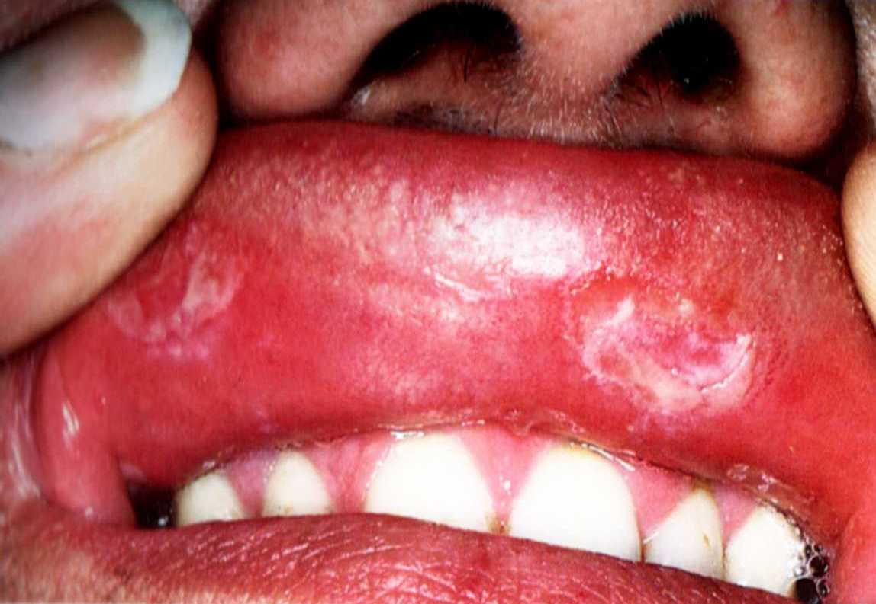

Slide 4
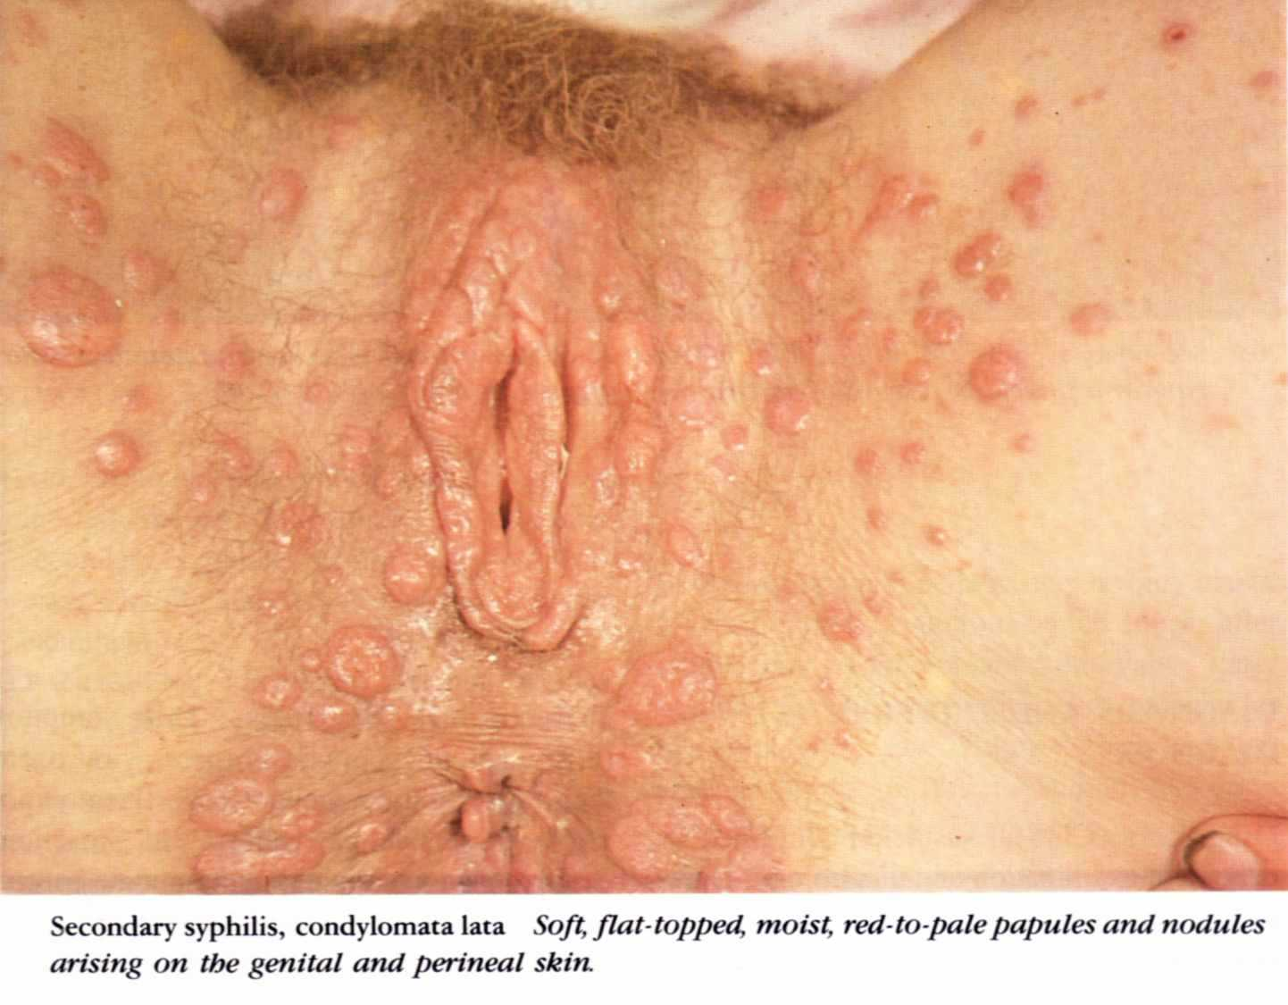

Slide 6
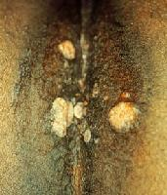
Condylomata lata

Slide 7
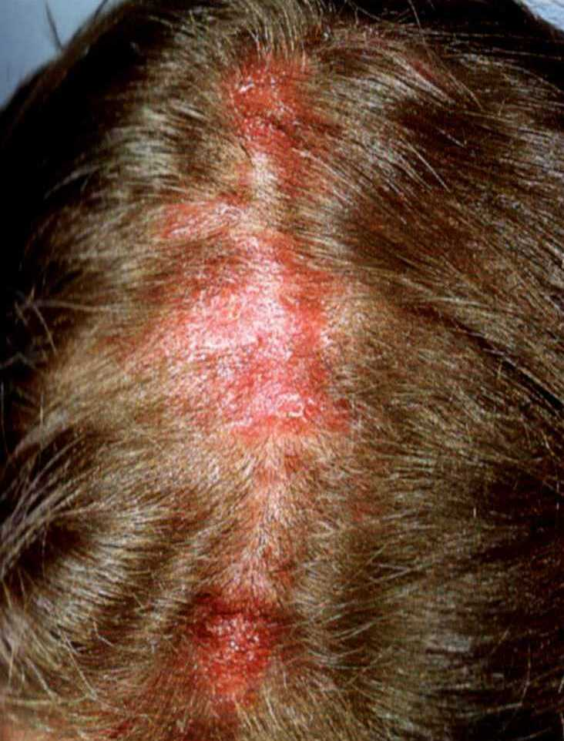
Moth
eaten
alopecia

Slide 8
Latent Syphilis
* Characterized by :
- Absence of clinical manifestations
- positive serological tests
* Types of Latent Syphilis:
A) Early latent B) Late latent
* Diagnosis:
* The patient is clinically free
* Serological test are positive

Slide 9
* C.S.F is normal
* Fate of latent Syphilis:
* 30 % ends by spontaneous cure
* 30% remain latent
* 40% evolve into - Benign tertiary stage
- Cardiovascular Syphilis
- NeuroSyphilis

Slide 10
Benign tertiary Syphilis
GUMMA (Occurs on the skin and bones, mucosa, viscera, muscles and eyes) starts as a slowly progressive painless nodule or plaque and breaks down into ulcer
Characters of gummatous ulcer:
* Punched out edge
* Wash leather floor ( dirty slough)
* Regional lymph nodes are not enlarged

Slide 11
* It is not infectious
* It heals leaving a thin atrophic scar
Diagnosis:
1) DGT: -VE
2) Serological tests: STS (70-90%). Specific
(100%)

Slide 12
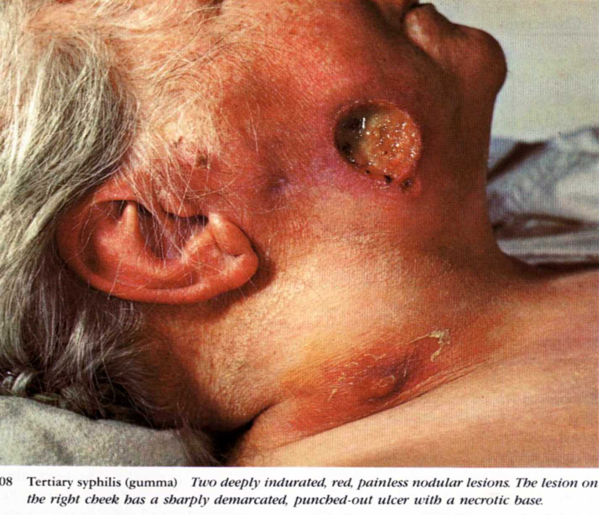

Slide 13
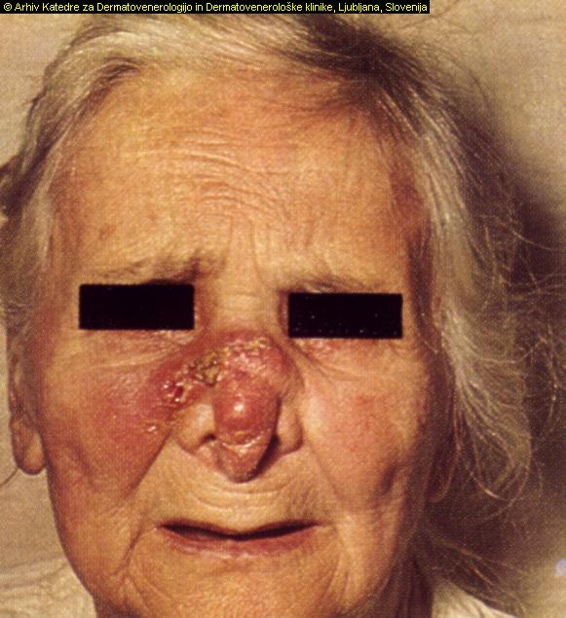

Slide 14
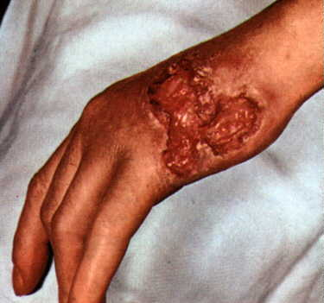
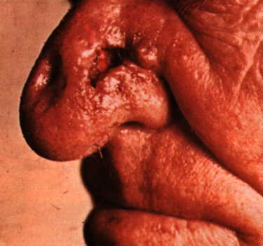

Slide 16
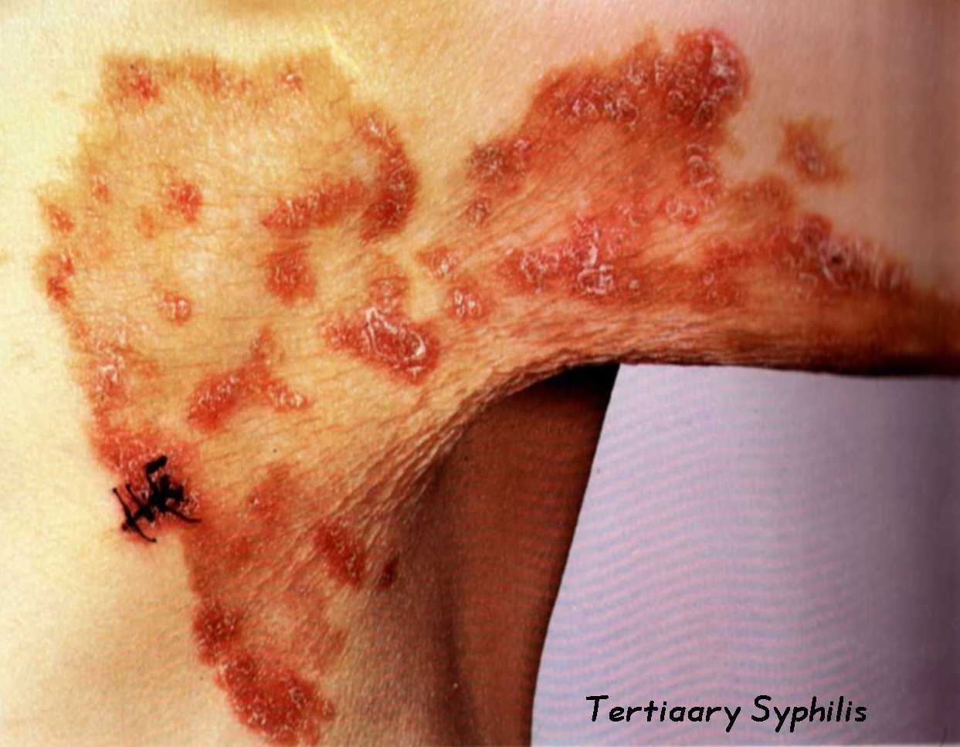

Slide 17
Cardiovascular Syphilis
1) Syphilis of the heart:
- Gumma
- Diffuse affection of the myocardium
2) Syphilis of the aorta:
- Aortic regurge
- Aortic aneurysm
- Coronary osteal stenosis

Slide 18
Neurosyphilis
* Asymptomatic neurosyphilis
* Syphilitc meningitis
* Meningovascular syphilis
* General paresis of insane
* Tabes dorsalis

Slide 19
Congenital Syphilis (Prenatal Syphilis)
Etiology:
Transmission of Treponema pallidum from the mother to fetus via the placenta
Outcome of pregnancy of a syphilitic mother:
1- Abortion after the 4th month
2- Stillbirth

Slide 20
3- Child may be born with signs of syphilis
4- Child may be born well but develop signs of early congenital Syphilis or late Congenital Syphilis
5- Child may escape infection

Slide 21
Early congenital syphilis
- It appears in the first 2 years of life
Main features are:
* Senile facies and marasmus
* Skin rash ( macular, papular and bullous)
* Mucous membrane lesions as syphilitic rhinitis
* Condylomata lata
* Osteochondritis, iritis, meningitis and liver fibrosis

Slide 22
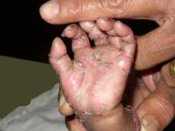

Slide 23
Late Congenital Syphilis
- It appears after first 2 years of the life
Main features are:
* Presentations of tertiary Syphilis
* Frontal bossing * Rhagades
* Hutchinson’s triad
- Hutchinson’s teeth
- Interstitial keratitis
- Eighth nerve deafness
* Other

Slide 24
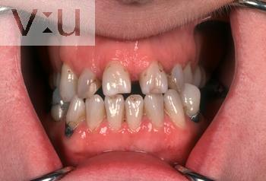
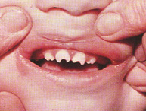

Slide 25
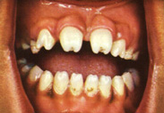

Slide 26
Stigmata
- Scars and deformitis of congenital Syphilis are many e.g. * Frontal bossing
* Rhagades
* Hutchinson’s teeth
- Diagnosis:
* Dark ground test
* Serological tests

Slide 27
Treatment of syphilis
Treatment of the aquired Syphilis
A) Treatment of early Syphilis:
* Procaine penicillin 600,000 units IM daily for 10 days (6 million units) or
* Benzathine penicillin in a single dose I.M. injection of 2.4 million units

Slide 28
B) Treatment of late Syphilis:
* Procaine penicillin 600,000 units IM daily for 20 days (12 million units) or
* Benzathine penicillin in 2.4 million I.M. injection every week for 5 week ( 12 million units )

Slide 29
Patients allergic to penicillin
Tetracycline 500 mg 4 times daily ( on empty stomach ) for 15 days in early and 30 days in late syphilis or
Erythromycin 500 mg 4 times daily ( on empty stomach ) for 15 days in early and 30 days in late syphilis

Slide 30
Treatment of congenital syphilis
* Early congenital syphilis
Procaine penicillin 50.000 units per kg body weight I.M. daily for 10 days
* Late Congenital Syphilis
As late aquired Syphilis

Slide 31
Reactions to treatment
1) Reactions to penicillin
2) Herxheimer reaction
3) Therapeutic paradox

Slide 32
THANK
YOU

