Slide 1
Diagnosis of E.D:
Detailed history (medical & sexual)
Detailed examination (general & genital)
Differentiation between organic & psychogenic
* ICI test.
* Nocturnal erection monitoring.
D) Detection of underlying causes

Slide 2
Investigations:
* Hormonal assay and blood sugar
* ICI (Papverine, Phentolamine and PGE1)
* Color doppler sonography
* RigiScan
* Cavernosometery and Cavernosography

Slide 3
Treatment of E.D.
A) Medical therapy:
1) Oral therapy:
a) Centrally acting drugs:
. Adrenergic antagonists:
(Yohimbine, Phentolamine)
. Serotoninergic agonists:
(Trazodone)
. Dopaminergic agonists:
(Apomorphine)

Slide 4
b) Peripherally acting drugs :
. Selective phosphodiesterase inhibitors:
(Sildenafil citrate - Others)
. Non selective phosphodiesterase inhibitors:
(Pentoxifylline)
. Nitric oxide donners:
(L.arginine)

Slide 5
PDE5is
Mechanism of action
Members
Indications
Side effects and contraindication
Administration

Slide 6
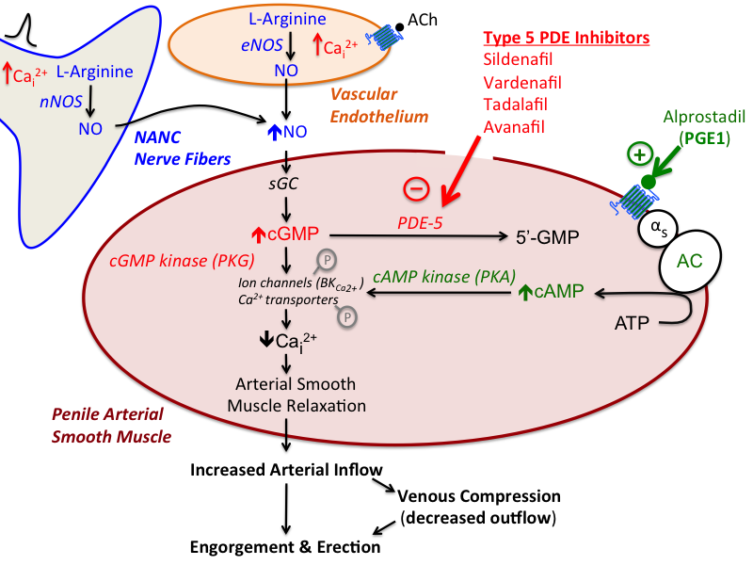

Slide 7
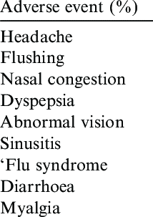

Slide 8
2) Local therapy:
a) Transdermal therapy
(Nitroglycerine, Minoxidil, Papavarine gel)
b) Intraurethral therapy
3) ICI
(Papverine, Phentolamine, PGE1)

Slide 9
B- Vaccum constriction devices
C- Surgical therapy

Slide 10
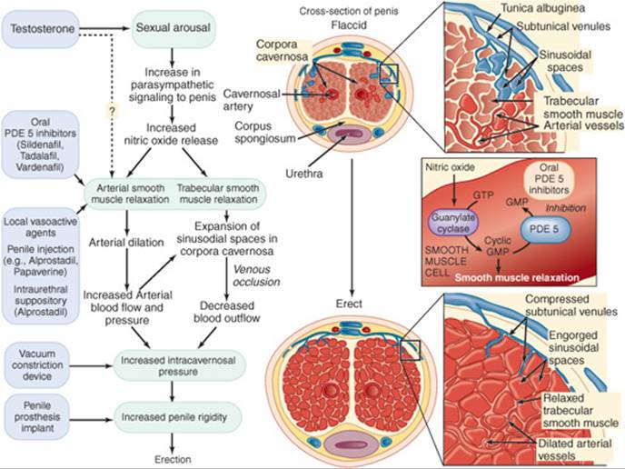

Slide 11
Premature ejaculation
Definition
Clinical types
IELT
Causes
Treatment

Slide 12
THANK YOU

