Slide 1
Andrology Part 1:
Male infertility
By:
Mohamad Alaa, M.Sc.
Department of Dermatology, Venereology and Andrology
Sohag University

Slide 2
Andrology
Branch of medical science concerned with study of physiological and pathological aspects of male reproductive tract.

Slide 3
Male reproductive function
Male fertility potential
Male sexual function

Slide 4
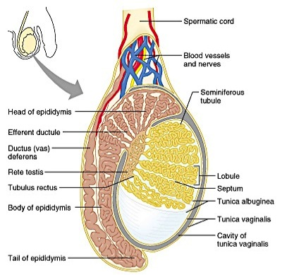
Testis
Anatomy
Functions
Hormonal control

Slide 5
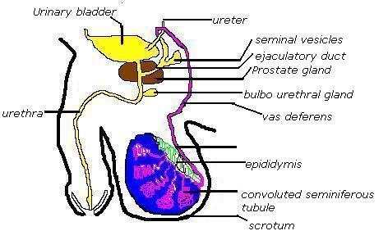

Slide 6
Definition:
Failure of conception after at least a year of regular unprotected intercourse
Primary infertility:
When the man has never impregnated a woman before
Secondary infertility:
When the man has impregnated a woman before

Slide 7
Etiology of male infertility
A) Functional causes :
1. Chromosomal anomalies e.g Klinefelter’s Syndrome (47 xxy)
2. Sertoli cell only Syndrome
3. Undescended testis (bilateral)
4. Varicocele

Slide 8
Etiology of male infertility
5. Hypogonadism and hyperprolactinemia
6. Post-pubertal mumps & leprosy orchitis
7. Chemical e.g cancer chemotherapeutics
8. Irradiation
9. Excessive heat exposure
10. Idiopathic

Slide 9
B) Obstructive causes:
Congenital Bilateral Absence of Vas Deferens (CBAVD)
Post inflammatory e.g Bilharziasis, TB and gonorrhoea
Surgical trauma with vasectomy e.g herniorrhaphy

Slide 10
Diagnosis of male infertility
A) History and clinical examination:
1- History:
- 1ry or 2ry infertility
- Duration and regularity of marriage
- Sexual and ejaculatory function
- Fever during past 6 months
- Chronic diseases e.g. T.B., D.M. - Hormonal treatment
- Chemotherapy, radiotherapy or surgery

Slide 11
2- Clinical examination:
* General: 2ry sexual characters or gynaecomastia
* Local:
- Penis for ulceration, hypo- or epispadius
- Testis for size, consistency and descent
- Epididymis for nodules or cysts
- Spermatoc cord for varicocele (grades)
- Prostate by PR

