Slide 1
Viral infections
Doaa Gaber Abdel baset
Assistant lecturer of Dermatology
2020

Slide 2
The main viral diseases of the skin
Herpes simplex
Herpes zoster
Wart
Molluscum contagiosum

Slide 3
Herpes simplex
Type 1,,,,, Facial infection
Type 2,,,,, Genital infection
Modes of infection:
Droplet Direct contact

Slide 4
Human Herpes Virus

Slide 5
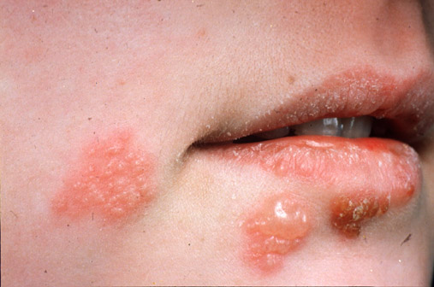
Herpes simplex

Slide 7
Herpes infection
Primary: Symptomatic in 10%......Children…..Constitutional symptoms….Enlarged LN
Large vesicles….not grouped……dissiminated
Recurrent: Grouped vesicles,,,,,No general symptoms

Slide 8
Clinical varients of primary herpes simplex
Herpetic gingivostomatitis
Herpes genitalis
Keratoconjunctivitis
Eczema herpeticum ( Kaposi’s varicelliform eruption )
Neonatal herpes simplex

Slide 11
Eczema herpeticum

Slide 12
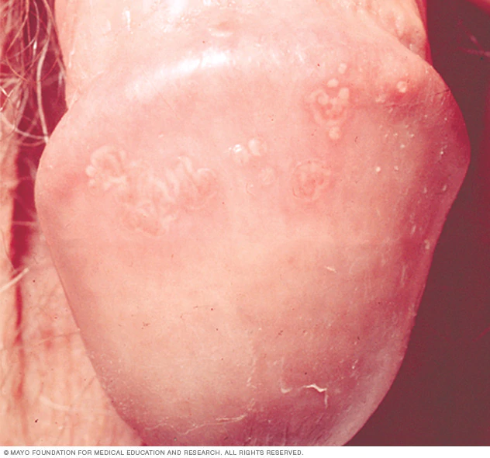
Genital herpes

Slide 14
Recurrent herpes simplex
Stress
Immunosupression
Menstruation
Infection
Minor trauma

Slide 15
Recurrent herpes simplex varients
Herpes facialis
Herpetic Keratoconjunctivitis
Herpes genitalis

Slide 16
Treatment of herpes simplex
Topical: antibiotic, antiseptic lotion, acyclovir cream
Systemic: Acyclovir, valacyclovir

Slide 17
VARICELLA (CHICKEN POX)
Organism: Varicella zoster (HHV 3)
IP: 10-20 days
Mode of infection: Direct contact or droplet
Usually permanent immunity
Mainly in children
Symptomatic in 95% of cases

Slide 18
Clinical picture
General: fever, malaise, headache, enlarged LN
Ctanueous: vesicles – pustules – crustations (polymorphic lesions)
Healing: Without scar
Distribution: Centripetal (mainly on the trunk, face & oral mucosa)

Slide 22
Varicella Complications
Varicella pneumonia……Fatal
Neonatal varicella

Slide 23
Treatment
Treatment is symptomatic
Antipruritic lotions & anti histamines are given for itching
Antibiotics for secondary infection
Acyclovir in Severe cases 20mg/kg

Slide 24
HERPS ZOSTER
Organism: Zoster virus (Reactivation of varicella virus)
Age group: Middle aged and elderly
Mode of infection: mostly reactivation of the latent virus in immunosuppressed patients
IP: 2-3 weeks

Slide 25
Clinical picture of Zoster infection
Pain…..usually the first manifestation
Following distribution of a sensory nerve
Eruption consists of Grouped vesicles on an erythematous base
The vesicles become pustular ,crust &heal in 2 –4 weeks with scar
The regional L .N. are enlarged &tender
The eruption mostly unilateral and usually affects one dermatome
The thoracic (commonest) & lumbo-sacral dermatomes are the most commonly affected

Slide 28
OPHTHALMIC ZOSTER (H.Z. OPHTHALMICUS)
H .Z. may affect any division of the trigeminal nerve but the ophthalmic division is the most frequently involved
Ocular involvement is most commonly in the form of Uveitis & Keratitis

Slide 31
RAMSY-HUNT SYNDROME
It is due to involvement of the geniculate ganglion It constitutes vesicles on the external ear, facial palsy & auditory symptoms as rhinitis, deafness &vertigo

Slide 32
Complications of herpes zoster
Post –herptic neuralgia
Ocular complications
Secondary bacterial infection & gangrene
Encephalitis
Facial palsy

Slide 33
Treatment of herpes zoster
Topical treatment
Systemic treatment
Analgesics for pain
Antibiotics for secondary bacterial infection
Acyclovir & New anti-viral drugs

Slide 34
WARTS (VERRUCAE)
Organism: HPV (Frequent types)
Mode of transmission: Direct contact

Slide 35
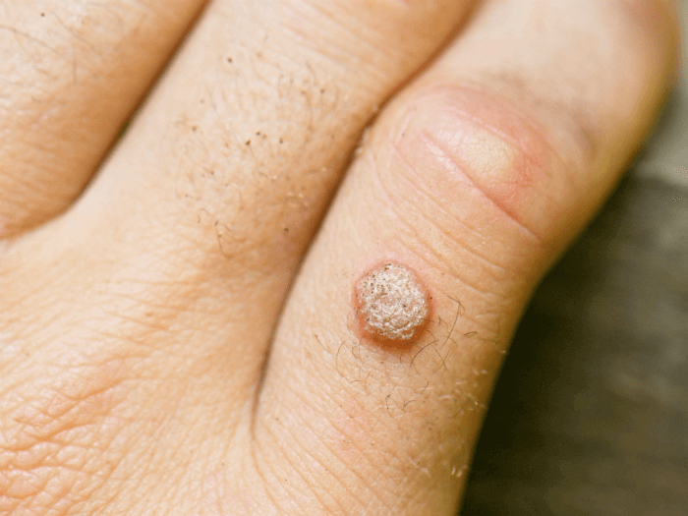
Clinical types of warts
Common warts
HPV 1,2,4

Slide 36
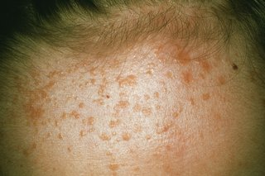
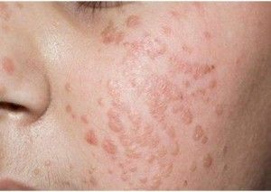
Plane warts
HPV 3, 10
Koebner phenomena

Slide 37
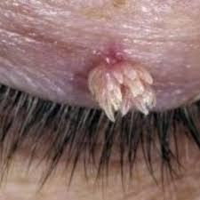
Filiform warts

Slide 38
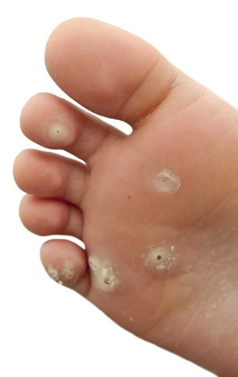
Plantar warts

Slide 39
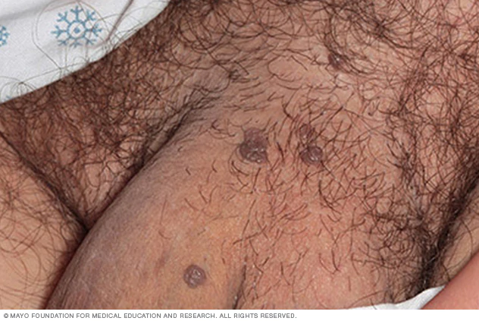
Anogenital warts
( Condylomata acuminata)
HPV 6, 11
Sexually transmitted infection

Slide 40
m

Slide 41
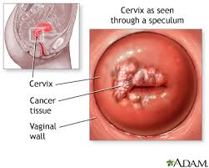
Cancer Cervix
HPV 16, 18

Slide 42
Treatment of warts
Chemical Treatment
- Salicylic acid 15- 20 %
- Podophylin 10- 25% for Condylomata acuminata
- Formalin 2-3 %for planter warts
Electrocautery
Cryotherapy with liquid nitrogen or carbon dioxide snow
Laser therapy

Slide 43
HPV Vaccines
Cervarix for HPV types 16,18
Gardasil for HPV types 6, 11, 16, 18

Slide 44
Molluscum contagiosum
Molluscum contagiosum virus ( Pox virus , DNA virus)
Direct contact
Sexual contact

Slide 45
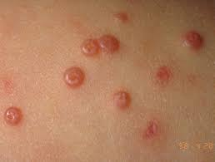

Slide 46
Treatment of MC infection
Spontanous disappearance
Curettage and diathermy
Squeezing with forceps
Focal TCA peel
Topical 5% imiquimod
Cryotherapy

