Slide 1
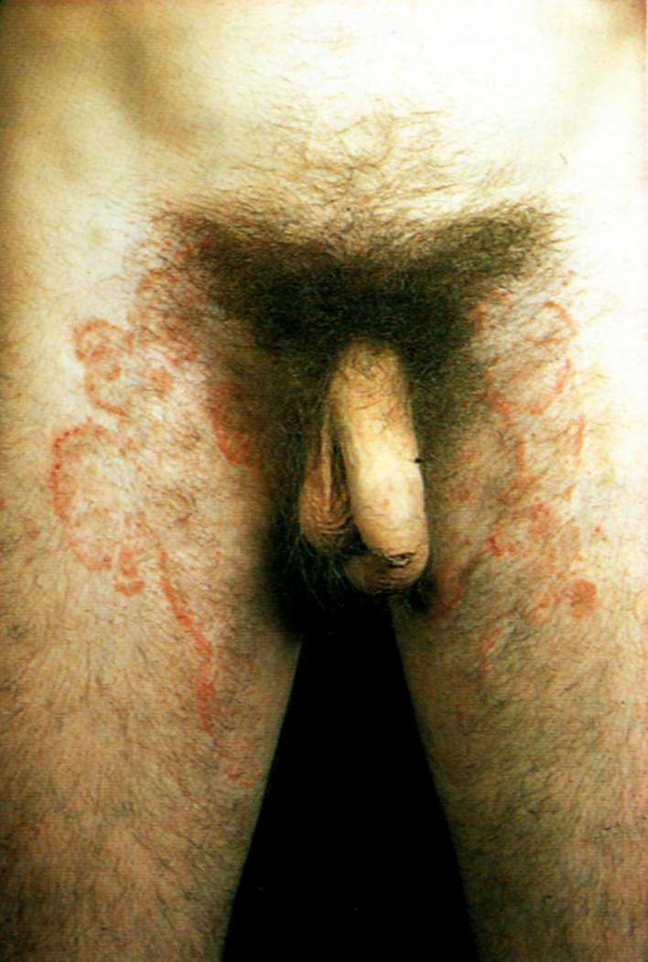
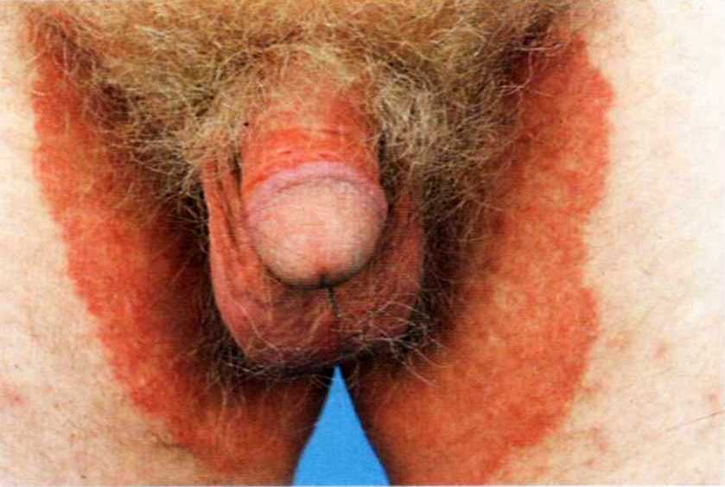

Slide 2
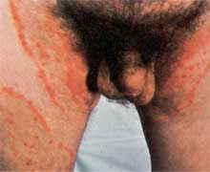

Slide 4
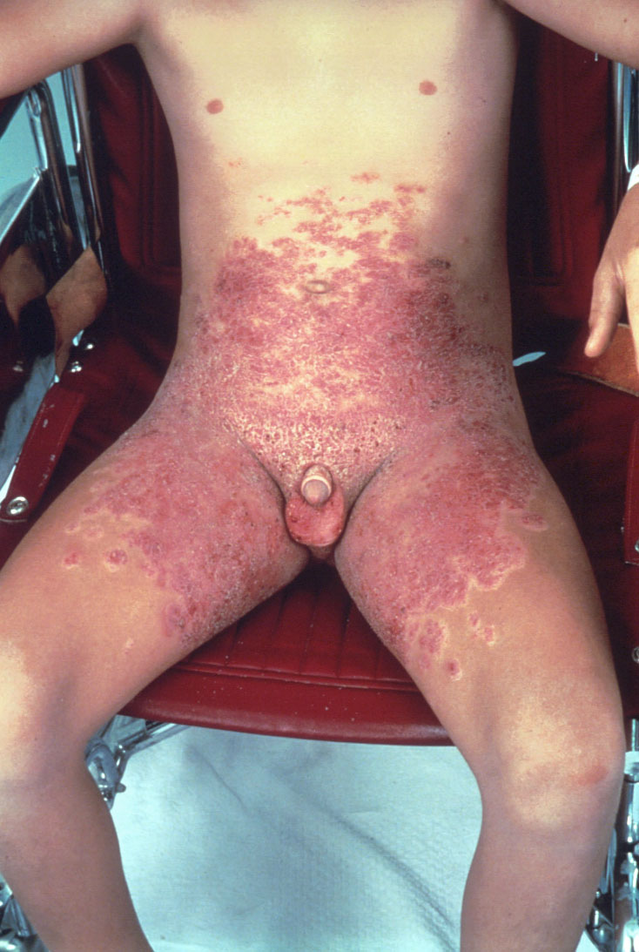

Slide 6
(5) Tinea pedis ( Ringworm of the feet )
Most common fungal infection ( Athlete's foot ), more in adult males
Predisposing factors :
1- Wearing of tight shoes
2- Communal showers
3- Swimming baths
4- Hyperhydrosis

Slide 7
Clinical varities :
1- Interdigital variety : ( commonest form ) peeling, maceration & fissuring affecting lateral toe clefts; may involve undersurface of the toes
2- Squamous hyperkeratotic variety : very chronic & resistant to treatment; characterized by erythema & scaling may involve entire sole & sides of feet
3- Vesiculobullous variety : acute vesicular or bullous eruption may involve entire sole

Slide 8
Patient may complain of itching, bad smell or 2ry bacterial infection.
Treatment :
1- Dry the feet thoroughly after bathing
2- Antifungal powder on feet of susceptible persons
3- Topical antifungals for mild cases & systemic for extensive lesions

Slide 9
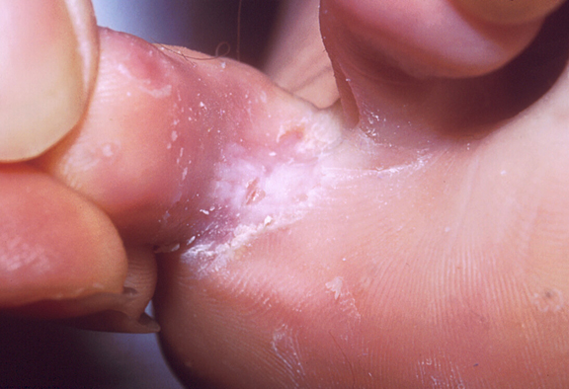
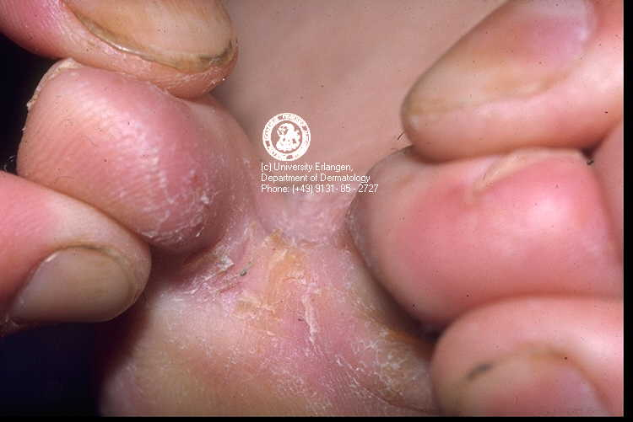

Slide 10
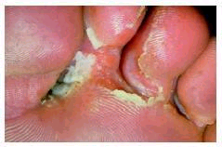
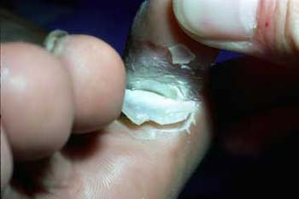

Slide 12
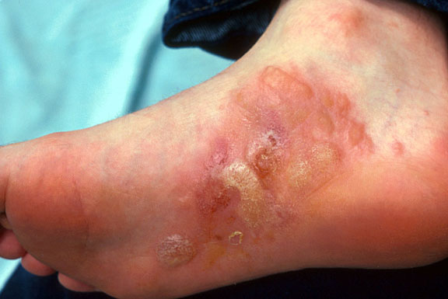
Vesiculobullous variety

Slide 13
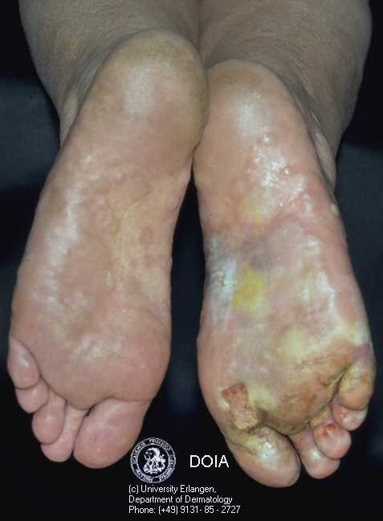

Slide 14
Squamous
hyperkeratotic
type

Slide 15
(6) Onychomycosis ( Tinea unguium )
Nail plate becomes thickened, discolored and cracked with accumulation of subungual hyperkeratosis
Later on; onycholysis and massive destruction of nail plate
Treatment :
- Oral antifungals; oral terbinafine of choice
- Used for 6 weeks in finger nails & for 12 weeks for toe nails

Slide 17
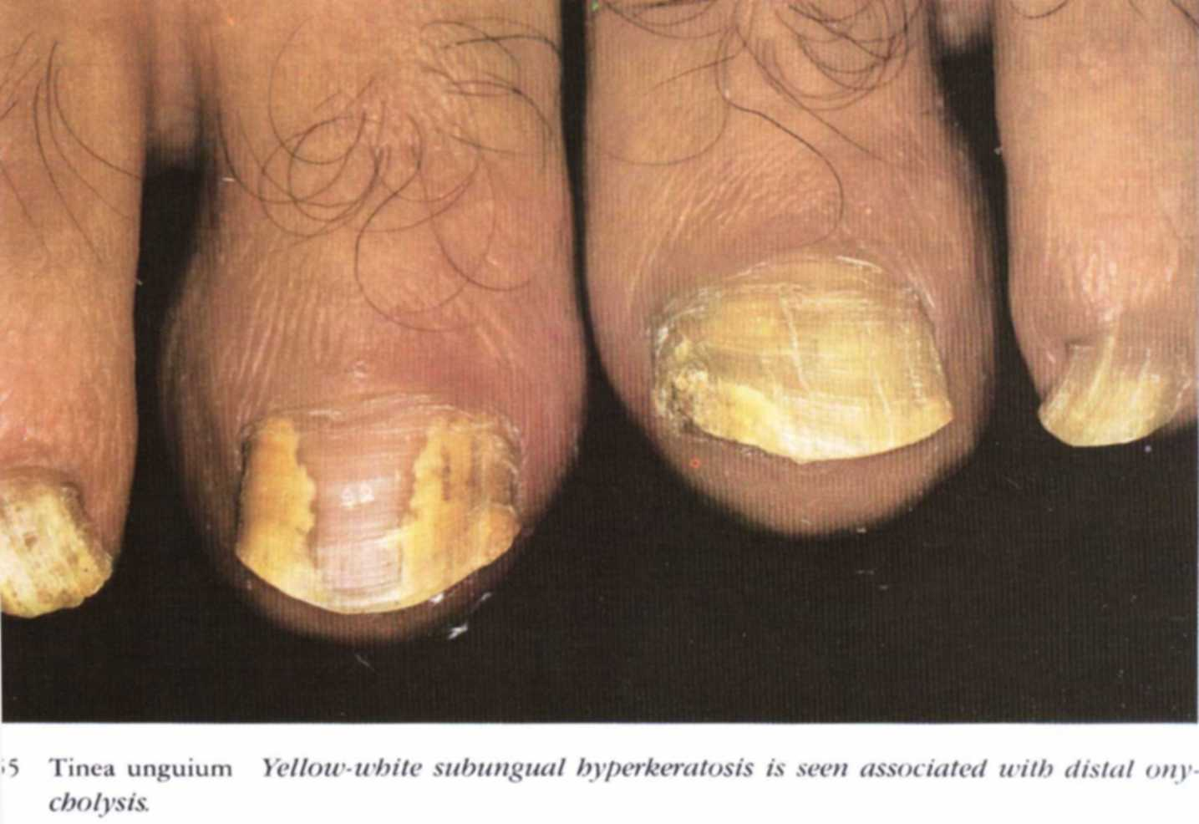
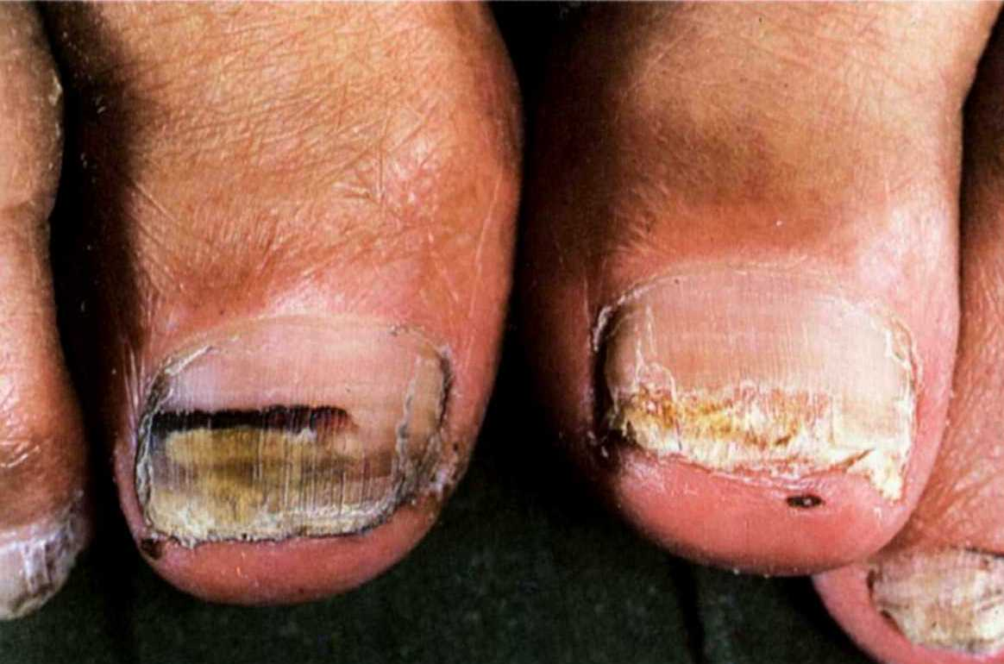

Slide 18
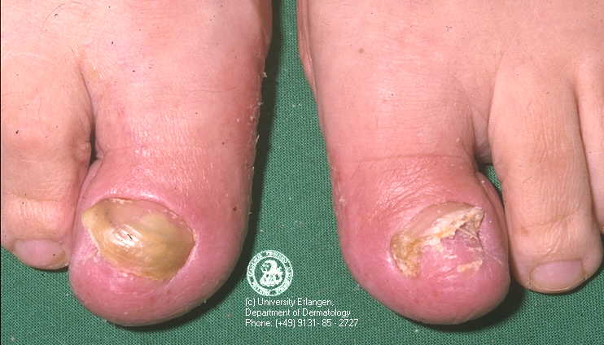

Slide 19
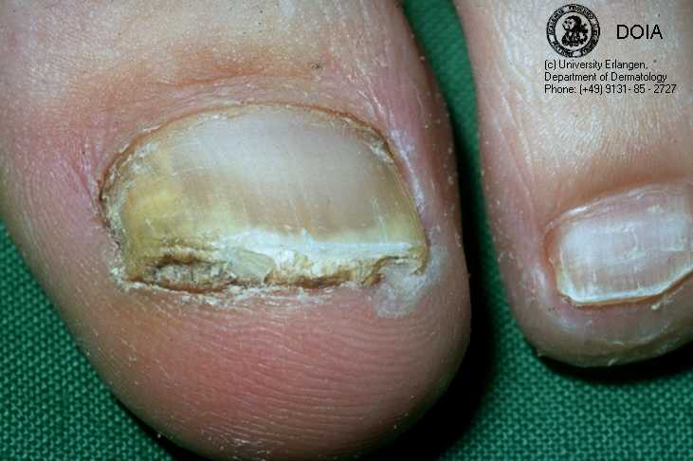
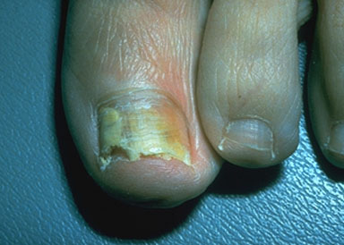

Slide 20
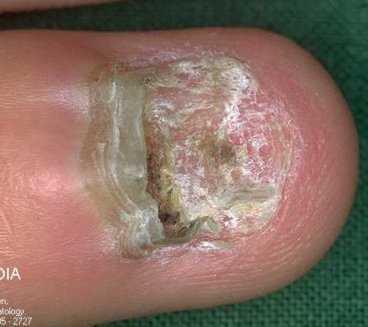
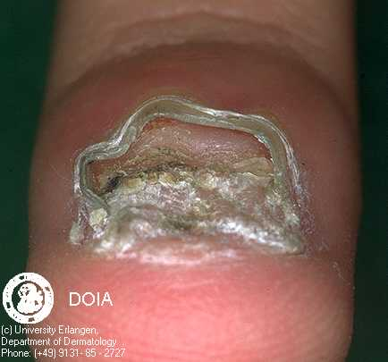

Slide 21
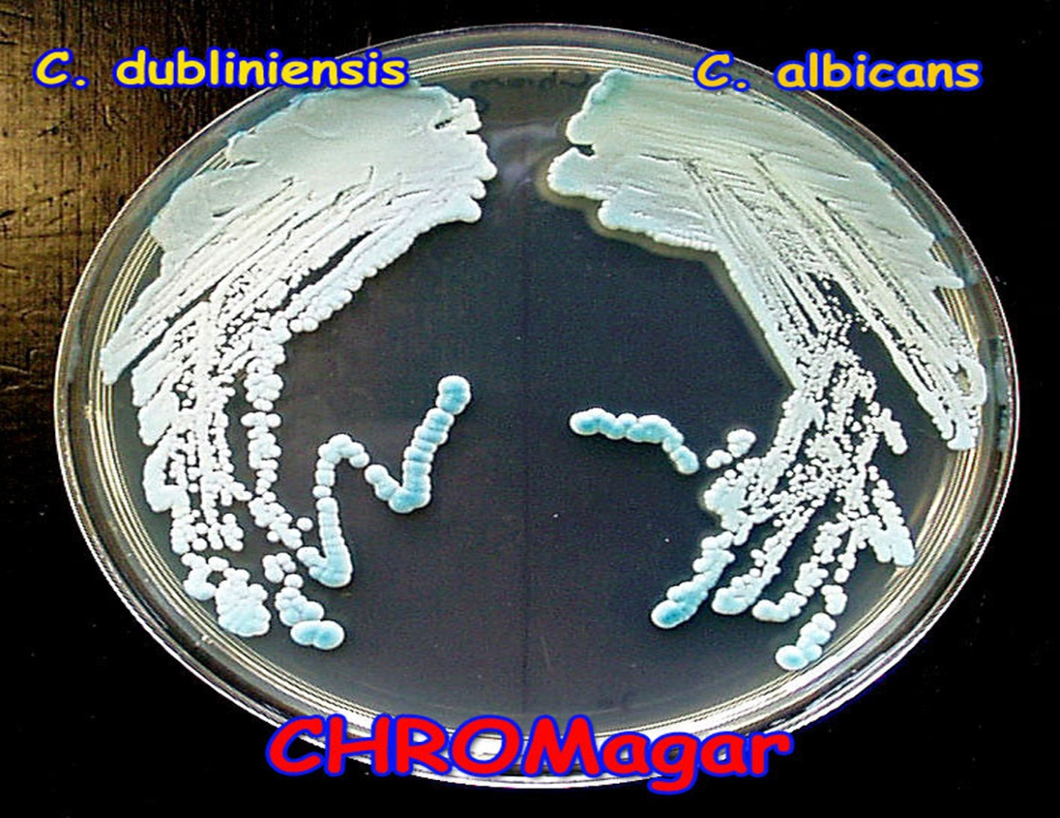
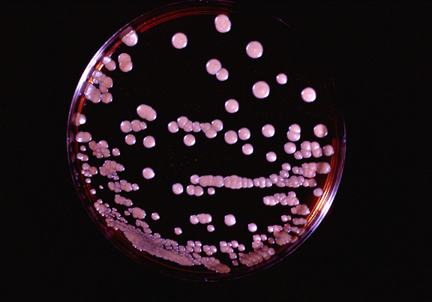
YEAST
INFECTIONS

Slide 22
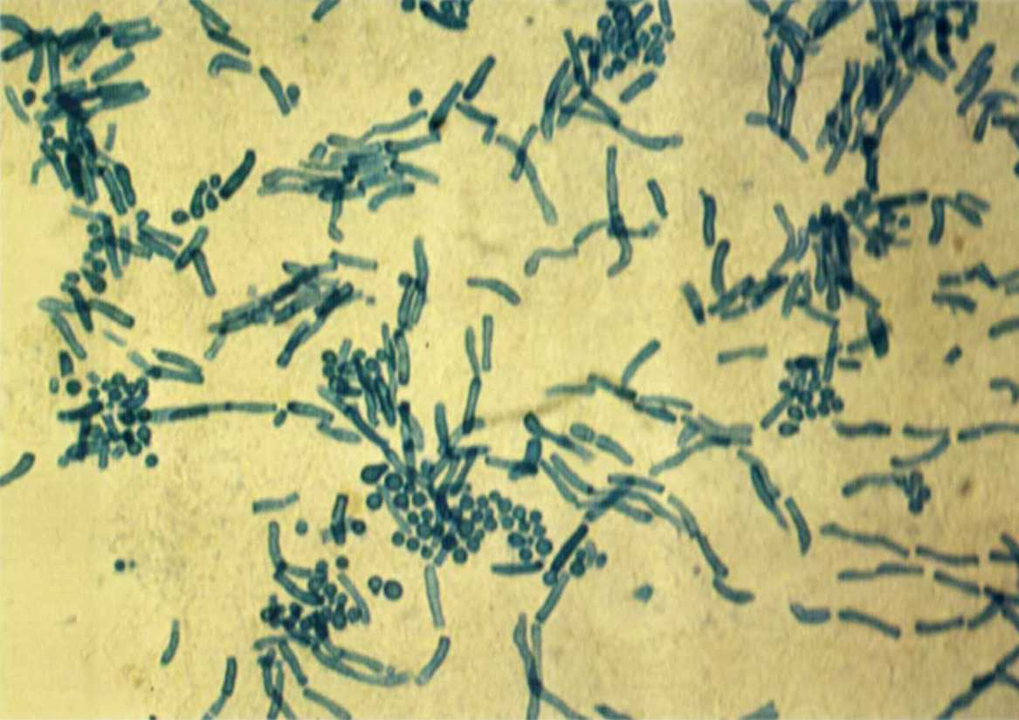
Pityriasis versicolor ( Tinea versicolor )
Mild, chronic fungal infection; caused by Malassezia furfur
More common in tropical climates; with onset commonly in warmer months of year
Mainly in young adults
Spaghetti and meatballs
appearance

Slide 23
Clinical picture :
Patient complains of change of skin color or mild itching. Primary lesion is sharply demarcated macule covered by fine branny scales. lesions may coalesce to form large confluent areas & scattered oval patches
Patches are yellowish or brownish in white skin and hypo pigmented in dark skin
Sites : chest, upper arms, abdomen, back, neck & intertriginous areas

Slide 24
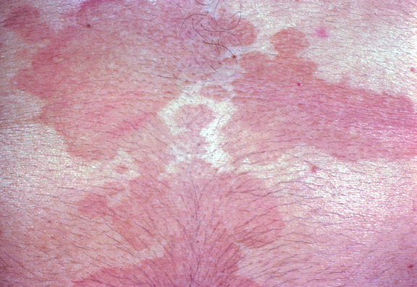

Slide 25
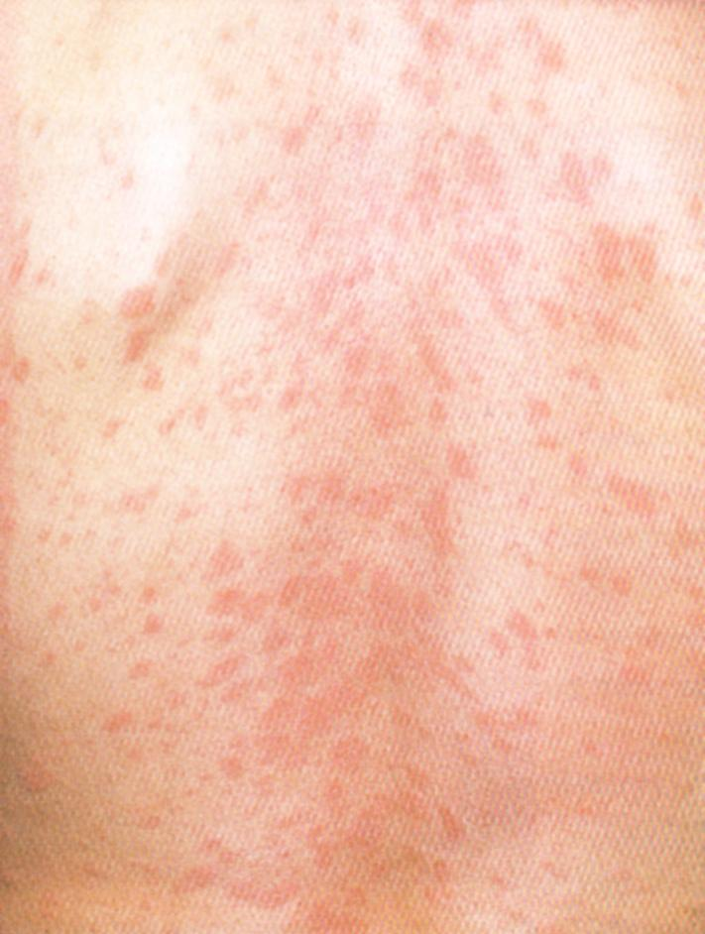

Slide 29
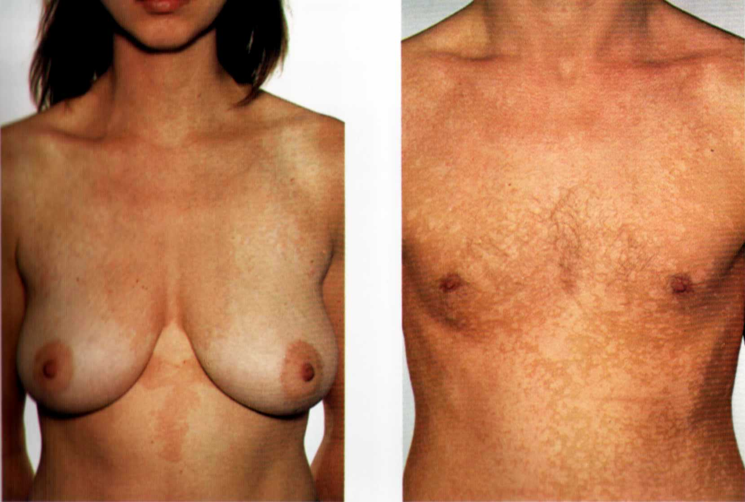

Slide 30
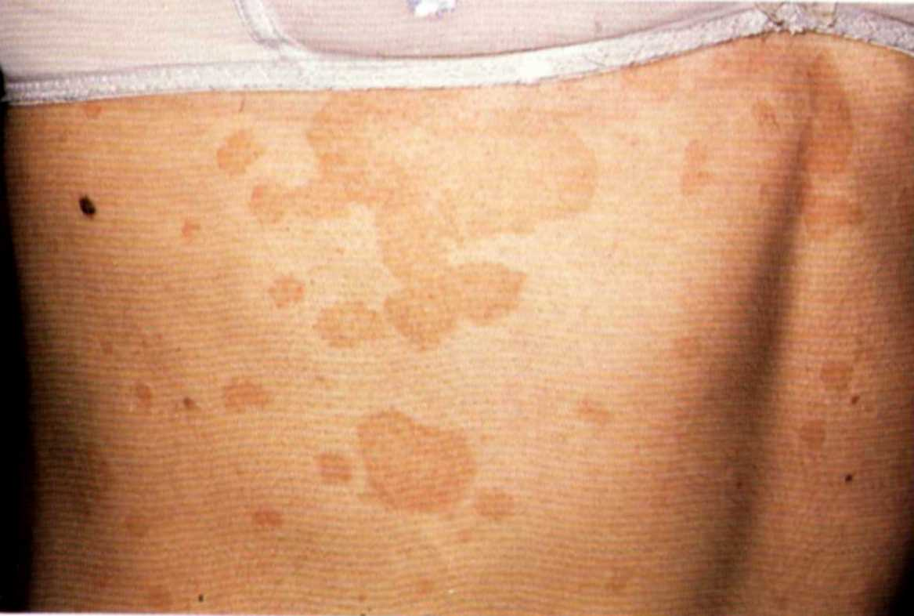
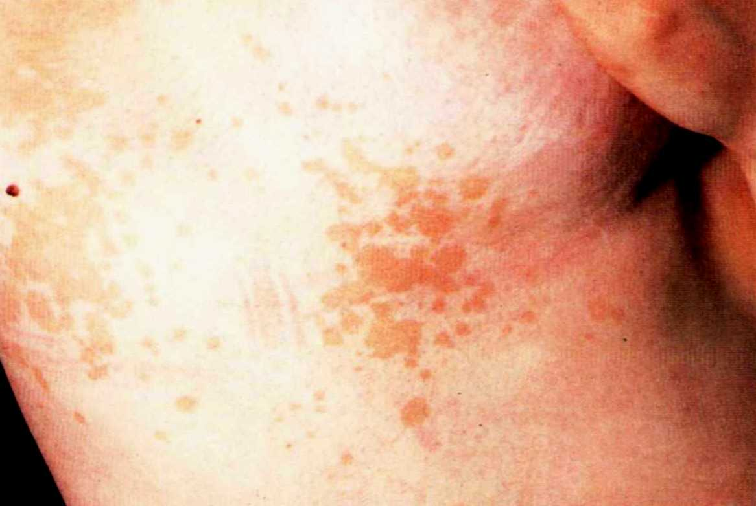

Slide 31
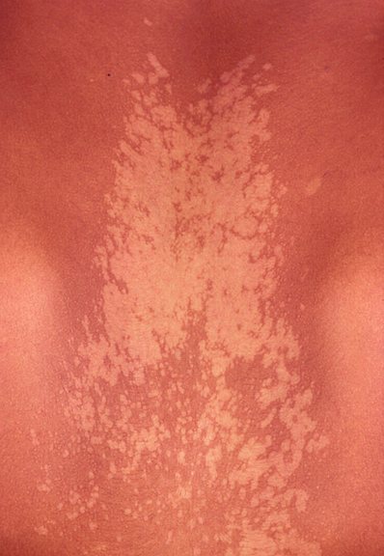
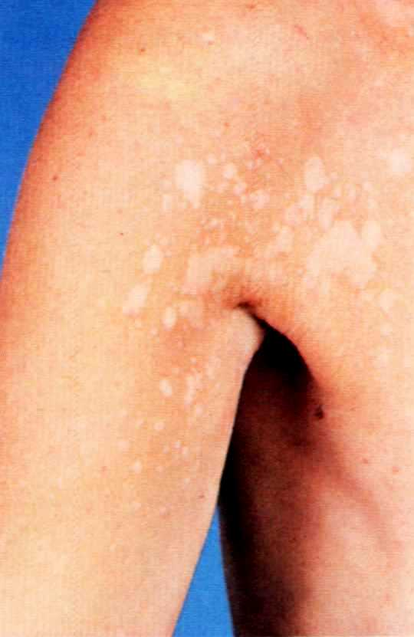

Slide 32
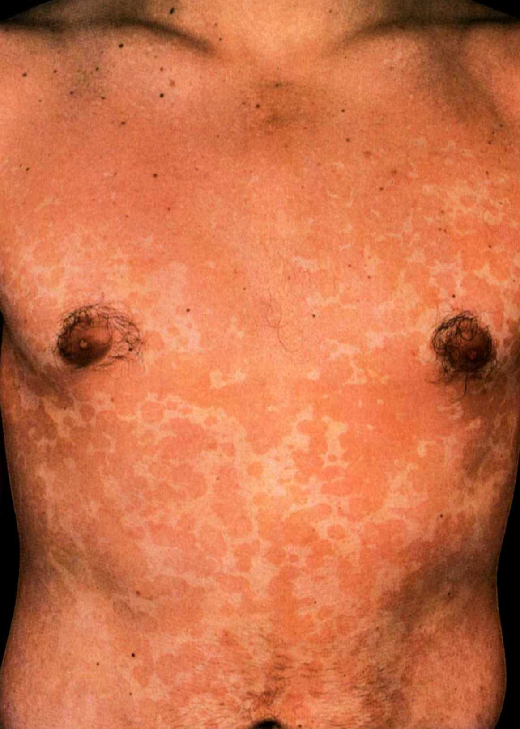
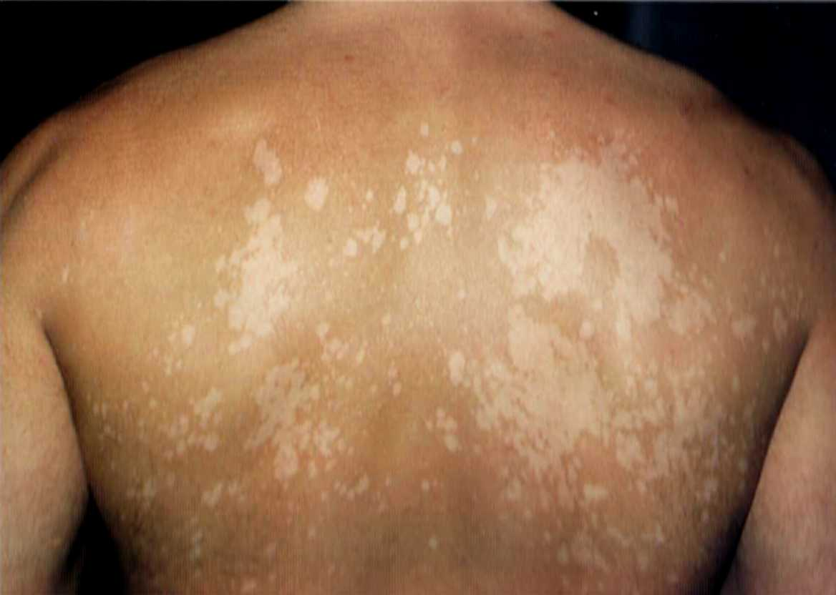

Slide 33
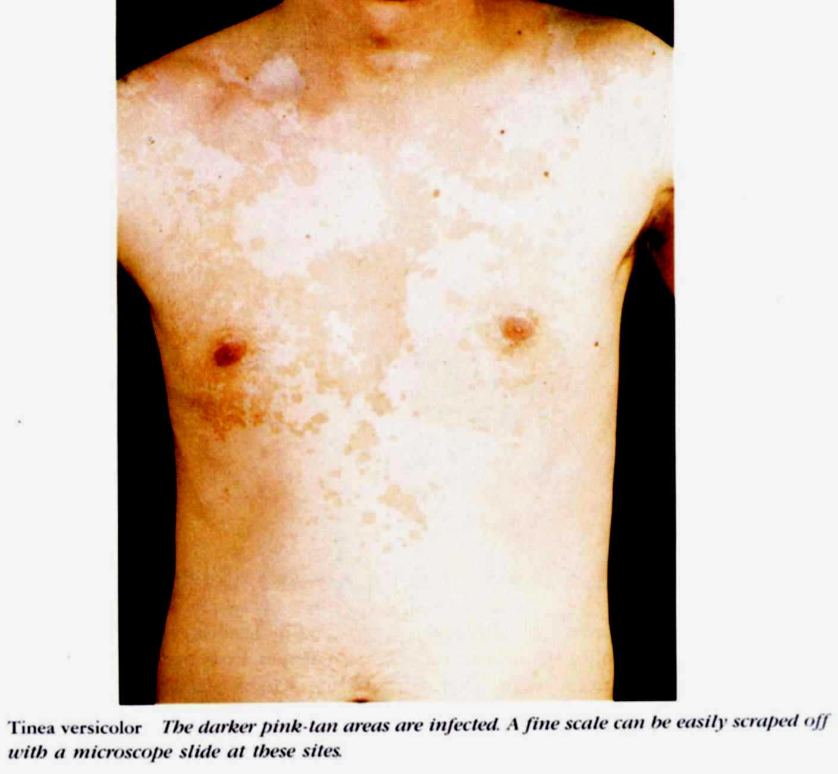
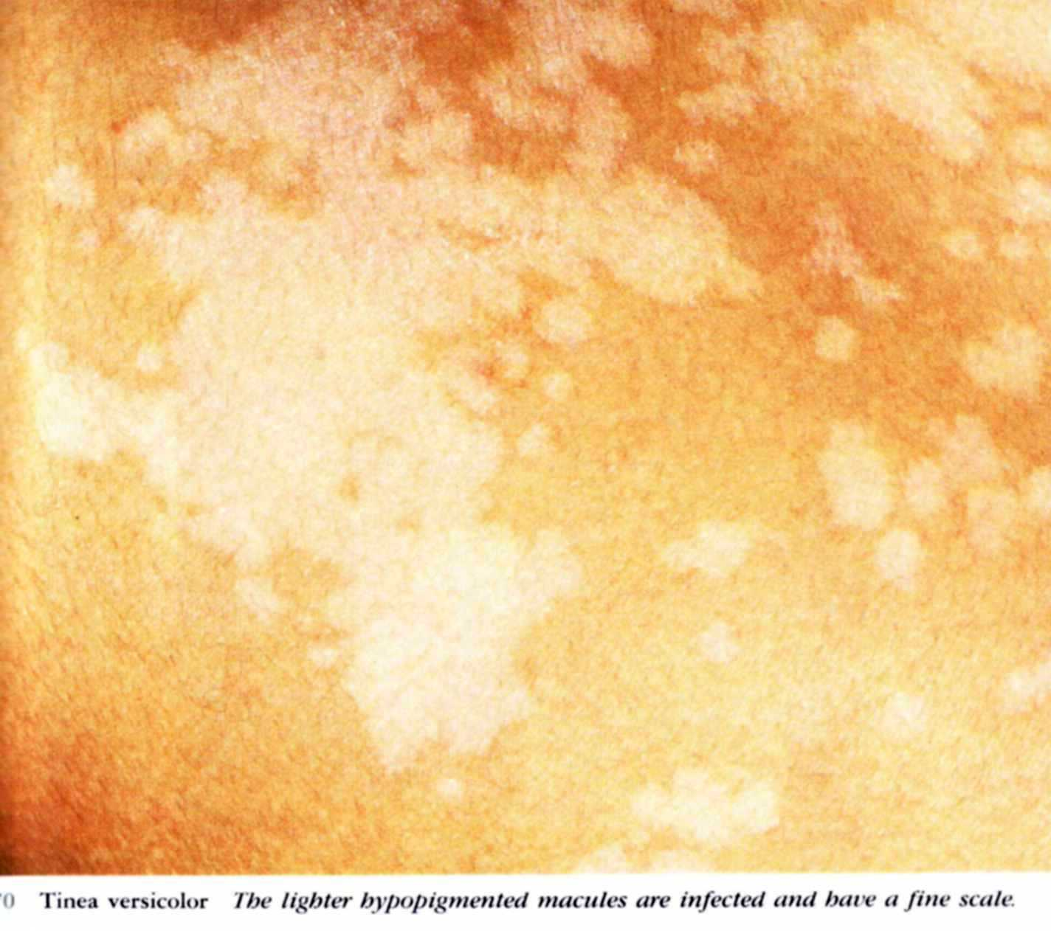

Slide 34
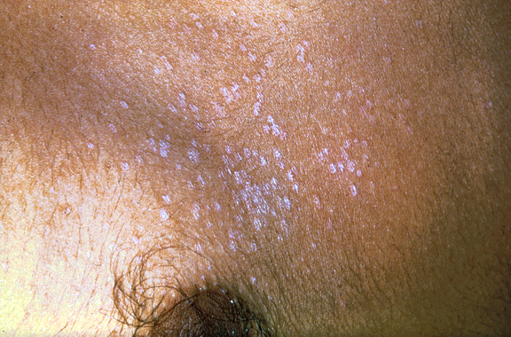
Follicular type

Slide 35
Relapse is very common
Treatment :
1- Topical antifungals daily for 2-3 weeks
2- Ketoconazole 2% shampoo
3- Selenium sulphide 2-5 % shampoo
4- Sodium hyposulphide 20 % solution
5- Oral ketoconazole, fluconazole & Itraconazole ( oral terbinafine & griseofulvin are ineffective )

Slide 36
Other cutaneous disorders associated with Malassezia yeasts
1) Seborrheic dermatitis
2) Atopic dermatitis
3) Pityrosporum folliculitis
4) Sebopsoriasis
5) Confluent and reticulate papillomatosis

Slide 37
Candidiasis
Causative fungi :
Candida albicans ( normal inhabitant at various sites as gut, mouth & vagina ) or other species of candida.
Predisposing factors :
1- Warmth, moisture & maceration of skin
2- Drugs :e.g. prolonged use of steroids, antibiotics & immunosuppressives

Slide 38
3- Chronic debilitating diseases :e.g. DM, lymphoma & carcinoma
4-AIDS
Clinical manifestations :
1- Oral candidiasis ( thrush ): sharply defined patch of creamy, curd-like, white pseudomembrane, when removed an erythematous base

Slide 39
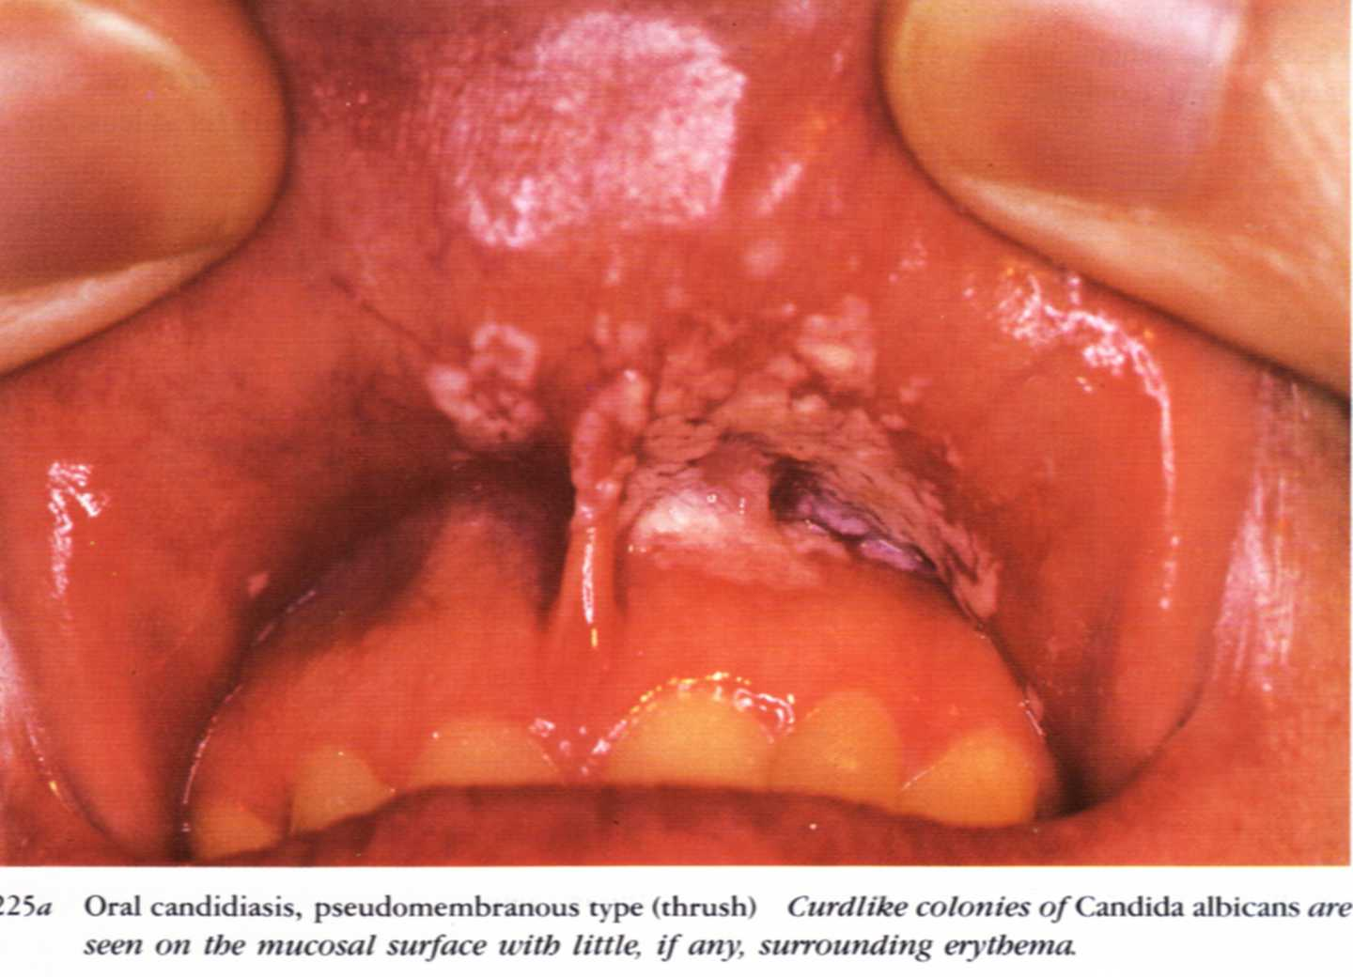
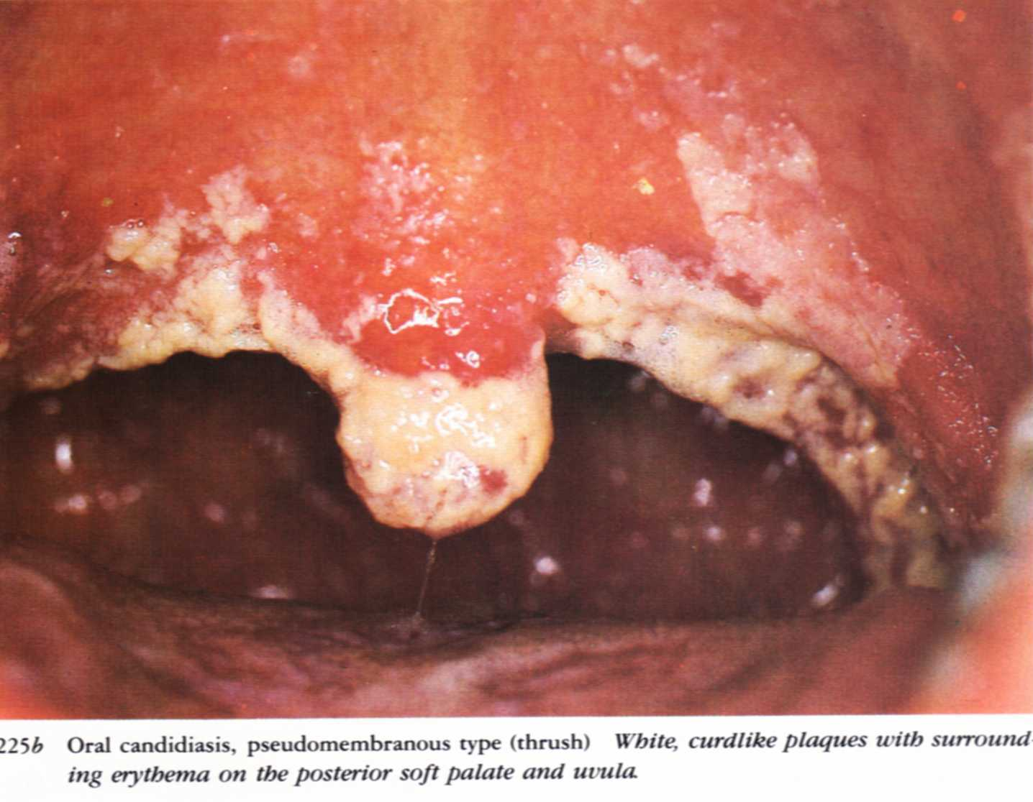

Slide 41
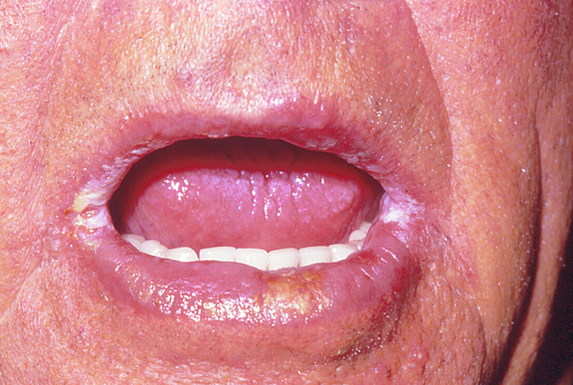
2- Perleche (angular stomatitis): maceration with transverse fissuring of the angles of the mouth

Slide 42
3- Candidal vulvovaginitis : labia are erythematous, moist & macerated; cervix is hyperaemic, swollen & eroded with some vesicles on its surface. Vaginal discharge is thick & tenacious

Slide 44
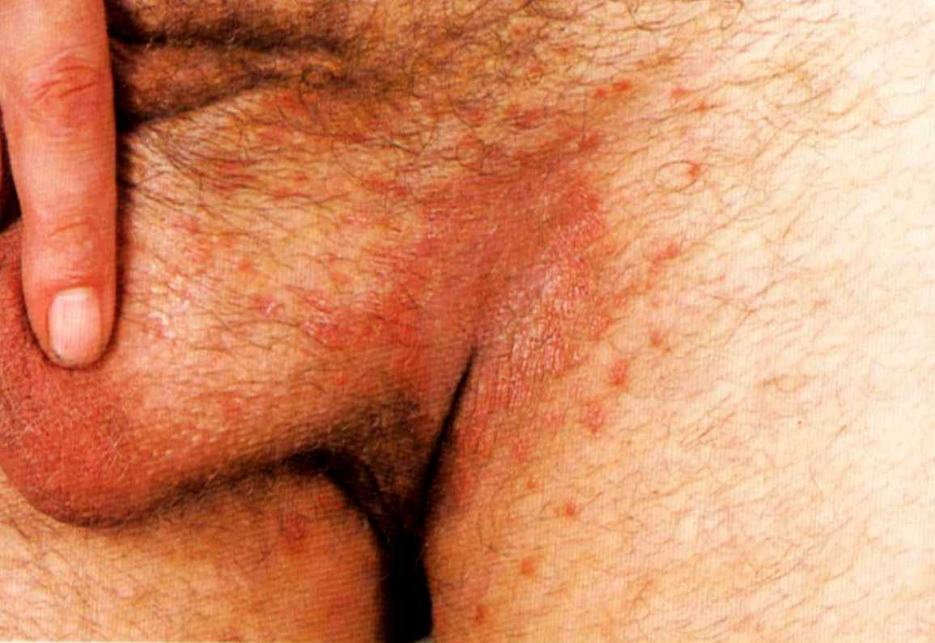
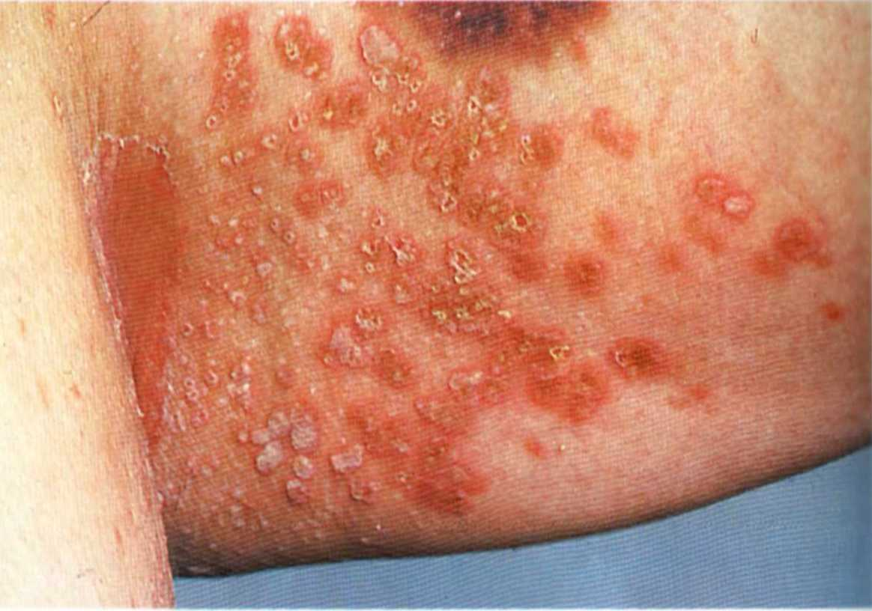
4- Candidal intertrigo : in skin folds,esp. in obese

Slide 45
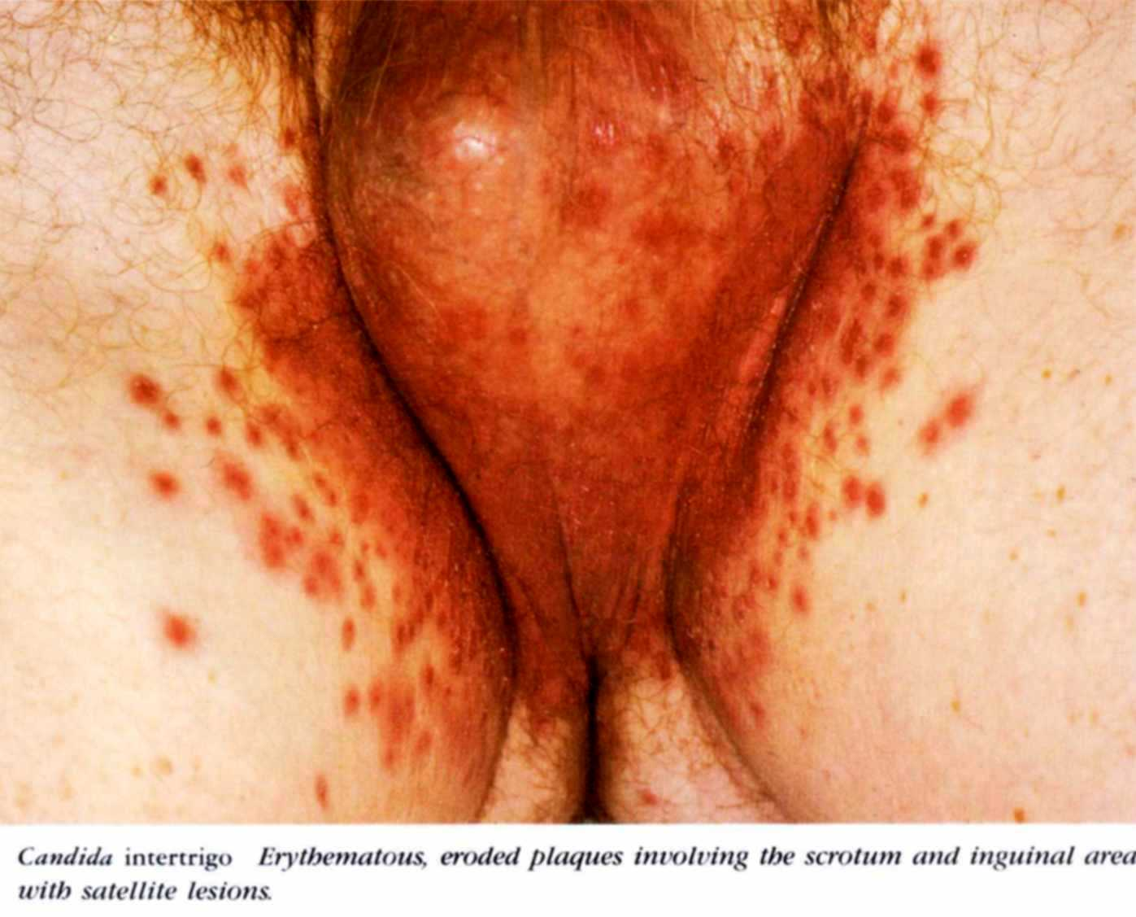
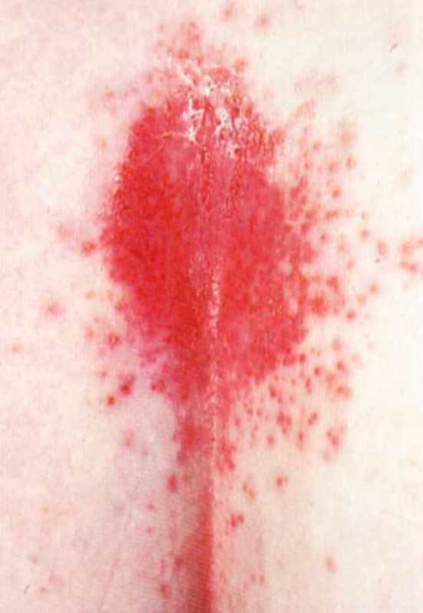

Slide 46
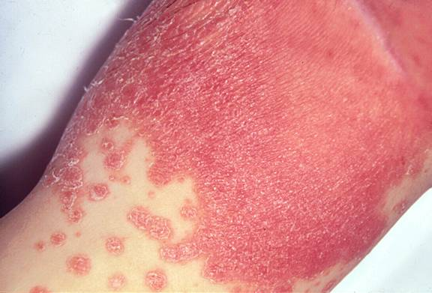
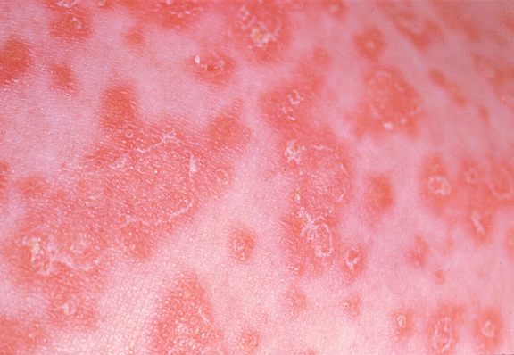

Slide 47
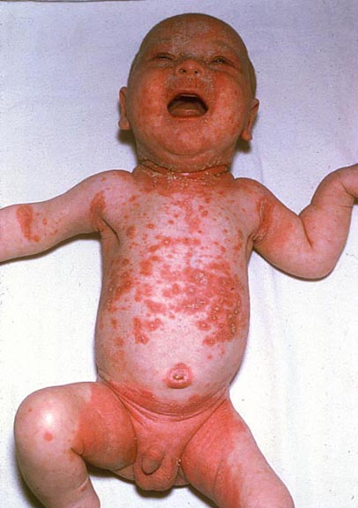
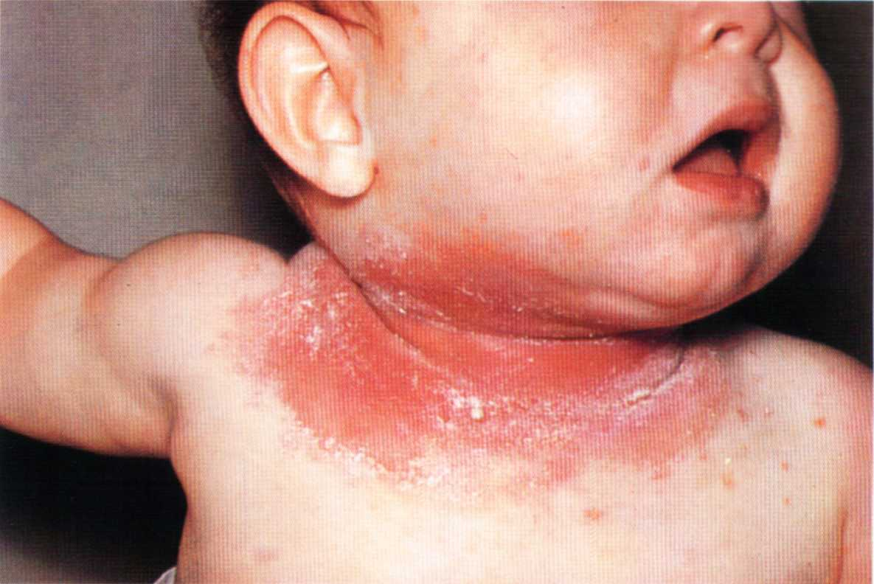

Slide 48
Interdigital candidiasis

Slide 49
5- Napkin candidiasis : enhanced by maceration produced by wet diapers

Slide 51
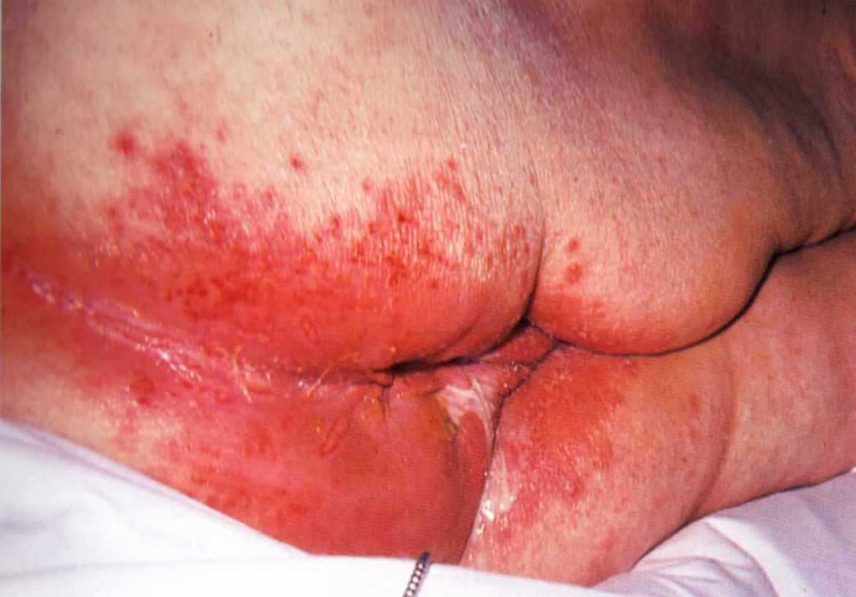

Slide 52
6- Candidal paronychia : cushion-like thickening of paronychial tissue, erosions of lateral borders of nail, gradual thickening & discoloration of nail plates, with development of transverse ridges. More in those whose hands are frequently in water as housewives & cocks

Slide 53
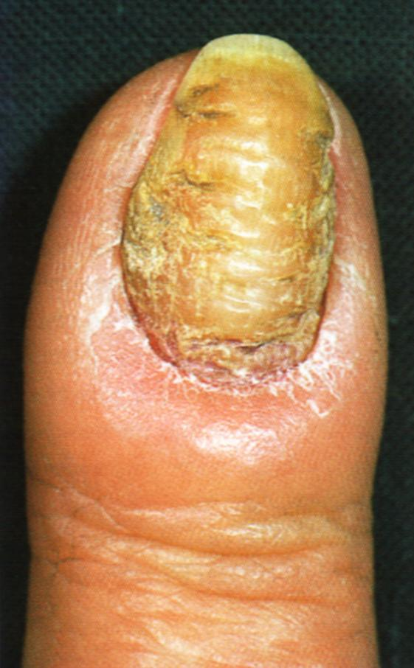
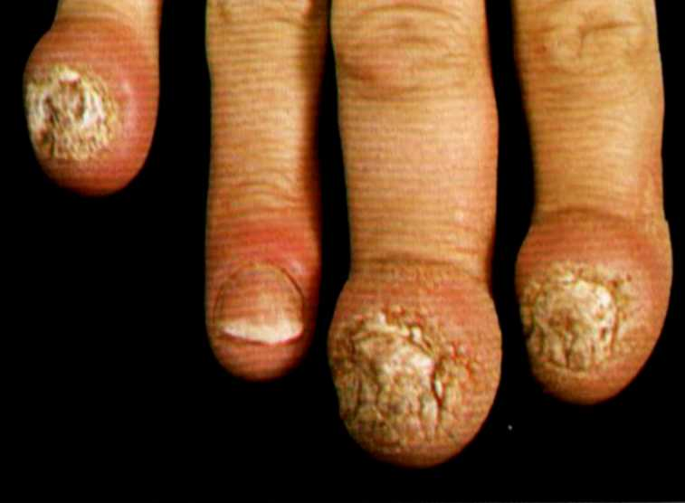

Slide 54
Treatment :
1- Topical nystatin
2- Topical imidazoles
3- Systemic treatment; with ketoconazole, fluconazole & Itraconazole

Slide 55
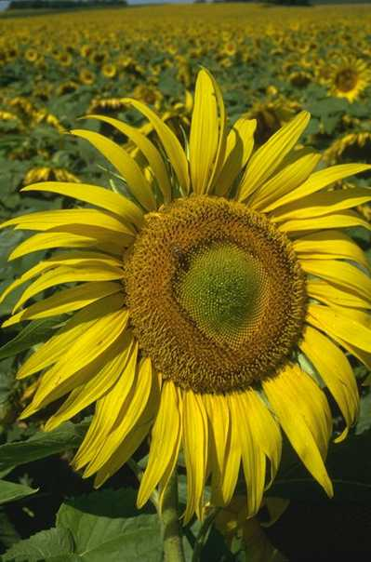
THANK
YOU

