Slide 2
Reactions in Leprosy
1. Type 1 reaction:
Occurs in border-line leprosy
Due to rapid change in immunity
Nerves are swollen and tender
Serious neurological complication may occur
Skin lesions become erythematous, edematous and may ulcerate
2. Type 2 reaction (erythema nodosum leprosum):
Occurs in BL & LL
It is an immune-complex disease
Characterized by painful, red nodules on the face and extremities
Fever, malaise, myositis, artheritis & orchitis
Nerve affection is less than in type 1 reactions

Slide 3
Treatment of Leprosy
* Paucibacillary leprosy: (TL & BT)
1. Rifampicin: 600 mg monthly supervised
2. Dapsone: 100 mg daily self-administered
Duration of treatment: at least 6 months
Duration of follow-up: at least 2 years
* Multi-bacillary: (BB, BL & LL)
1. Rifampicin: 600 mg monthly supervised
2. Dapsone: 100 mg daily self-administered
3. Clofazimine (Lamprene): 300 mg monthly supervised & 50 mg daily self-administered
Duration of treatment: at least 2 years
Duration of follow-up: at least 5 years

Slide 4
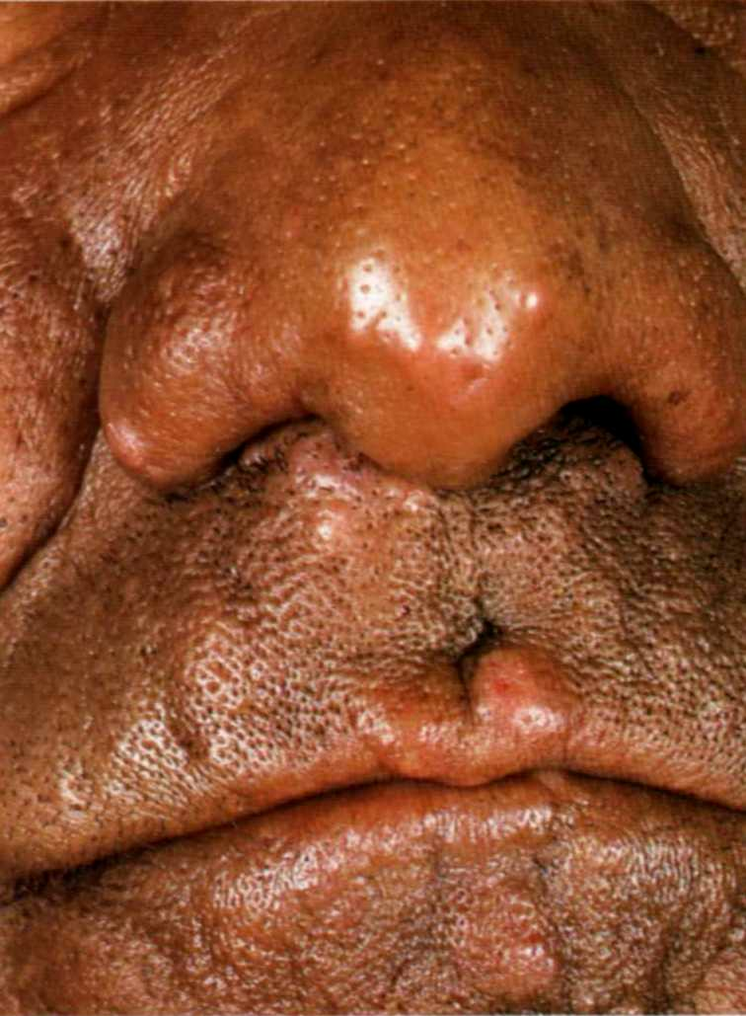

Slide 5
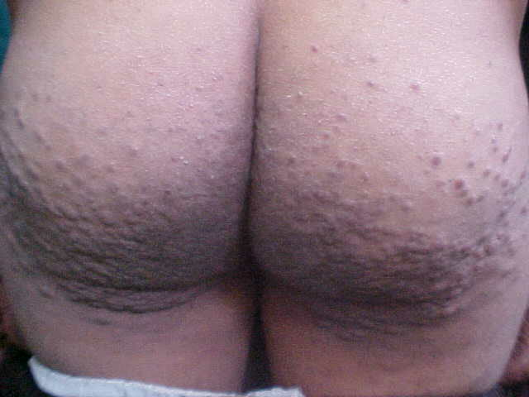

Slide 6
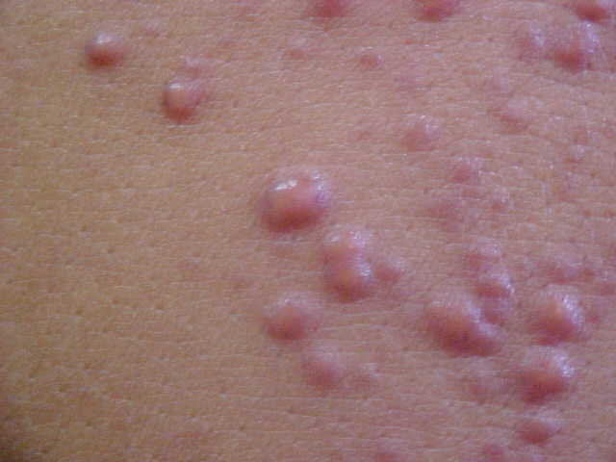

Slide 7
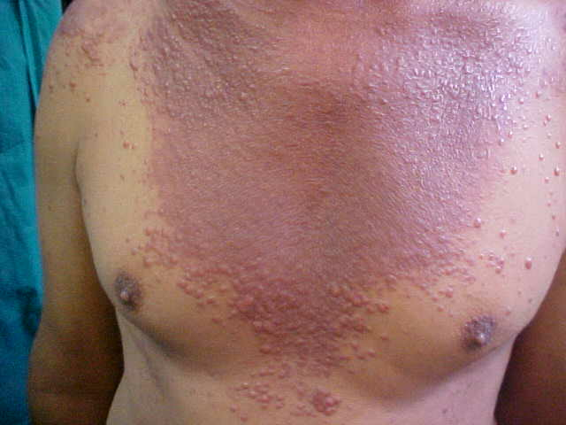

Slide 9
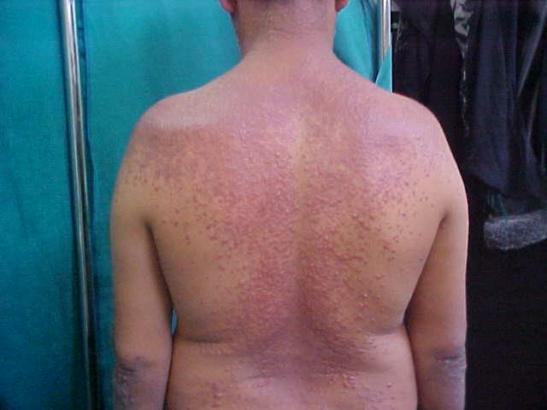

Slide 11
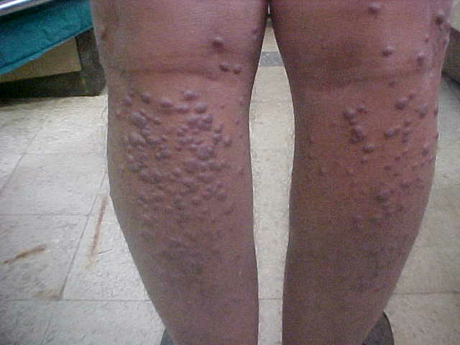

Slide 12
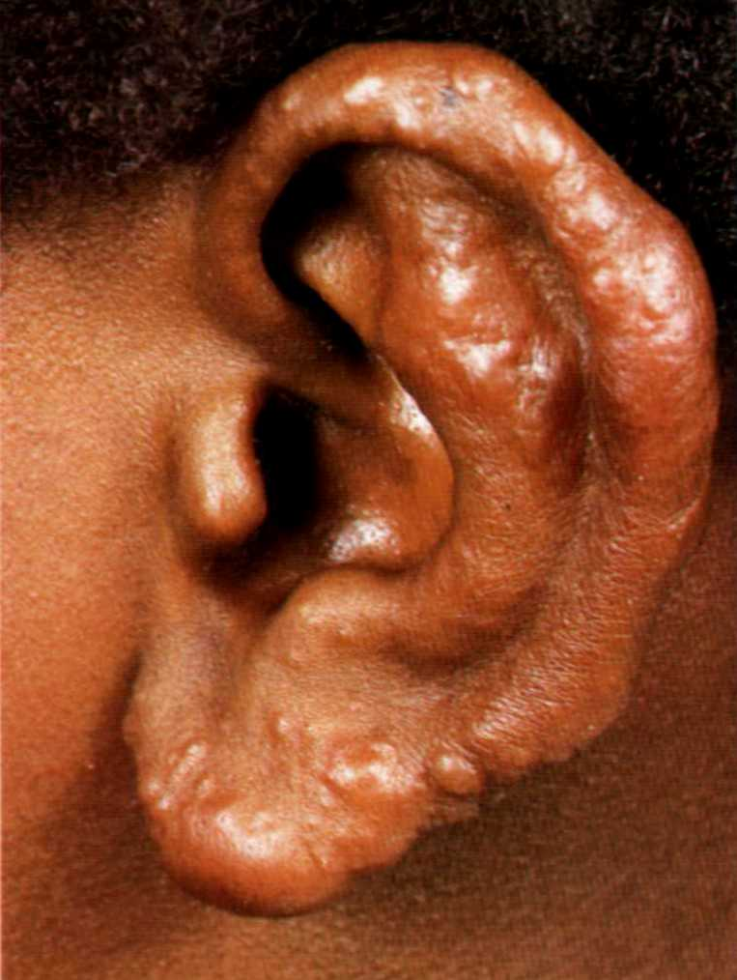

Slide 13
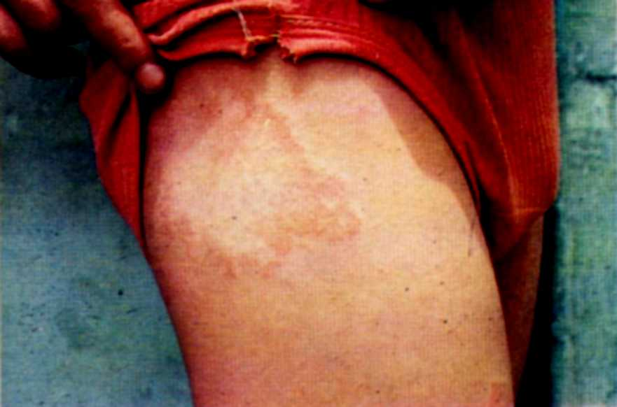

Slide 14
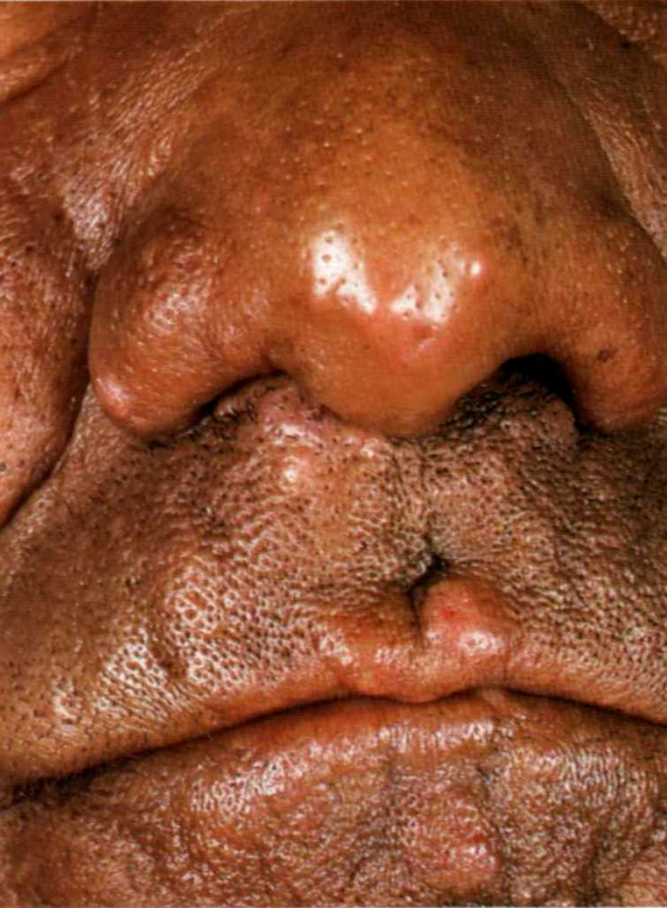

Slide 27
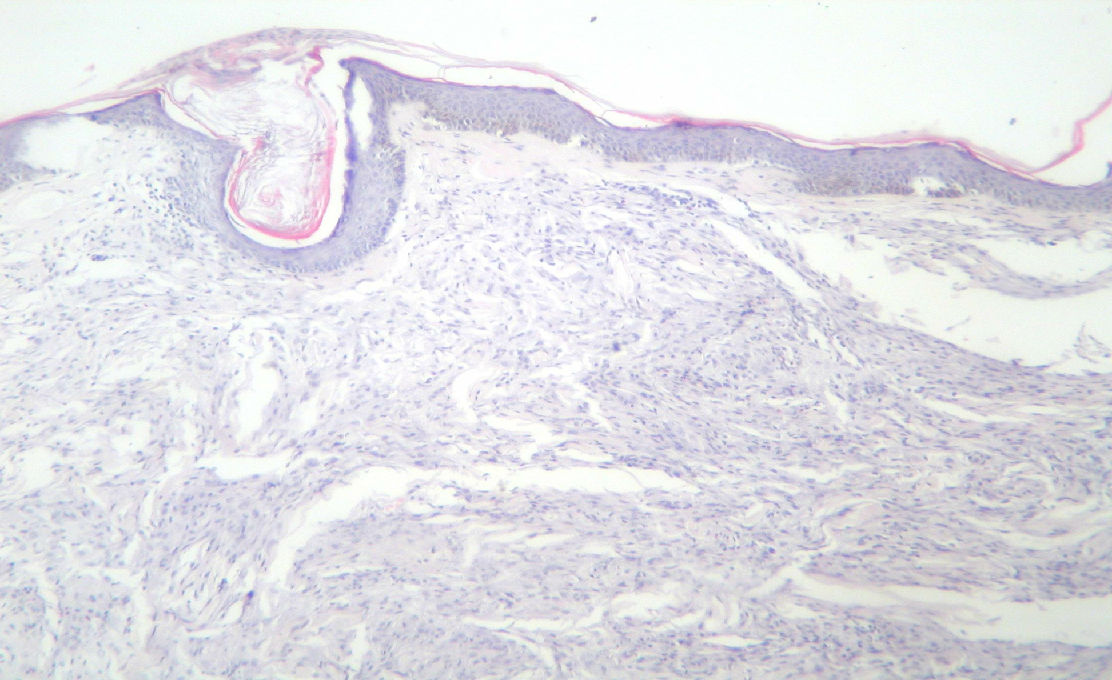
Histopathology of lepromatous leprosy

Slide 28
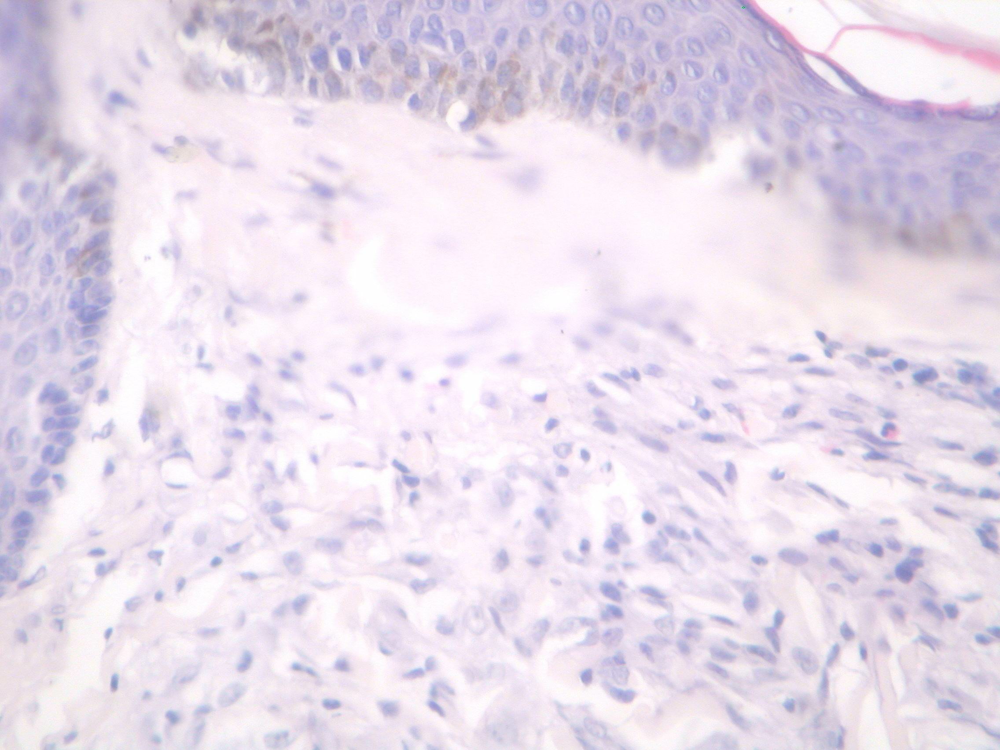

Slide 30
Thank You

