Slide 1
URTICARIA

Slide 2
DEFinition:
Transient eruption of erythematous or edematous swellings of the dermis, usually associated with itching.
Pathogenesis:
Histamine release capillary permeability extravasation of protein and fluids.

Slide 3
Urticaria Classification
Duration Pathogenesis
Acute chronic
immunologic non immunologic

Slide 4
Etiology
Drugs: abs. and NSAIDs.
Foods: eggs, fish …….
Insect bites and stings
Inhalant: sprays, pollens
Infections and Infestations: sinusitis , tonsillitis and ascaris
Physical agents: heat, cold
Stress.

Slide 5
Clinical picture:
Lesion: Wheal of variable Number, size and shape
Site: any site (skin and MM)
Duration: < 24 h

Slide 6
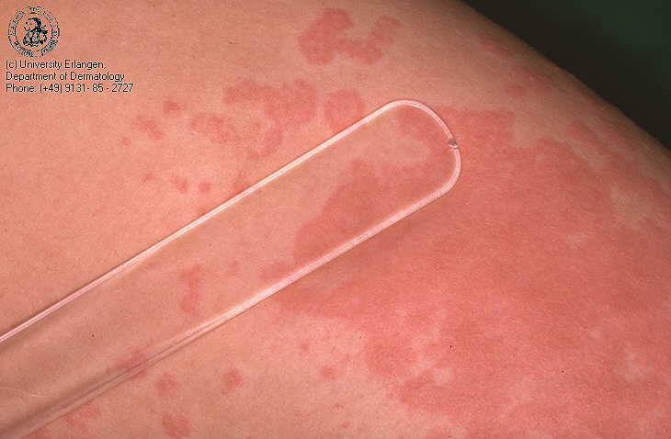

Slide 7
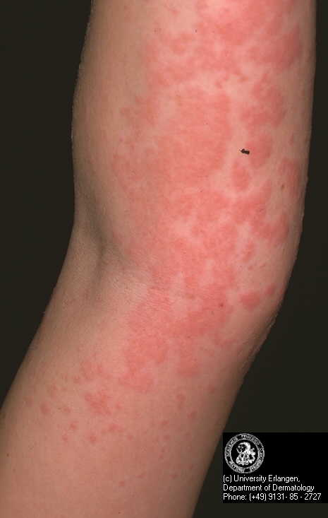

Slide 8
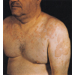

Slide 9
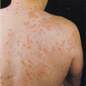

Slide 10
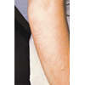

Slide 14
Clinical varieties
Papular Urticaria
Physical Urticaria
Angiodema

Slide 15
Treatment
Treatment of the cause
Antihistamines
Systemic steroids
Topical antipruritics
adrenaline

Slide 16
Papular Urticaria
Clinical variety of urticaria caused by insects as mosquitoes and fleas.
Clinical picture:
Infants and children
itching
Extremities
Itchy urticarial wheal firm pruritic papule v vesicle and pustule (infection).

Slide 17
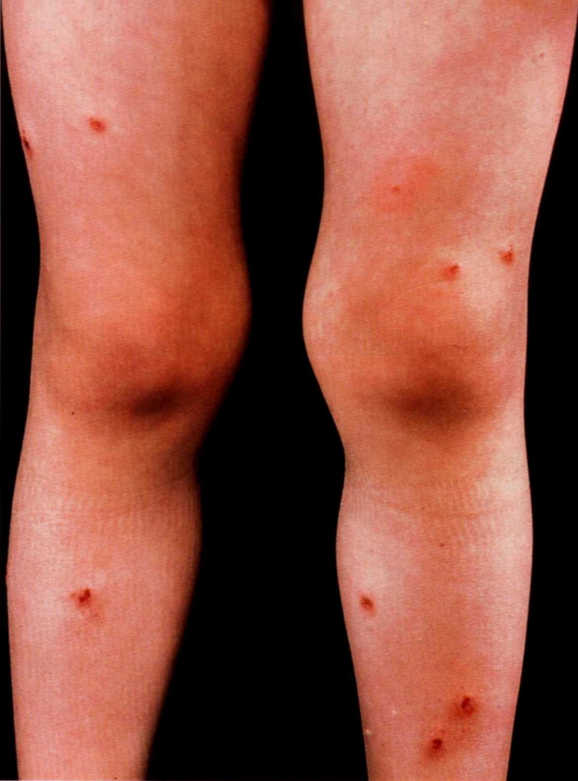

Slide 19
Prurigo of Hebra
Continuation of papular Urticaria
Disease of childhood
Affect extensor surfaces then progress to involve all body .
Dryness, excoriated papules and lichenification

Slide 20
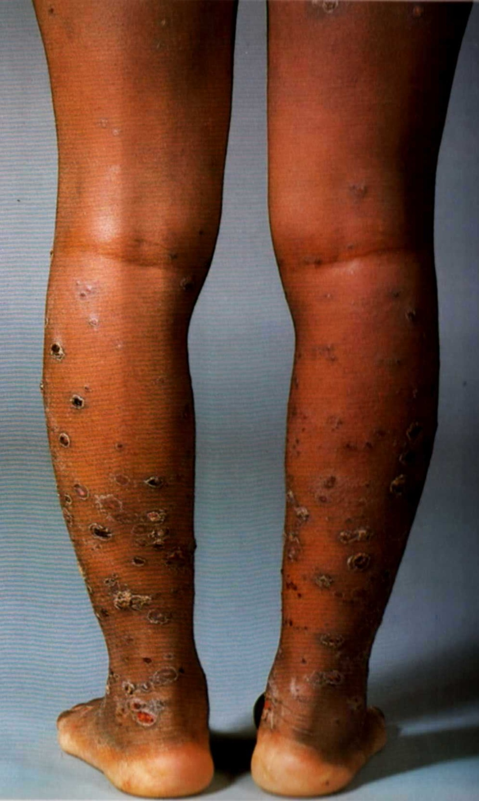

Slide 21
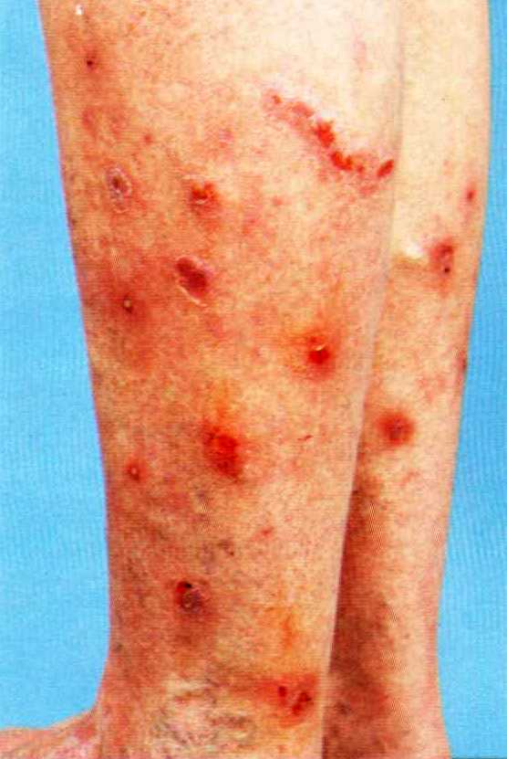

Slide 22
Angiodema
More deep swelling that affect the deeper dermis or subcutaneos tissue.
May affect the MM (!!! Larynx)
Usually in the distensible tissues: eye lids, lips, ear lobules

