Slide 1
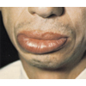

Slide 2
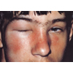

Slide 3
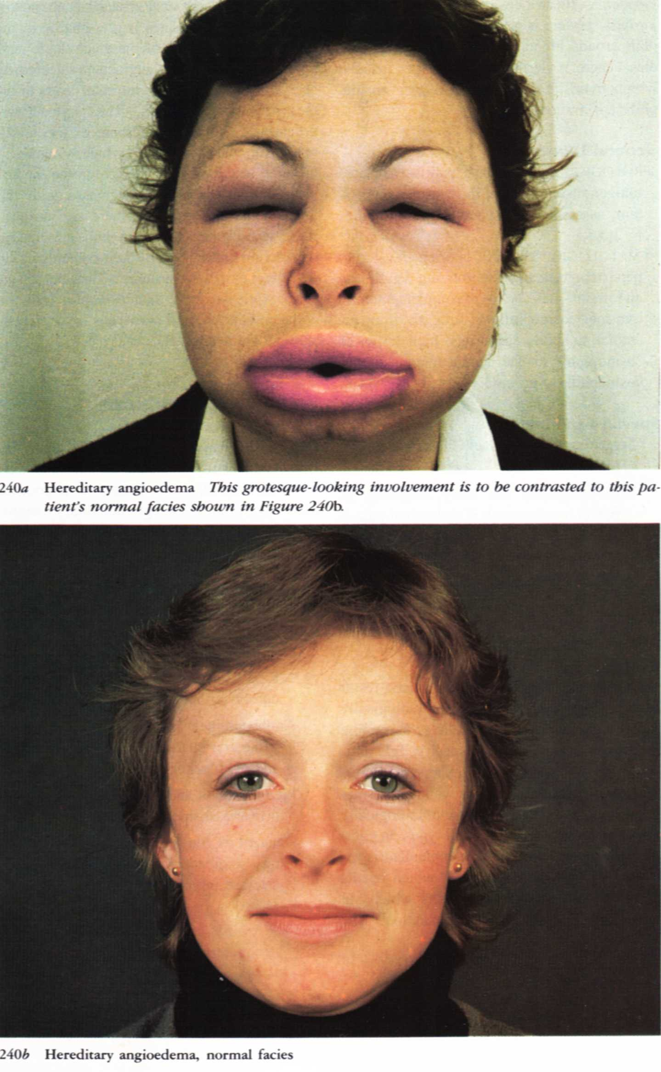

Slide 5
ERYTHEMA MULTIFORME

Slide 6
Acute self limiting eruption characterized by target “iris” lesion
Etiology:
Unkown
Viral
Drugs
X rays
Malignancy
Lupus erythemtosus

Slide 7
Clinical picture:
EM minor:
80% of cases
Dull red maculopapules
Iris lesion:
Typical: dusky erythema edema erythema.
Atypical: 2 areas.
Sites
Minor MM affection.

Slide 8
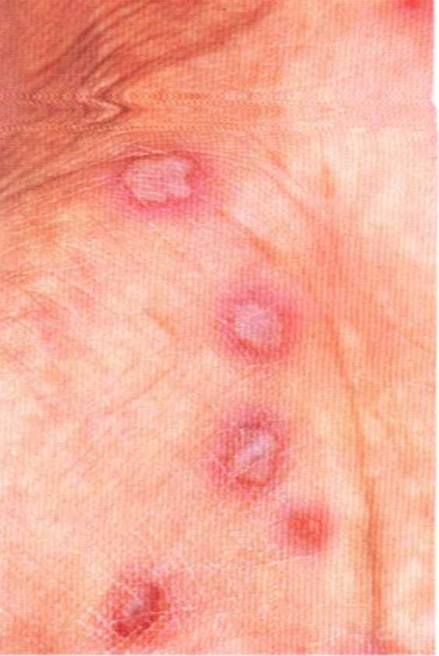

Slide 9
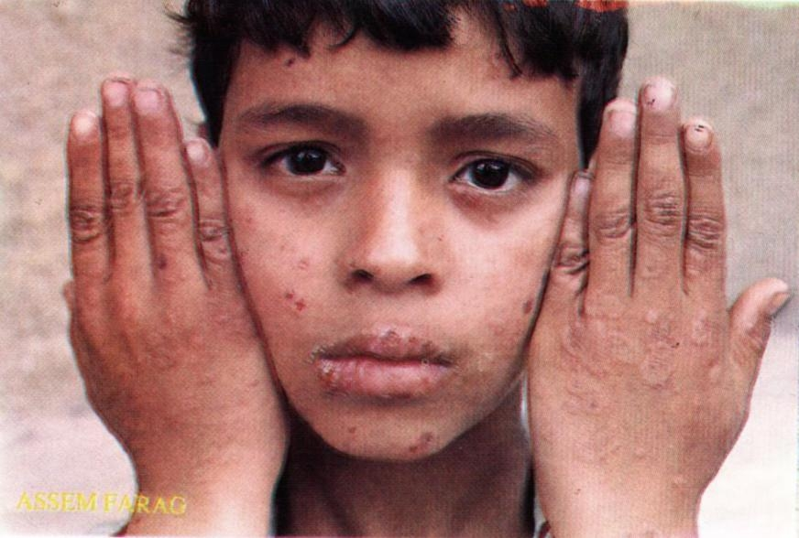

Slide 10
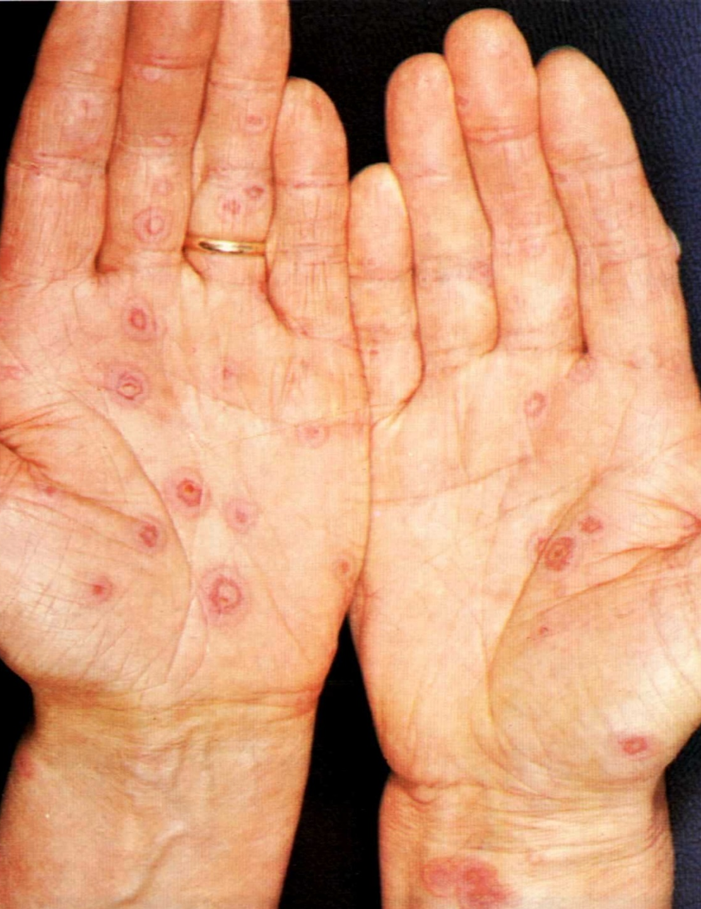

Slide 15
EM major ( S J ):
More sever
More MM affection
Pustules, bullae
Generally ill patient
Usually resolve without sequilae

Slide 16
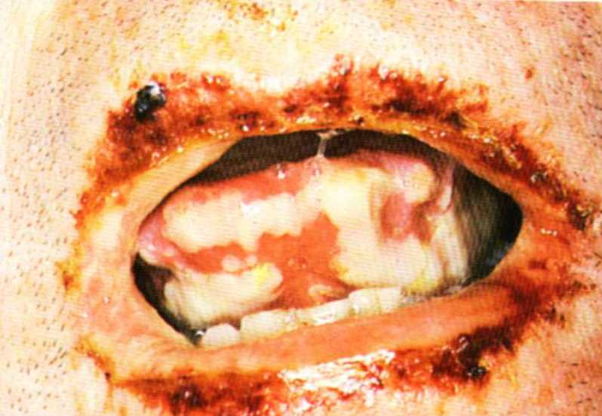

Slide 17
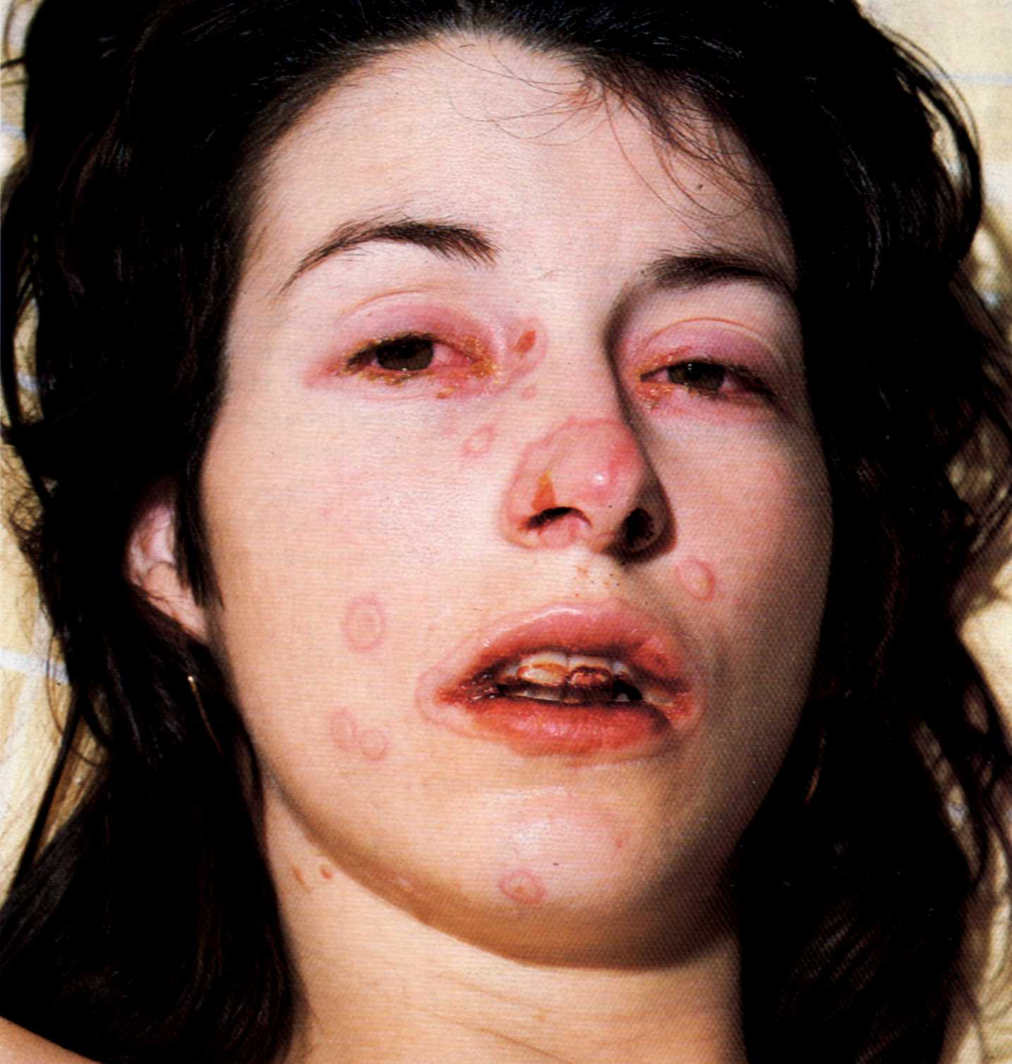

Slide 19
Treatment:
EM minor:
Treatment of cause
Antihistamines and antibiotics
Topical and systemic steroids
EM major
In burn unit
Care of MM lesion

Slide 20
Erythema nodosum
Def:
Nodular erythem. Eruption affecting the legs.
Etiology:
unknown
Infections: strept, TB, intestinal infection, fungal infection.
Sarcoidosis
Drugs: sulph., cp

Slide 21
Clinical picture:
Young female
Acute onset, malaise, arthralgia, leg edema
Bilateral ,symmetrical, deep and tender nodules.
Red smooth shinny skin.
Slow resolution without scarring.

Slide 22
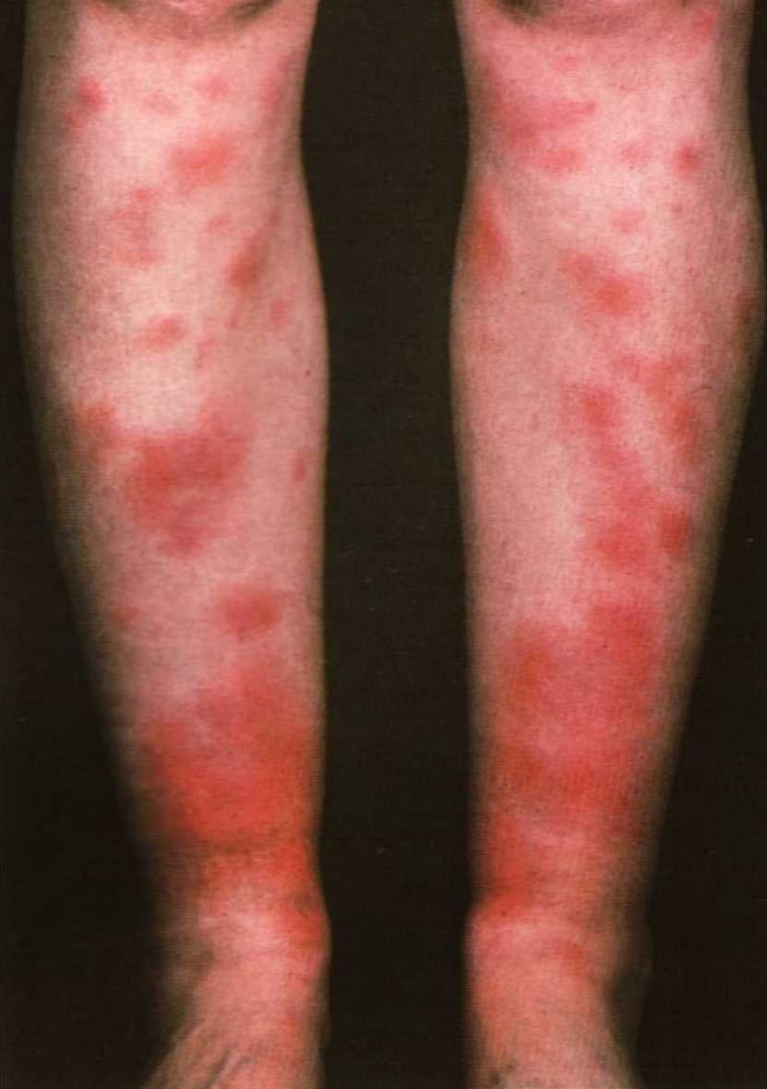

Slide 23
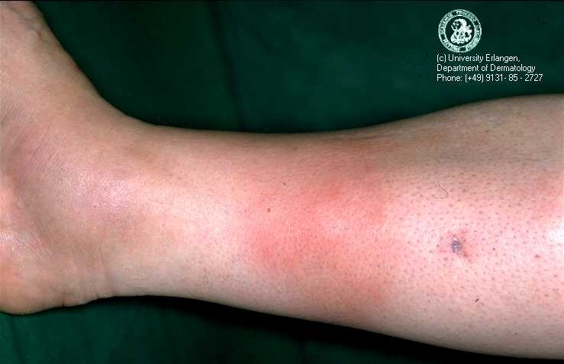

Slide 25
Treatment:
Cause
Bed rest
Bandages or stockings
NSAIDs

Slide 26
Fixed drug eruption
Occur in the same site (Limbs, MM, genitalia).
Sulph, NSAIDs, tetracyclines, laxatives, barbiturates.
Well defined eryth. violaceus plaque.
long lasting hyper pigmented post.
Vesicular or bulluos lesion may occur
Treatment: cause, antihistamines, steroids

Slide 27
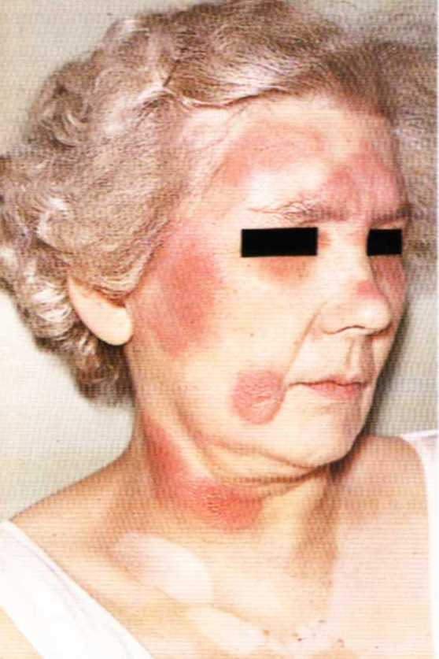

Slide 28
