Slide 1
Hair disorders By Doaa Gaber Abdel baset Assistant lecturer of Dermatology

Slide 2
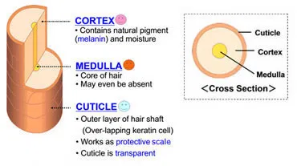
Hair Structure

Slide 3
Hair Cycle

Slide 4
Hair disorders
Increase:
Hirsutism Hypertrichosis
Decrease:
Alopecia

Slide 5
Alopecia
Cicatricial: Destruction of hair follicles, Evident cause, Scarring, Bad prognosis
Congenital Acquired
Non cicatricial: Good prognosis
Congenital Acquired

Slide 6
Cicatricial Alopecia
Aplasia cutis
Traumatic,,,,Mechanical,,,,,Thermal
Infections,,,,Pyogenic,,Fungal,,,Spirochetal,,,Mycobacterial
Malignancy
Inflammatory,,,,LPP,,,,DLE
Unknown,,,,Folliculitis decalvan

Slide 7
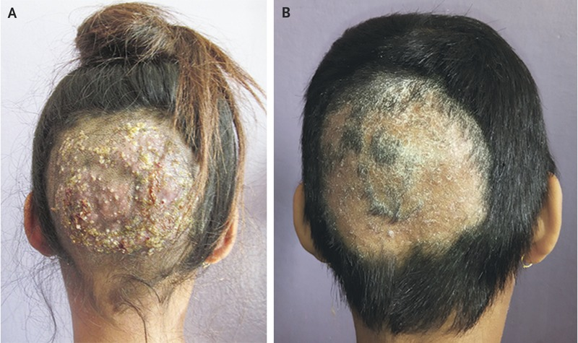
Kerion

Slide 8
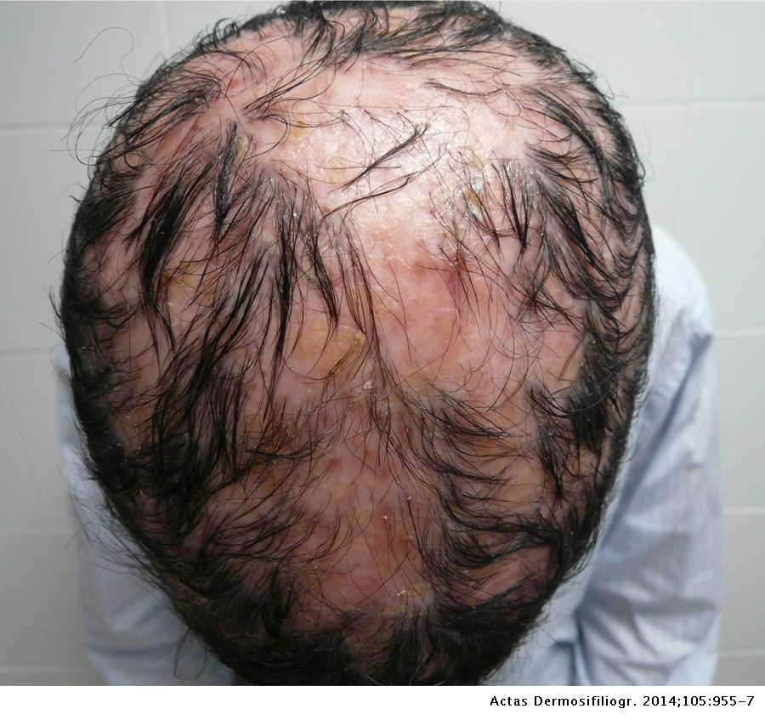

Slide 9
Non Cicatricial alopecia
Congenital: Atrichia,,,,,Hypotrichia
Acquired
Localized: Alopecia Areata,,,Infection,,,Trichotillomania
Diffuse: Telogen effluvium, Anagen effluvium, Androgenetic alopecia

Slide 10
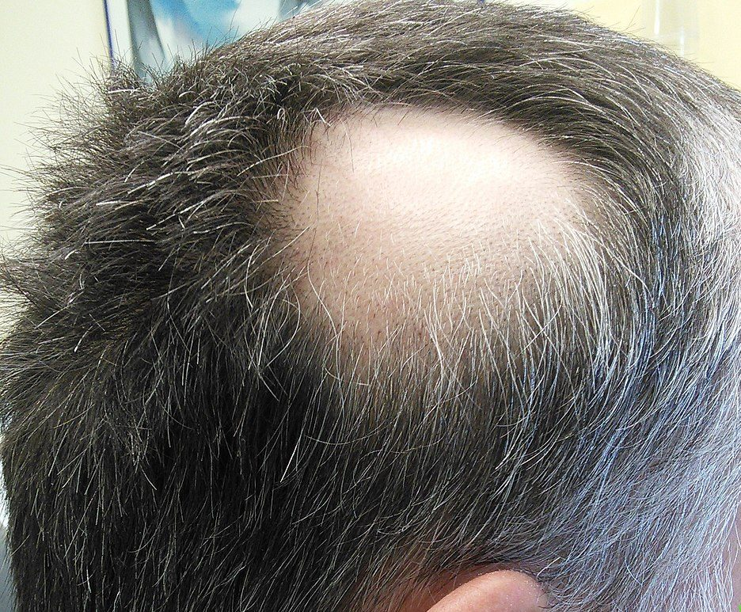
Alopecia Areata

Slide 11
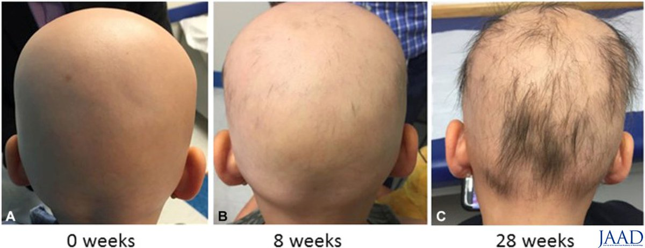
Types of alopecia areata

Slide 12
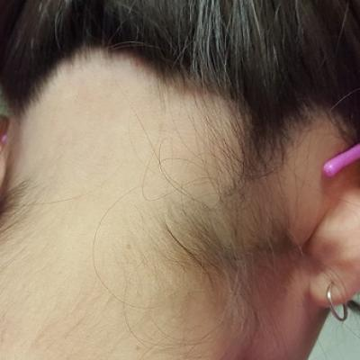
Ophiasis

Slide 13
Trichoscopy of AA

Slide 14
Management of Alopecia Areata
Topical therapy: Steroid,,,Immunomodulatory,,,Irritants
Systemic therapy: Steroid,,,,Methotrexate,,,Cyclosporin
Phototherapy

Slide 15
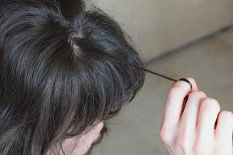
Trichotillomania

Slide 17
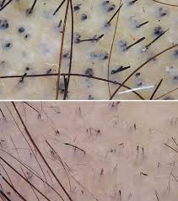

Slide 18
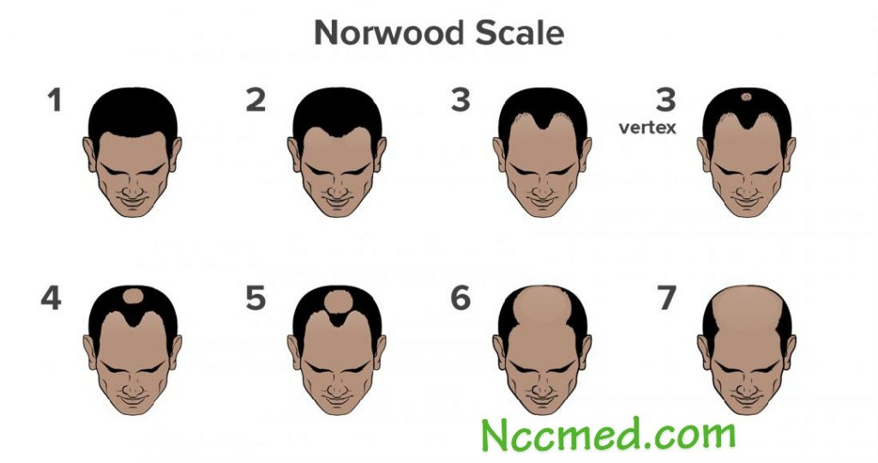
Androgenetic Alopecia: Male pattern

Slide 19
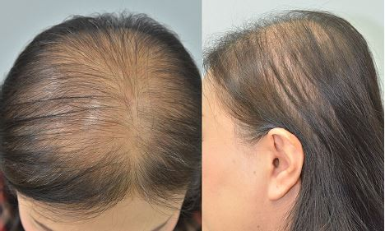
Female pattern hair loss

Slide 20
Androgenetic alopecia management
Diagnosis:
Clinically Trichoscope

Slide 21
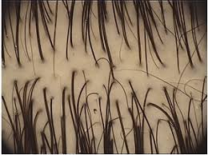
Trichoscope

Slide 23
Treatment of AGA
Topical: Minoxidil
Systemic: Antiandrogen
Surgical
PRP

Slide 24
Telogen effluvium
Causes:
Stress
Nutritional
Iron deficiency anemia
Crash Diet
Post partum
May be Acute or Chronic
Good prognosis

