Slide 1
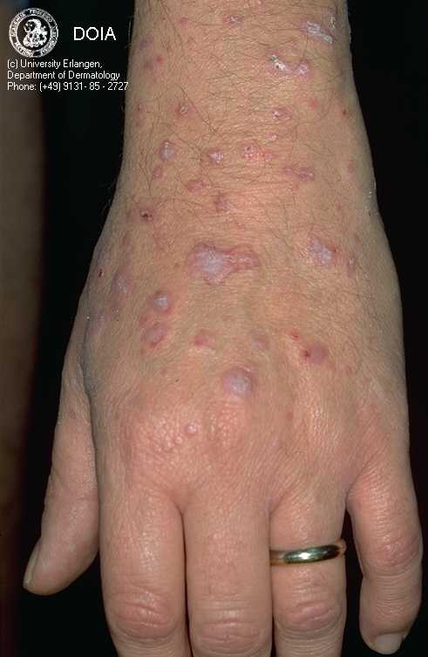
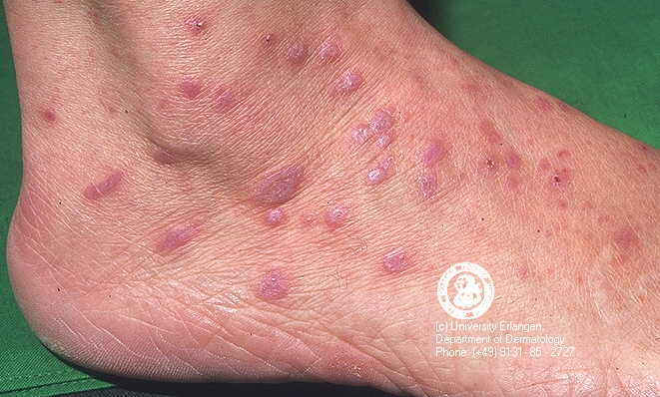

Slide 3
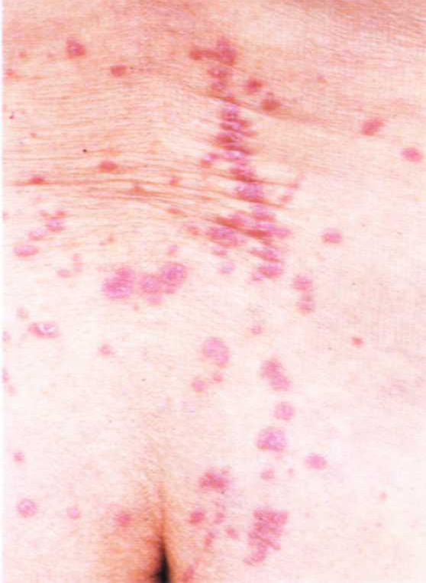
Koebner,s
Phenomenon
( Linear LP )

Slide 5
Clinical Patterns of Lichen Planus
Ordinery (classic)
Hypertrophic
Atrophic
Linear
Annular
Actinic
Follicular
Lichen planus of mucous membranes

Slide 6
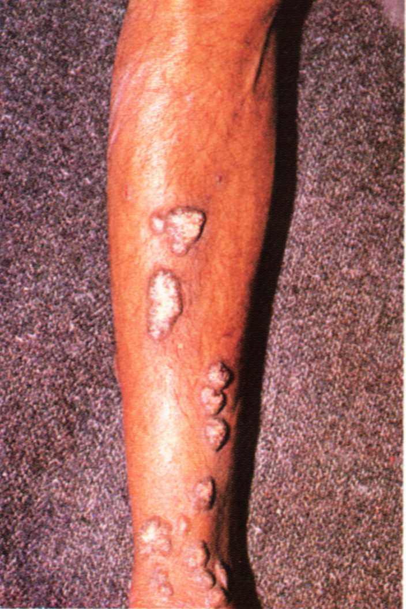
Hypertrophic
LP

Slide 7
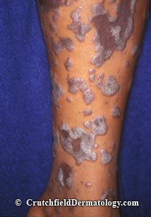
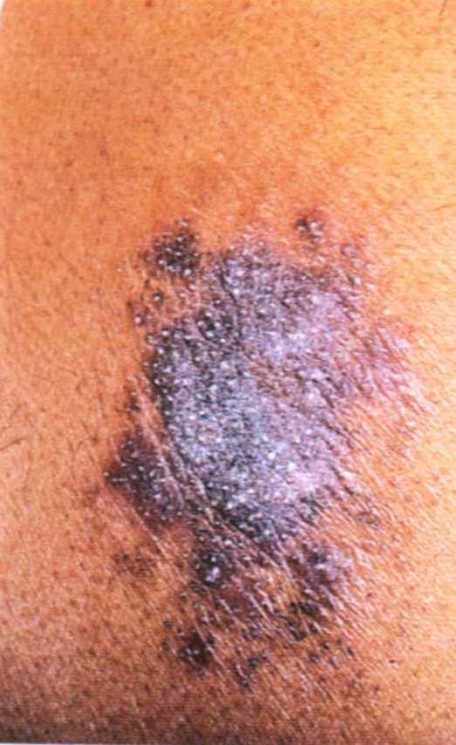

Slide 8
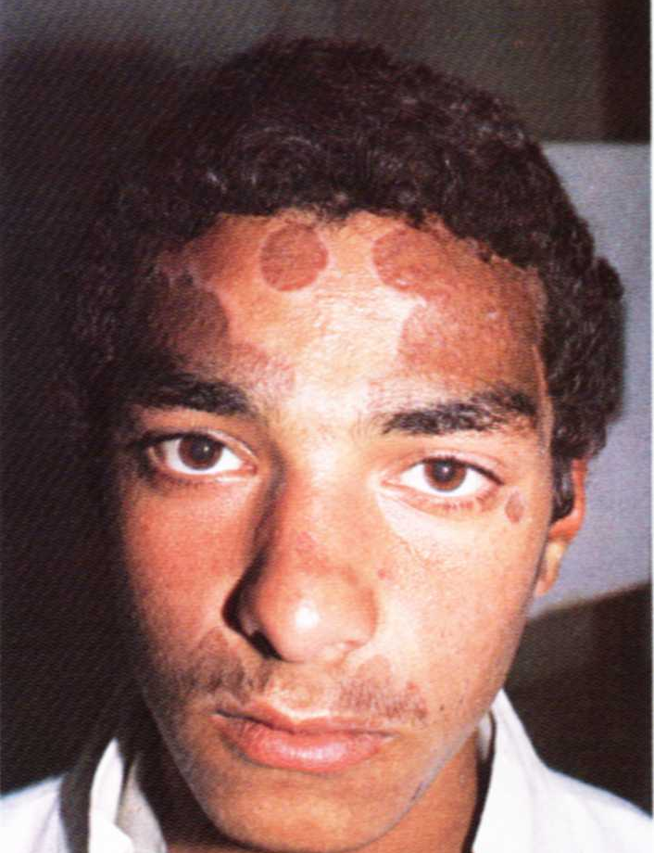
Actinic
LP

Slide 9
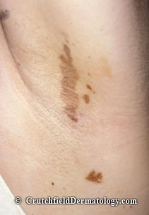
Atrophic
LP

Slide 10
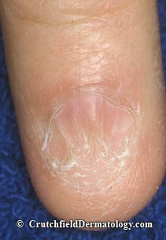
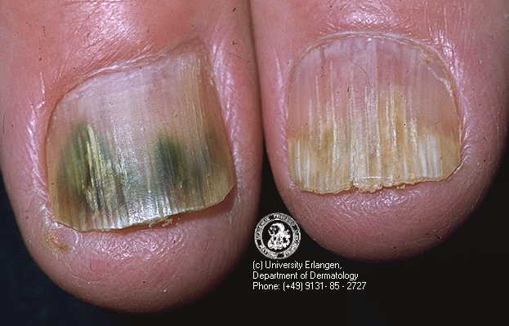
LP of nails

Slide 11
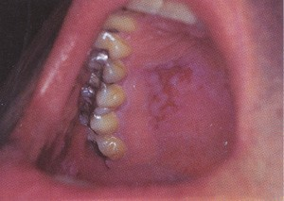
LP of
mucous
membrane

Slide 14
Follicular LP

Slide 15
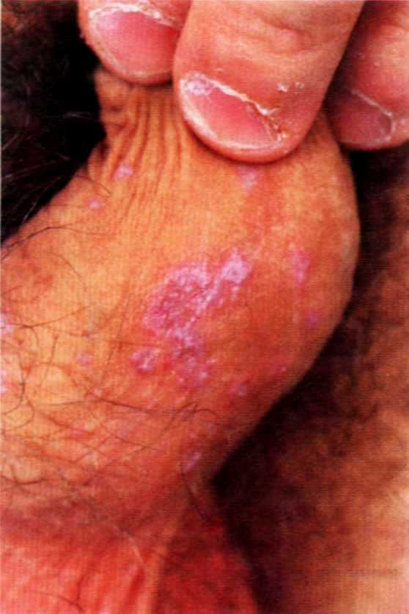
Annular
LP

Slide 17
Treatment of Lichen Planus
Topical corticosteroids
Oral antihistamines
Systemic steroids for extensive cases

Slide 18
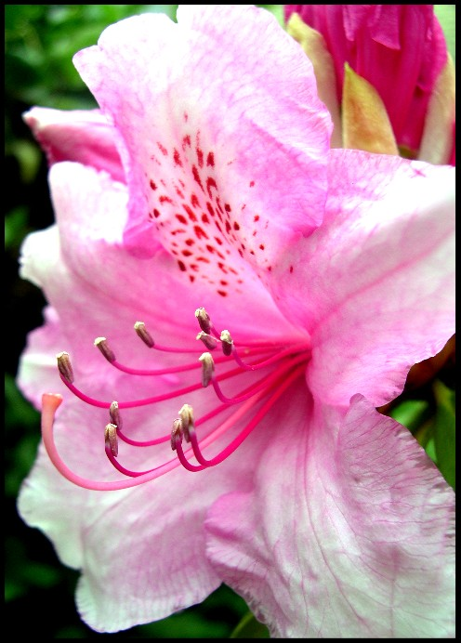
PITYRIASIS ROSEA

Slide 19
Pityriasis Rosea
* Definition:
Acute self-limiting disease affecting children and young adults and characterized by distinctive skin eruption; Common in spring and autumn
* Etiology:
Infective theory: viral infection
Drugs

Slide 20
* Clinical features of ordinary PR :
Appearance of herald patch
Generalized eruption appears in 5 – 15 days as pink macules covered with fine marginal scales
Long axes of the lesions are parallel to the ribs
Bilateral and symmetrical
Itching is usually mild
Spontaneous recovery in 3 – 6 weeks

Slide 21
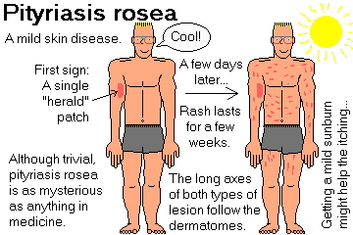

Slide 22
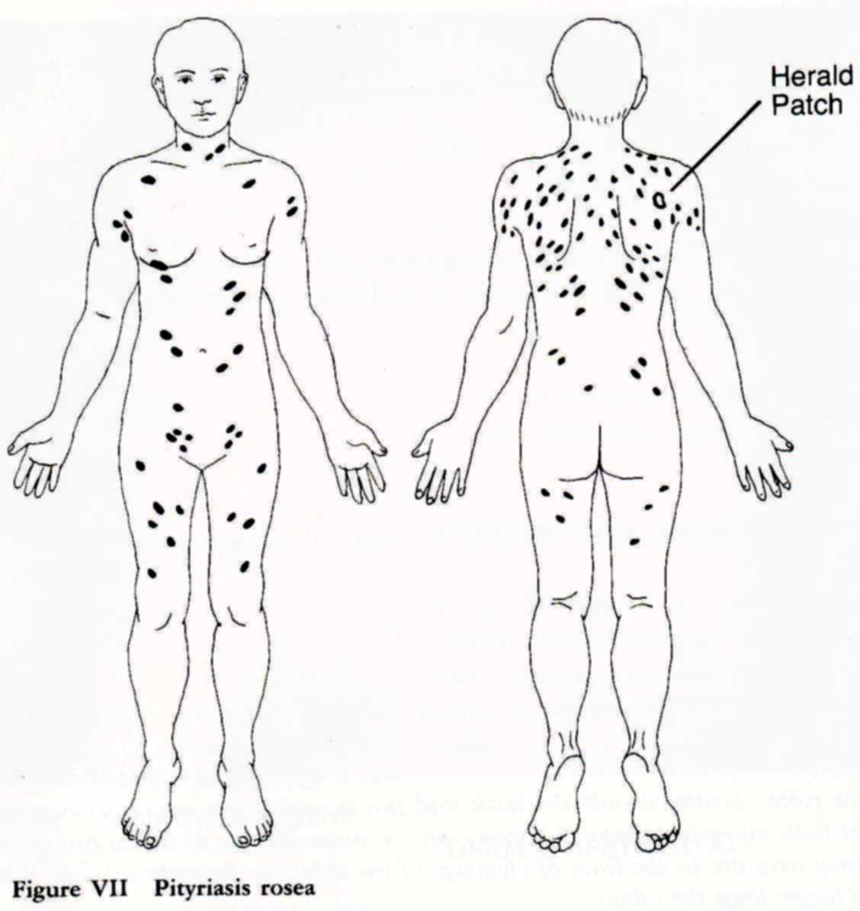
Classical
distribution

Slide 23
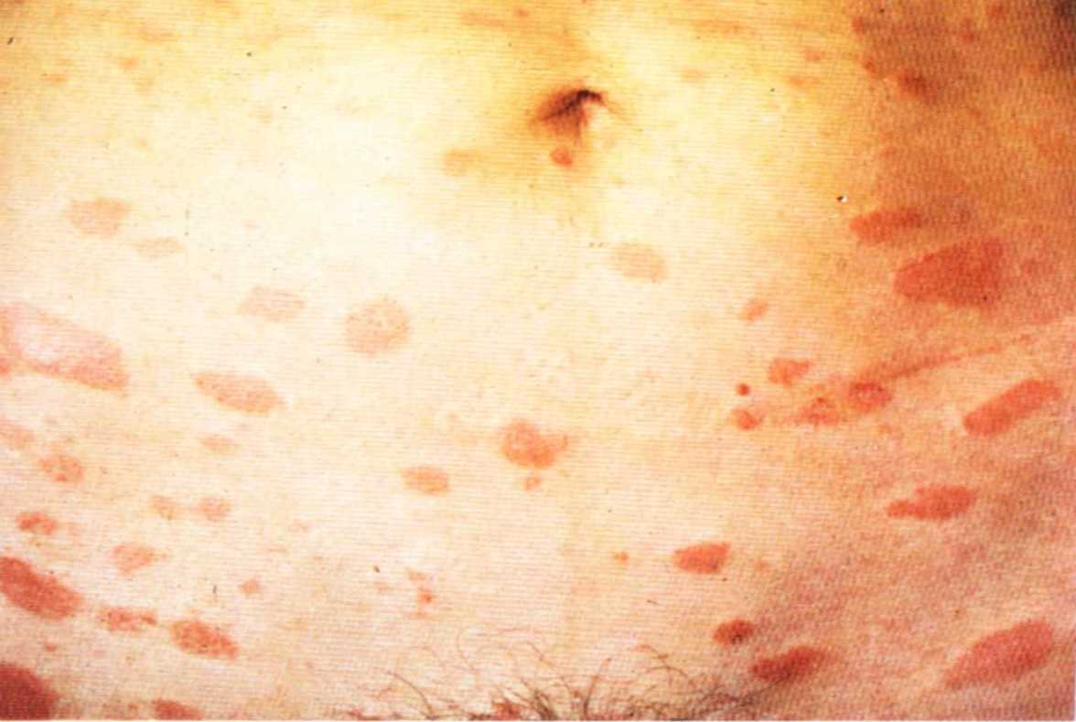
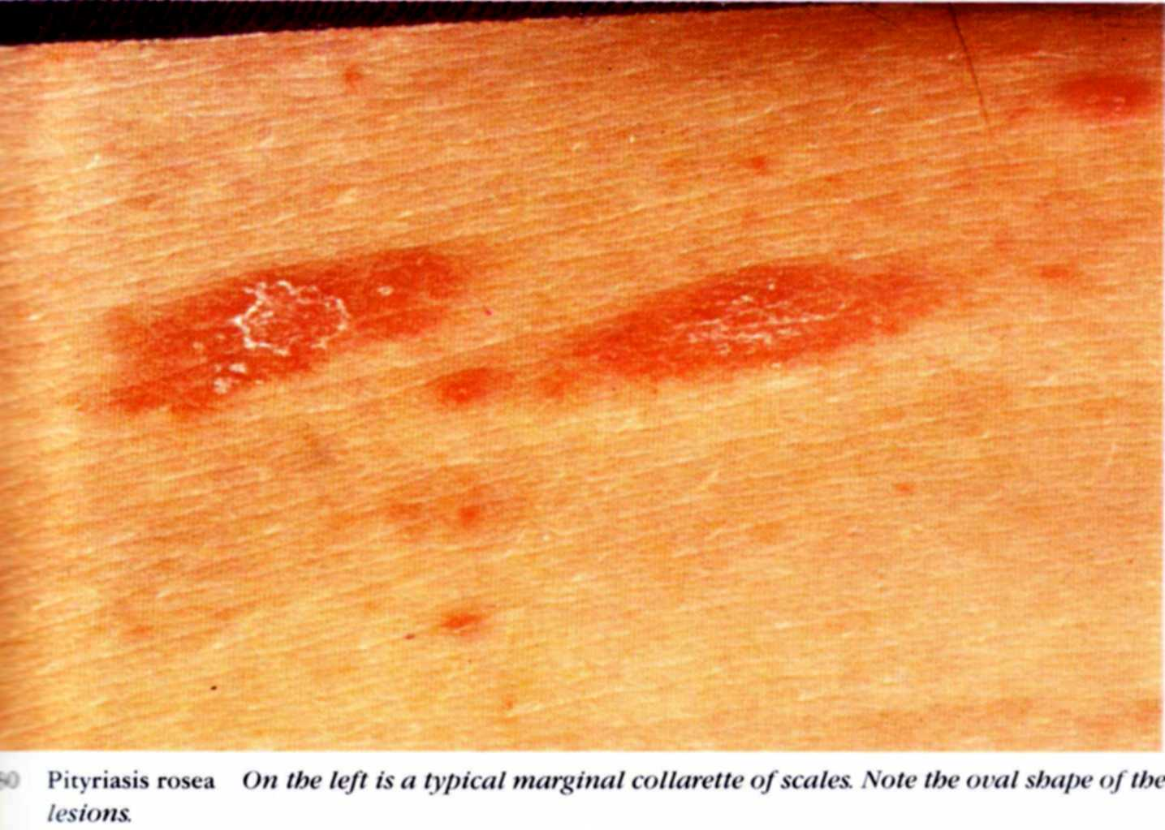
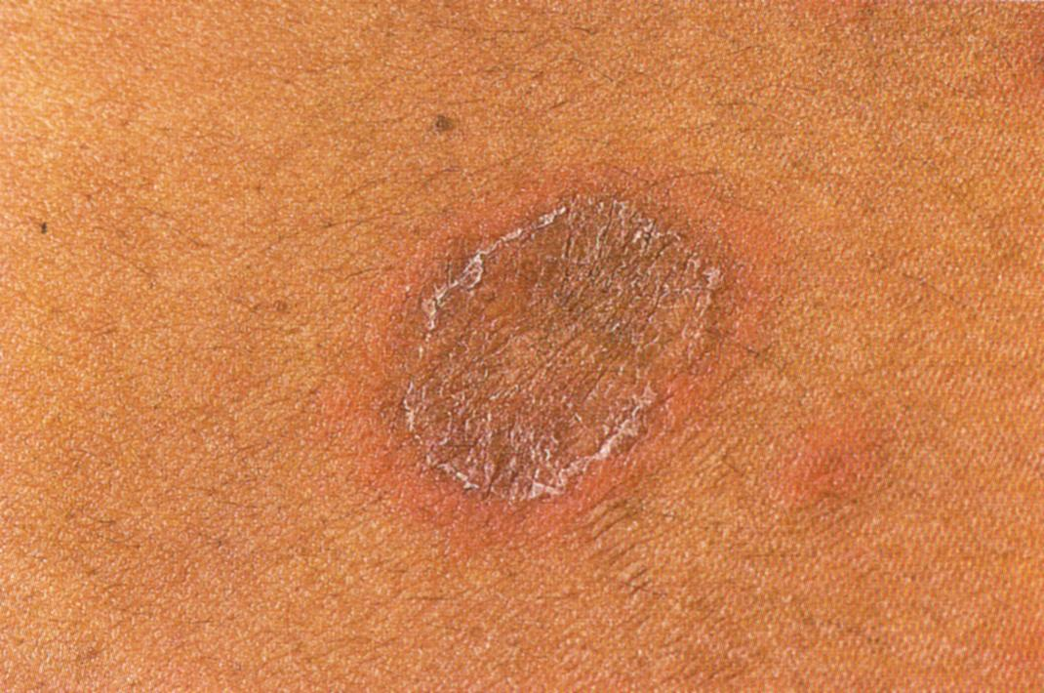

Slide 25
* Atypical varieties of pityriasis rosea:
Inverted type
Abortive type
Localized type
* Treatment of pityriasis rosea:
Reassurance
Topical corticosteroids
Oral antihistamines
UV

Slide 26
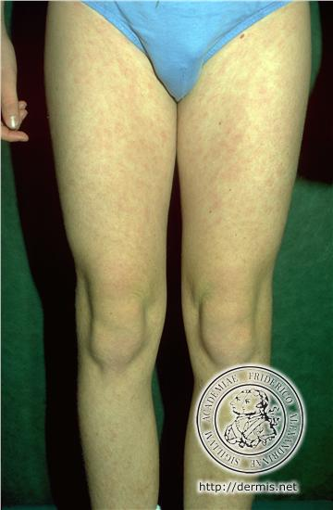
Inverted PR

Slide 27
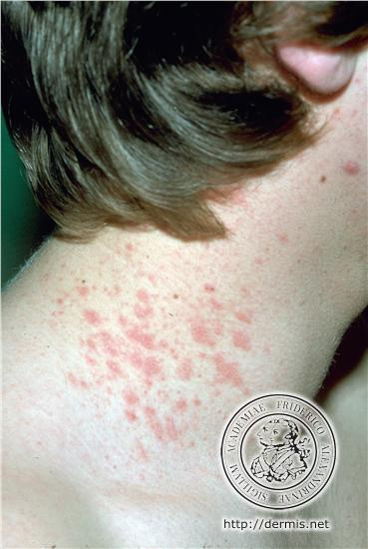
Localized PR

Slide 28
PITYRIASIS RUBRA
PILARIS

Slide 29
Pityriasis rubra pilaris
Pityriasis rubra pilaris is a chronic disease of unkown
* Clinical picture:
1) Circumscribed follicular keratoses
2) Erythema and scaling of the face
3) Diffuse scaling of the scalp

Slide 30
4) Palmoplanter keratoderma
5) Psoriasifrom patches
6) Erythroderma
7) The nail are thickened, discolored and brittle

Slide 31
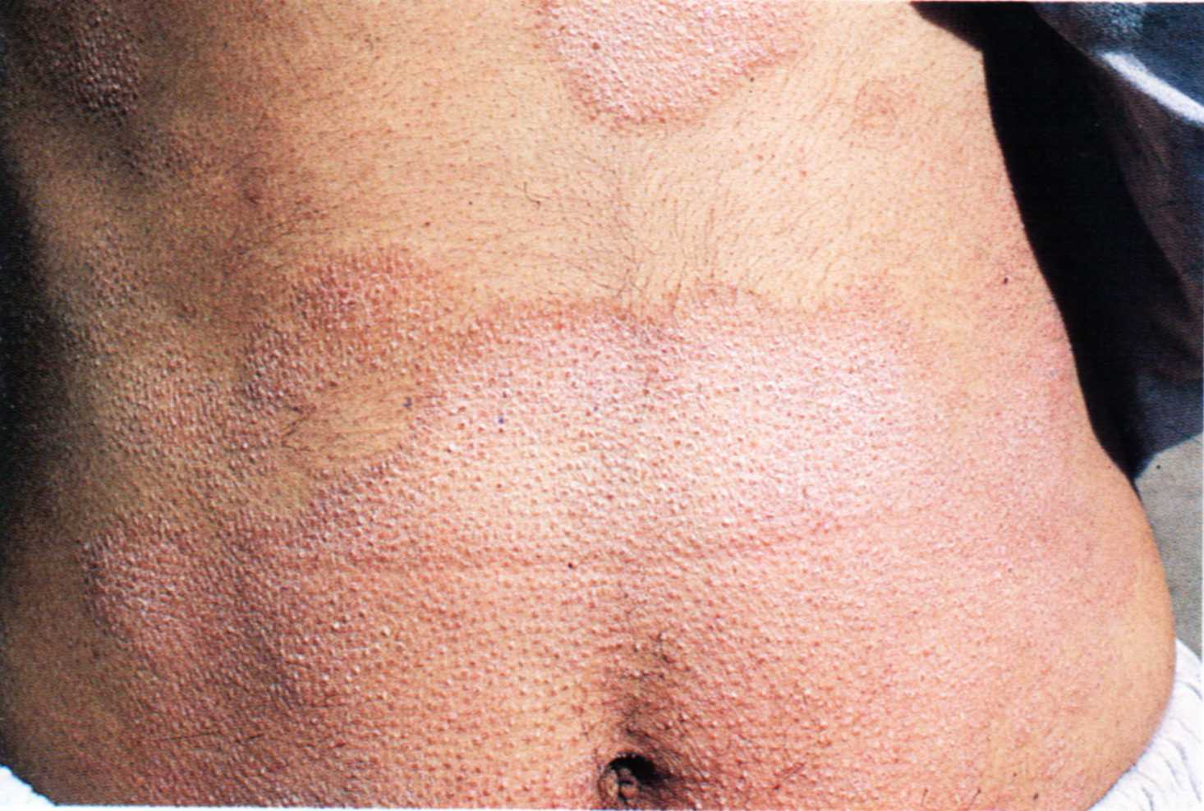

Slide 33
* Treatment of PRP:
1) Salicylic acid 3-5%
2) Systemic retinoids in severe cases
3) Methotrexate in severe cases

Slide 34
Thank you

