Slide 1
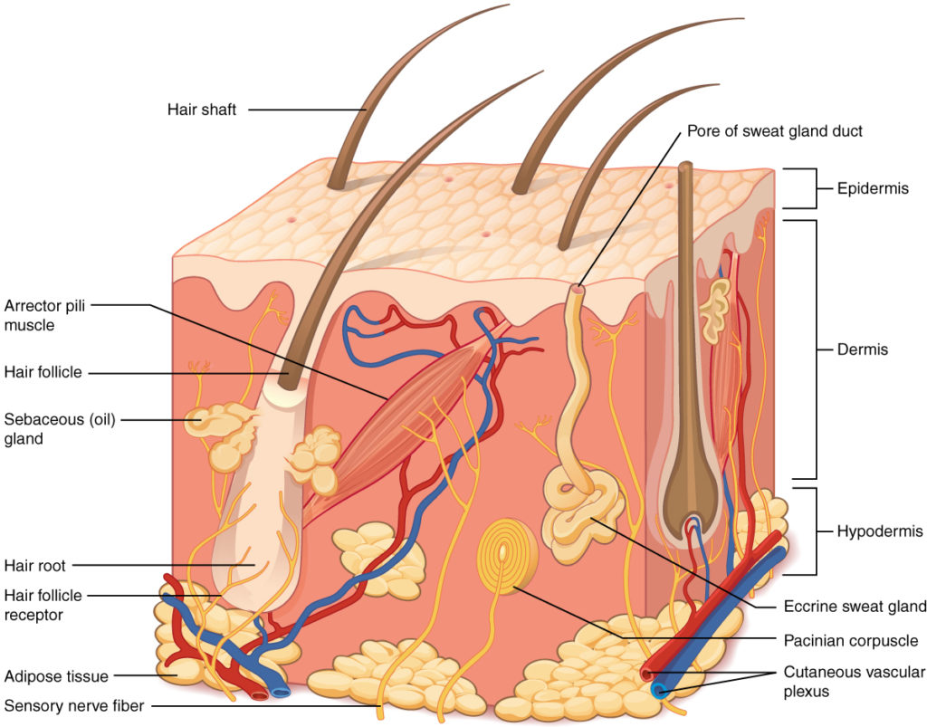
Structure and Functions of Skin by Doaa Gaber Abdel baset, MSc Assistant Lecturer of Dermatology 2020

Slide 2
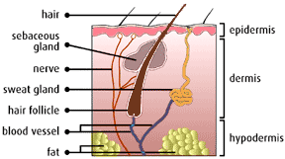
Structure of Skin
Epidermis:
Keratinocytes 95%
Non keratinocytes 5%
Dermis
Subcutaneous tissue

Slide 3
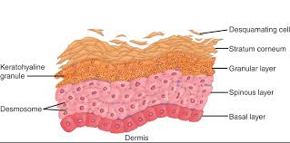
Layers of skin
Basal cell layer
Spinous cell layer
Granular cell layer
Horny cell layer

Slide 4
Functions of Skin
Cosmetic and Social
Protective,,,Physical..Sensory
Immunological
Thermal regulation
Photoprotective function
Metabolic,,,Vit. D synthesis
>>>Barrier Mechanical
Immunological

Slide 5
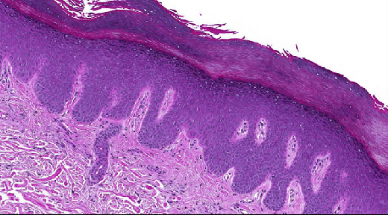
Pathological terms
Hyperkeratosis
Acanthosis
Parakeratosis
Spongiosis

Slide 6
Hyperkeratosis

Slide 7
Parakeratosis

Slide 8
Spongiosis

Slide 9
Acantholysis

Slide 10
Elongation of rete ridges

Slide 11
Primary Skin lesions
Papule
Nodule
Plaque
Macule
Patch
Vesicle
Bulla
Wheal
Burrows
Comedo

Slide 12
Papule

Slide 13
Papule

Slide 14
Nodule

Slide 15
Plaque

Slide 16
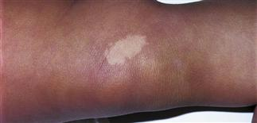
Macule

Slide 17
Patch

Slide 18
Vesicle

Slide 19
Bulla

Slide 20
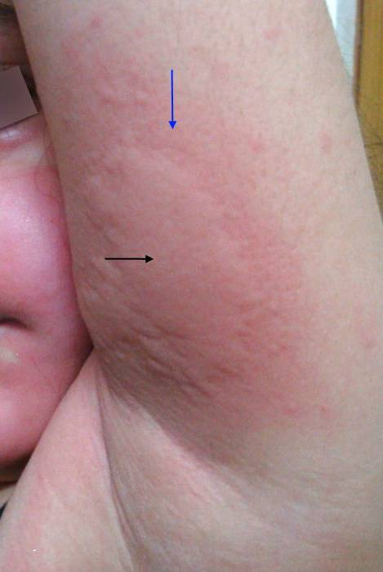
Wheal

Slide 21
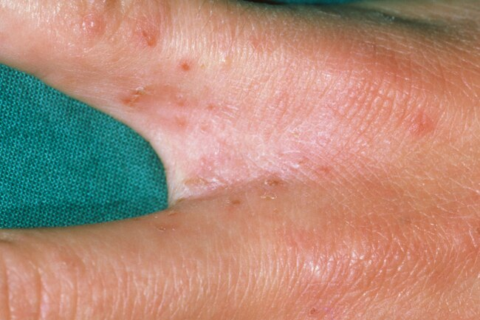
Burrow

Slide 22
Secondary Skin lesions crust**

Slide 23
Ulcer

Slide 24
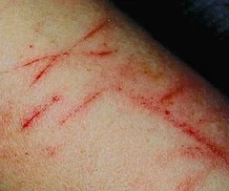
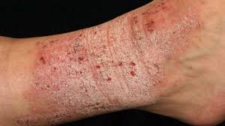
Secondary skin lesions
Scratch marks
Lichnification

