Slide 1
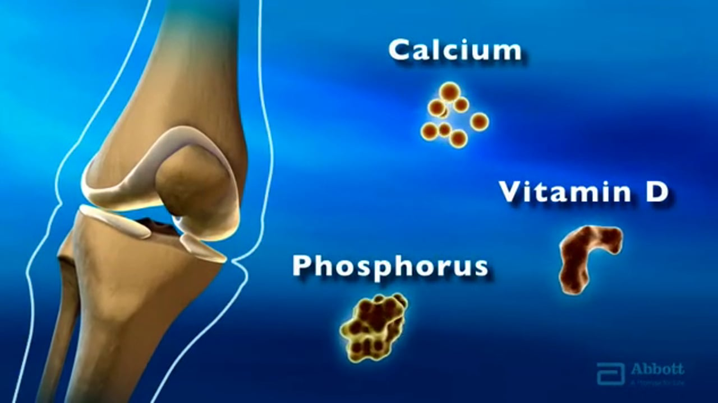

  Calcium and Bone metabolism

Slide 2
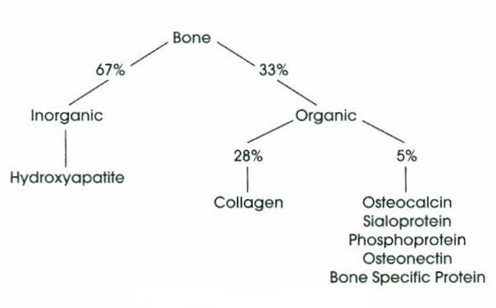

Bone composition
There are 3 major types of bone cells:
osteoblasts are the differentiated bone forming cells and secrete bone matrix on which ca²⁺ and PO₄³⁻ precipitate.
Osteocytes, the mature bone cells are enclosed in bone matrix.
Osteoclasts is a large multinucleated cell derived from monocytes whose function is to resorb bone.

Slide 3
Mineralization
99%
Requires adequate calcium and phosphate.
Dependent on vitamin D.
Alkaline phosphatase and osteocalcin play roles in bone formation(their plasma levels are indicators of osteoblast activity.
99% of the calcium in our bodies is found in our bones which serve as a reservoir for ca2+ storage.
10% of total adult bone mass turns over each year during remodeling process.
During growth rate of bone formation exceeds resporption and skeletal mass increases.

Slide 4
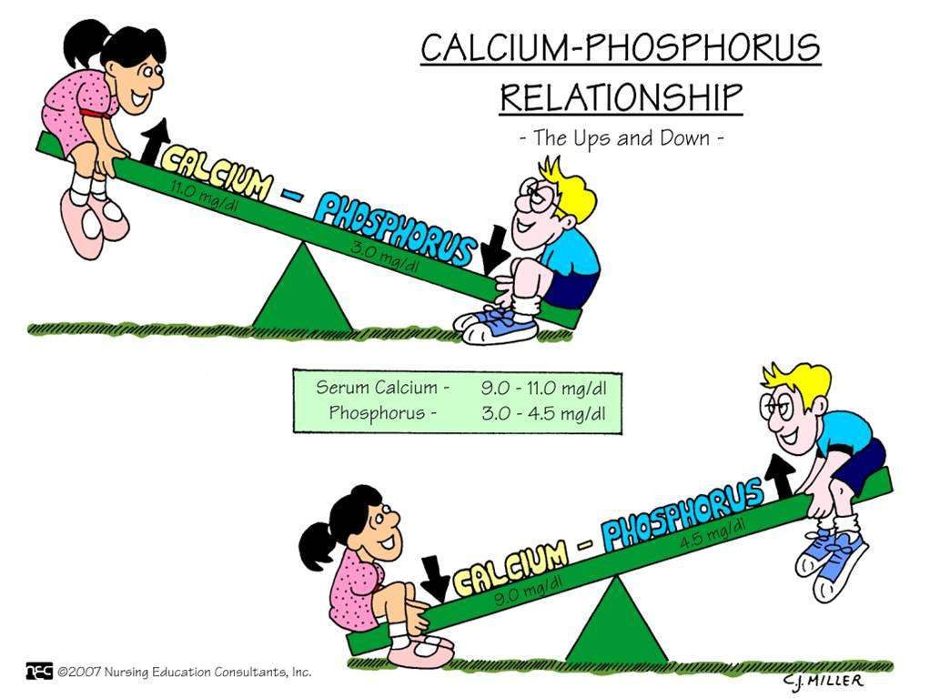
Calcium and phosphorous
Ca is tightly regulated with P in the body.
P is an essential mineral necessary for ATP, cAMP 2nd messenger systems, and other roles.
PO4 normal plasma concentration is 3.0-4.5 mg/dl. 85-90% is found in bone.
The rest is in ATP, cAMP and proteins.

Slide 5

Calcium Metabolism
Minerals; calcium is essential, we can’t synthesize it.
serum concentration
  Calcium (Ca²⁺); 2.2-2.6 mM(9-11mg/dl)( (total)
Intake = output
Negative calcium balance: Output > intake
  Neg Ca²⁺ balance leads to osteoporosis
Positive calcium balance: Intake > output
  Occurs during growth
Organ systems that play an import role in Ca²⁺ metabolism
  Skeleton
  GI tract
  Kidney

Slide 6
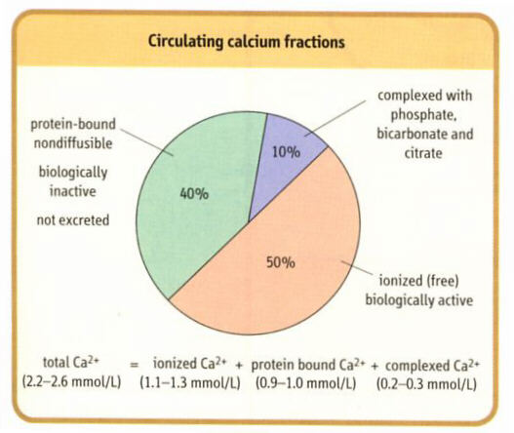

Slide 7
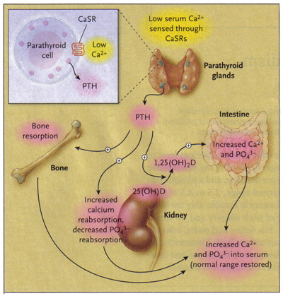
Calcitropic Hormones
(calcium homeostasis)
  Parathyroid hormone (PTH)
  Calcitonin (CT)
  Vitamin D (1,25dihydroxycholecalciferol)

Slide 8
Parathyroid Hormone
It is a polypeptide hormone synthesized in the para-thyroid glands.
Extracellular Ca 2+ regulates secretion of PTH.
  Low Ca 2+ increases it.
  High Ca 2+ decreases it.
Actions of Parathyroid Hormone
Parathyroid hormone acts directly on bone to stimulate resorption and release of Ca2+ into the extracellular space (slow),it also inhibits osteoblast function.
Parathyroid hormone acts directly on kidney to increase calcium reabsorption and phosphate excretion (rapid)
Stimulates transcription of 1-alpha hydroxylase for Vitamin D activation in kidney(Vitamin D increases calcium and phosphate absorption).
Calcitonin inhibition.

Slide 9

Vitamin D: What is it?
Fat soluble vitamin .
Hormone precursor,acts more like a hormone than a vitamin
Related to steroid hormones“neurosteroid”, endogenous, synthesized from cholesterol, regulator of a number of genes
Exists in 2 formsD3, D2

Slide 10
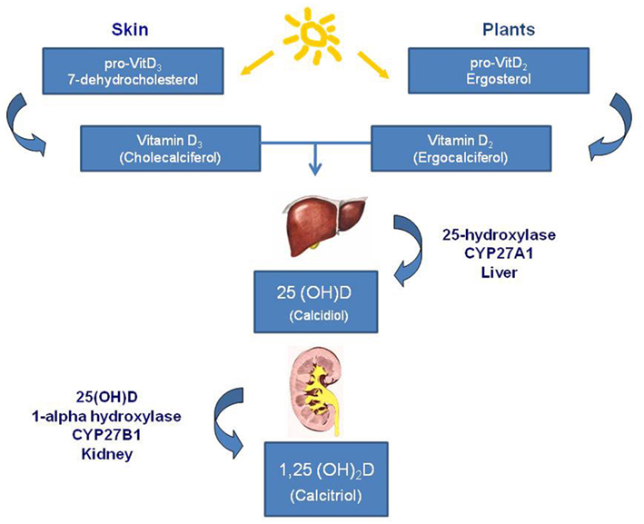
Vit D2 & D3 are biologically inert and Require two separate hydroxylations to give rise to active form.

Slide 11
Active vs. Inactive Vitamin D
1,25 dihydroxyvitamin D is the physiologically active form (serum half-life = 4-6 hours).
The inactive 25-hydroxy-vitd3 most often measured clinically in the serum and is an Indicator of Vit D stores in the body as it Reflects amount of Vit D derived from both food & sun(2-3 week half-life).
  Optimal Level to Prevent Disease?
30-100 ng/ml

Slide 12
Other Physiologic Functions of Vitamin D
Influences smooth muscle tone, endothelium, cardiomyocytes, controls intracellular Ca+
  Deficiency: cardiovascular disease, hypertension, stroke.
Anti-oxidative/neuroprotective
  Deficiency: dementia, Alzheimer's, schizophrenia, depression.
Neuromuscular stability
  Deficiency: myofascial pain, musculoskeletal pain, myopathy.

Slide 13

Vitamin D and Bones
The main action of 1,25-(OH)₂-D is to stimulate absorption of Ca²⁺ from the intestine.
1,25-(OH)₂-D induces the production of calcium binding proteins which sequester Ca²⁺, buffer high Ca²⁺ concentrations that arise during initial absorption and allow Ca²⁺ to be absorbed against a high Ca²⁺ gradient.
Proper bone formation is stimulated by 1,25-(OH)₂-D.
In its absence, excess osteoid accumulates from lack of 1,25-(OH)₂-D repression of osteoblastic collagen synthesis.
Inadequate supply of vitamin D results in rickets, a disease of bone deformation.

Slide 14
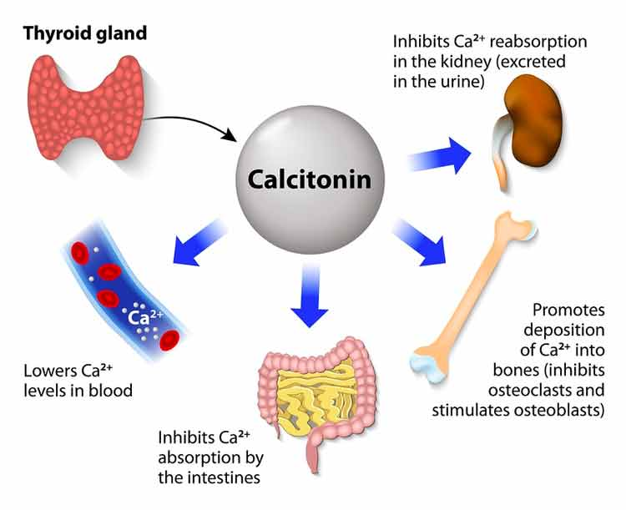
Calcitonin
Calcitonin is synthesized and secreted by the parafollicular cells of the thyroid gland.
Calcitonin acts to decrease plasma calcium levels.
While PTH and vitamin D act to increase plasma calcium -- only calcitonin causes a decrease in plasma calcium .
The major stimulus of calcitonin secretion is a rise in plasma calcium levels.
Calcitonin is a physiological antagonist to PTH as regard calcium homeostasis
The major effect of calcitonin administration is a rapid fall in calcium caused by inhibition of bone resorption.

Slide 15


