Slide 1
Death
and
Post-mortem Changes

Slide 2
Nature and Definition of Death:
Death is the cessation of life in a previously viable organism. A dead person is an individual who has sustained either:
1- Irreversible cessation of circulatory and respiratory functions or
2- Irreversible cessation of all functions of the entire brain, including the brain-stem.

Slide 3
Phases of death:
1) Somatic death or clinical death
2) Cellular or molecular death:
“period of warm ischemia” or
“period of molecular life”

Slide 4
Diagnosis of somatic death
Cessation of circulation
Cessation of respiration
Cessation of brain function

Slide 5
Early diagnosis of death:
(Signs of somatic death)
1- Unconsciousness, loss of all reflexes, and complete lack of response to painful stimuli.
2- Complete and irreversible cessation of heart beat and respiratory movements.
3- Muscular flaccidity.
Primary: due to loss of tone.
Contact flattening: due to loss of elasticity.

Slide 6
4-Ocular signs:
a-Failure of the pupils to react to light, though they respond to drugs such as atropine for many hours.
b-Loss of corneal reflex.
c-The eyeballs become soft due to rapid decrease in the intraocular tension, as it depends upon arterial pressure for its maintenance.

Slide 7
4-Ocular signs:
d-The cornea loses its normal glistening reflectivity due to laxity and failure of lacrimal moistening.
e-The columns of blood in the vessels may be broken up into segments called “trucking”, similar to trucks in railway train.

Slide 8
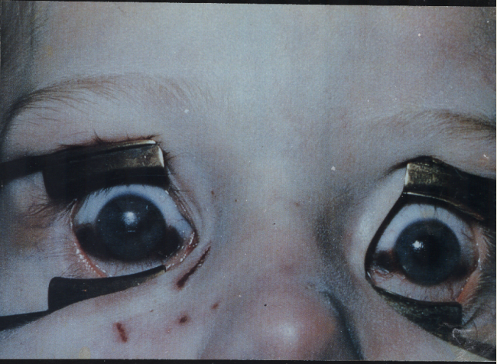
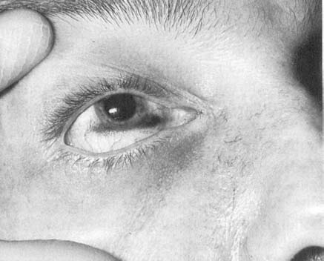
Taches Noires
Brownish discolouration of the sclera due to cellular debris and dust

Slide 9
Suspended Animation
It is a condition in which the vital functions of the body are at such a low level that they cannot be appreciated by clinical examination
Apparent death
This may last few seconds to minutes.
Voluntary- by yogis
Involuntary – drowning, electrocution, heat stroke, typhoid fever etc.

Slide 10
Medico-legal importance of early diagnosis of death:
1. The earliest determination of death for prompt taking of organs for transplantation purposes.
2. The legality of discontinuation of life-supporting equipments.
3. The determination of the time of death in criminal and civil problems.

Slide 11
Medico-legal importance of early diagnosis of death:
4. Early determination of death at time of epidemics is desirable.
5.Differentiation between death and suspended animation (death-like state), to prevent premature burial: involuntarily, voluntarily.

Slide 12
Brain death:
Cortical death
Brain stem death

Slide 13
Vegetative state
Def:
is a condition of patients with severe brain damage who were in a deep coma with persistence of spontaneous breathing and cardiac function.
It is classified as a Permanent Vegetative State (PVS) after approximately 1 year of being in a Persistent Vegetative State which is called so after 4 weeks in a Vegetative State (VS).

Slide 14
Criteria of brain stem death:
• The patient must be in a deep coma (depressant drugs, metabolic or endocrine disorders or hypothermia must be excluded).
• The patient must be on mechanical ventilation (neuromuscular blocking agents and curare like drugs must be excluded).
• No sever metabolic or endocrine disturbance.

Slide 15
Firm diagnosis of the cause of death, has been persistent for at least 6 hours.
Absence of motor response to painful stimulation.
Absence of brain-stem reflexes: these tests should be done in the following order, if any of these reflexes are preserved, no need to proceed any further.

Slide 16
diagnosis of brain stem death:
Exclusions
The patient should not be under the effect of drugs.
The core temp. should not be below 35˚C .
The patient should not be suffering from severe metabolic or endocrine disturbance.

Slide 17
personnel
The tests should be performed by two medical practitioners each separately .
The doctors involved should be experts in this field…….No transplant surgeons.
At least one of the doctors should be a consult not junior
Each doctor should perform twice separately with an interval 6 hours at least.

Slide 18
Tests:
Absent papillary response to light.
Absent corneal reflex.
Oculocephalic reflex (doll’s eye) is absent.
Vestibulo-ocular reflex is negative when ice-water is introduced into the ears.
Pharyngeal and tracheal reflexes are absent (gagging and coughing).

Slide 19
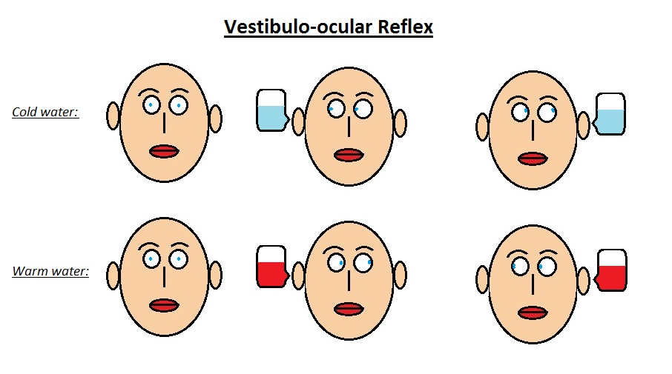

Slide 20
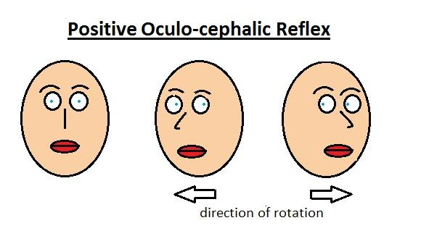

Slide 21
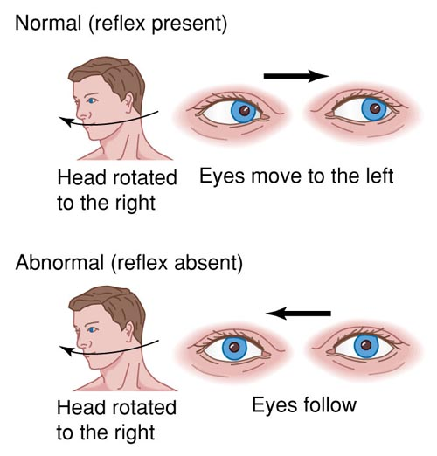
Doll's eye sign

Slide 22
Testing for apnea (failure of spontaneous respiration)
if all previous clinical tests are lost, an apnea test should be done.

Slide 23
N.B.:
Testing must be carried out with a core temperature not less than 35⁰C to avoid hypothermia.
The tests should be repeated at least once.

Slide 24
Death Certification:
This is provided by the doctor where death is known or believed to be due to natural disease and where there are no suspicious or unusual circumstances.

Slide 25
The medical cause of death is divided into two parts:
Part I: Conditions which led directly to death:
Part II: Other conditions, not related to part I, but also contributed to death.
Mode of death:
The mode of death refers to the abnormal physiological state that pertained at the time of death e.g.: Coma, cerebral hemorrhage, hypertension, congestive cardiac failure, cardiac arrest, pulmonary edema, syncope, and cardio-respiratory failure.

Slide 26
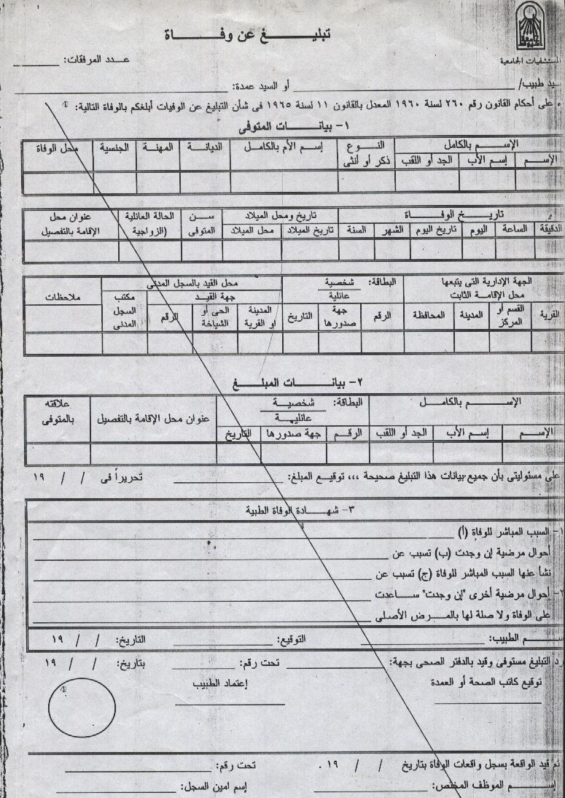

Slide 27
Death Certification:
A male patient aged 45 years was admitted to ICU following severe hematemesis . Antishock measures together with blood transfusion were given , patient was diagnosed as bilharzial hepatic fibrosis, ascitis and bleeding esophageal varices. Few hours later the patient passed into coma and died . Write the death certificate.

Slide 28
أ السبب المباشر للوفاه : توقف بالدورة الدموية و القلب
ب تسبب عن : تليف الكبد ادى الى فشل بوظائف الكبد و دوالى بالمرىء ادى انفجارها الى قىء دموى
ج تسبب عن : الاصابة بالبلهارسيا
احوال مرضية ساعدت :----------

Slide 29
Death Certification:
A female patient had cancer breast and was treated surgically. After 3 years bone scanning revealed bone metastasis, radiotherapy started. a month later she developed dysnea and hemorrhagic pleural effusion . Tomography revealed pulmonary metastasis. The dysnea get worse and the patient died .Write the death certificate.

Slide 30
Postmortem
Changes

Slide 31
1-Cooling of the Body After Death: algor mortis
Imbalance between heat production and heat loss.
Loss of heat of body by means of evaporation, conduction convection and radiation, till it balances with the temperature of surroundings.
Rate of cooling is fast during first few hours and later slows.

Slide 32
Factors affecting rate of cooling:
The temperature gradient between the body and the environment.
The initial body temperature.

Slide 33
Body insulators.
Active air currents.
The medium around the body.
The surface area of the body in relation to its weight.
Posture.

Slide 34
2-Hypostasis or Postmortem Lividity:
Definition:
Postmortem hypostasis is bluish-red discoloration in the dependent areas of the deceased skin, tissues and internal organs.

Slide 35
Hypostasis or Postmortem Lividity:
Mechanism:
It is due to cessation of circulation and settling of blood by gravitational forces within dilated toneless capillaries and venous bed.

Slide 36
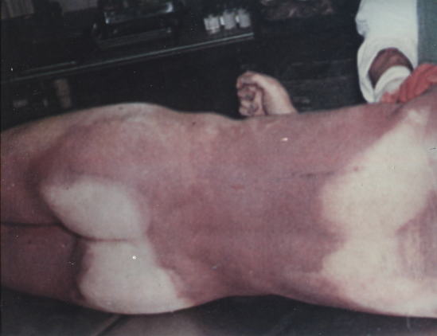

Slide 37
Factors affect the amount and extent of hypostasis:
The amount of blood left in the circulation after death.
The period of fluidity of this blood in the body.

Slide 38
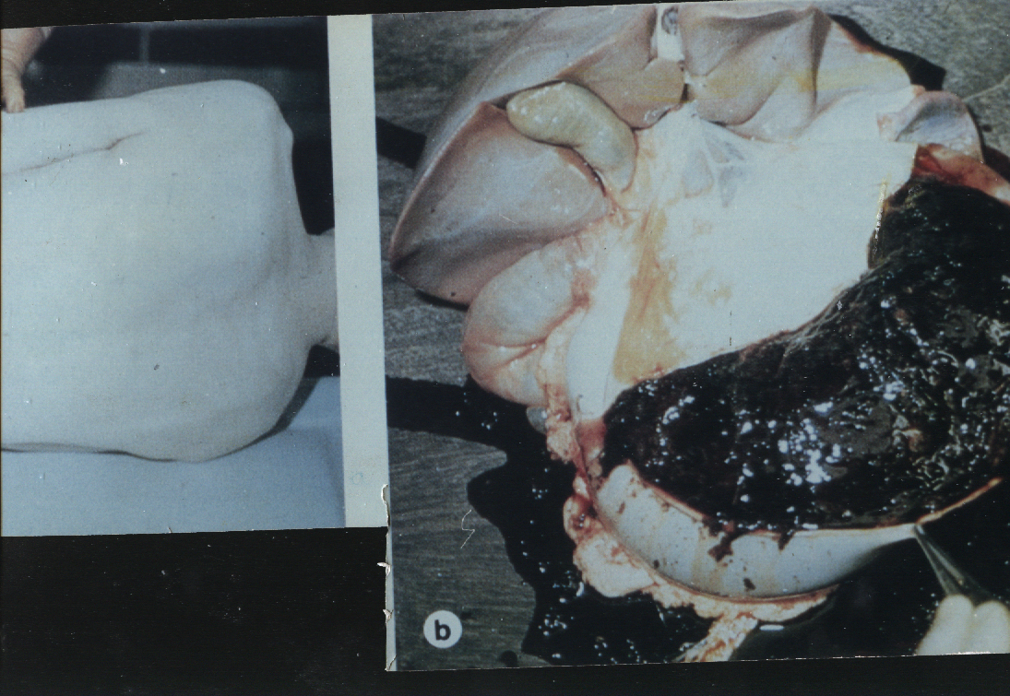

Slide 39
4-Appearance and disappearance:
Timing of hypostasis
Variable (30-60m)
Completted (6-12 h)
Fixation

Slide 40
5- Distribution of hypostasis:
*Posture of body
*Supine
*Prone
*Hanging
*Drowning
*Internal organs

Slide 41
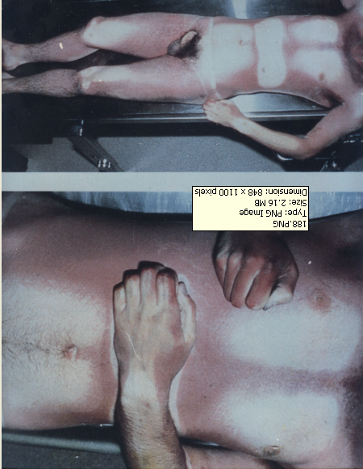

Slide 42
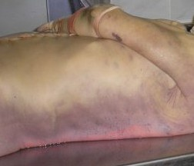

Slide 43
6- Colour of hypostasis:
*red hypostasis
*Brown
*bronze

Slide 44
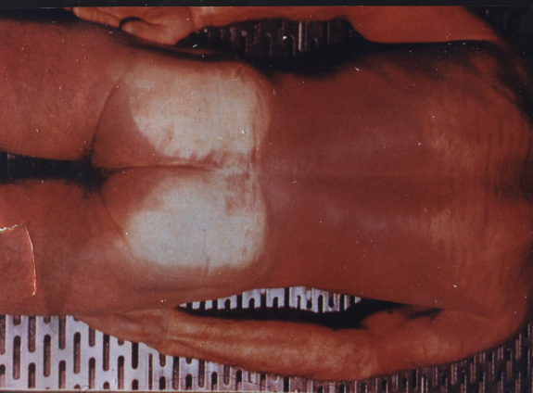

Slide 45
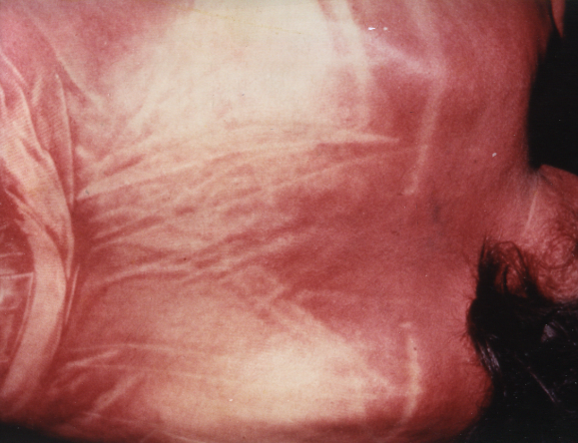
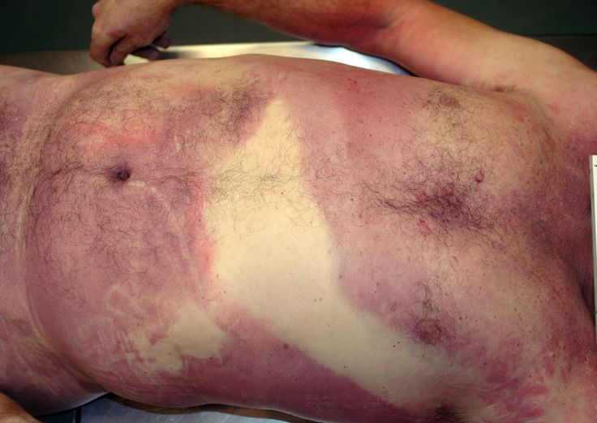

Slide 46
7- Medico-legal importance:
*Sure sign.
*Position.
*Time passed since death.
*Cause of death

Slide 47
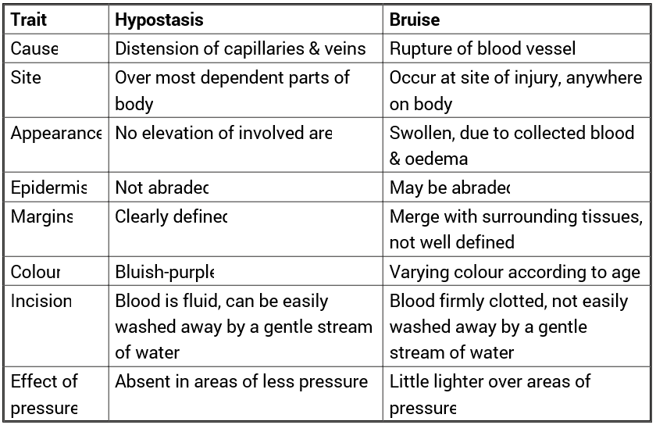
8-Differentiation between hypostasis and contusion (bruise).

Slide 48
Rigor mortis:
Definition:
It is a state of stiffening that affects most of dead bodies at a variable time after death, then, passes off to allow secondary flaccidity. It affects skeletal, cardiac and involuntary muscles.

Slide 49
Physicochemical basis of rigor mortis
(Mechanism):
It is due to an irreversible combination of actin and myosin within the muscle fibers.
During life.
ATP - P ADP
Glycogen ------------- lactic acid + energy
+ P
After death:

Slide 50
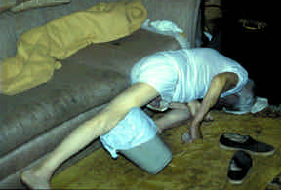
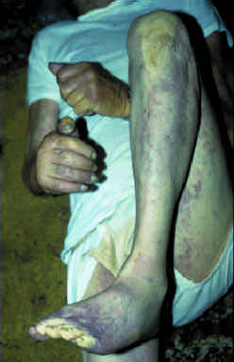

Slide 51
Estimation of time since death from rigor mortis:
Rigor may be first detectable within 1-4 hours in the face and within 4-6 hours in the limbs, increases progressively to a maximum within twelve hours, remains ‘for about twelve hours and then progressively disappears within 12 hours.
Secondary flaccidity becomes apparent from 24 to 50 hours after death.

Slide 52
Rigor Mortis
Body warm not stiff less than 3 hours
Body warm stiff 3-8 hours
Body cool stiff 8-36 hours
Body cool not stiff more than 36 hours

Slide 53
Factors affecting rigor mortis:
Temperature.
Muscular activity.
Muscular development.

Slide 54
Broken rigor

Slide 55
Conditions simulating rigor mortis
Cadaveric spasm.
Heat stiffening.
Cold Stiffening.

Slide 56
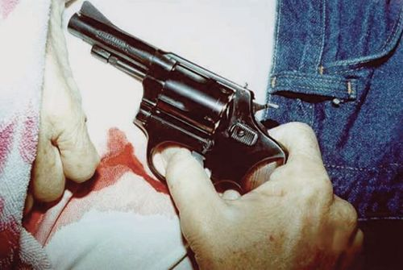
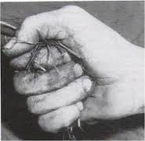
Cadaveric spasm

Slide 57
Differentiation between rigor mortis and cadaveric spasm:
 | Rigor mortis | Cadaveric spasm
Type of death. | Nearly all types. | Death accompanied by fear, excitement or severe pain.
Time since death. | Takes some time to develop. | Instantaneous.
Muscles affected. | Voluntary, involuntary and cardiac. | Some voluntary muscles only.
Nature | Physicochemical process. | Partially neurogenic

Slide 58
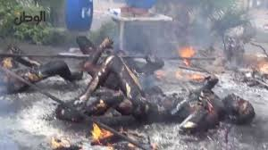
Heat stiffening
Boxer or pugilistic

Slide 59
DD between heat stiffness and cold stiffness

Slide 60
Post-mortem decomposition:
The disintegration of body tissues after death is known as decomposition. It follows the arrest of biochemical processes, which preserve the integrity of tissues. This decomposition is brought about by chemical processes (mostly enzymatic), bacterial and fungal attack and predation by many varieties of animal life.

Slide 61
Putrefaction
This is the usual course of decomposition (moist degeneration)
Greenish discoloration of the skin of the right iliac fossa.
- Marbling Appearance

Slide 62
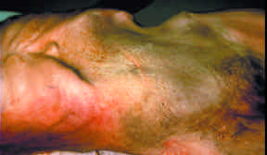

Slide 63
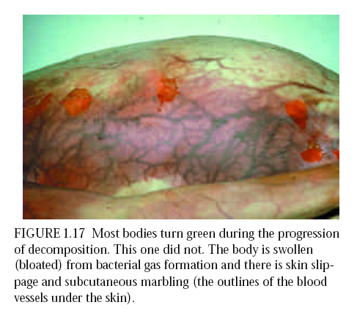

Slide 64
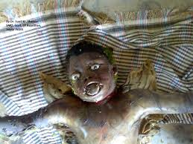

Slide 65
-At the end of the first week will be:
1-Generalised discoloration of the skin.
2-Swelling of the body.
3- Bloating of face.
4-Protrusion of the tongue and eyes.
5-Blood-stained froth.
6-Expulsion of the contents of the intestine and gravid uterus.
-Formation of large bullae and blisters.

Slide 66
- At the end of the second week:
1- Skin of the hands and legs sheds in glove-like fashion, a stocking-like pattern.
2- Hair becomes loose.
3- The body cavities burst.
4- The tissues progressively liquefy.

Slide 67
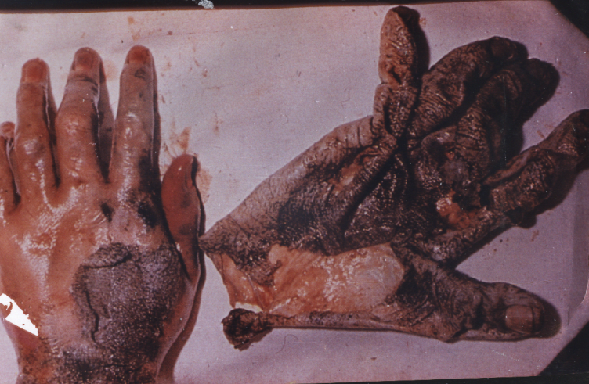

Slide 68
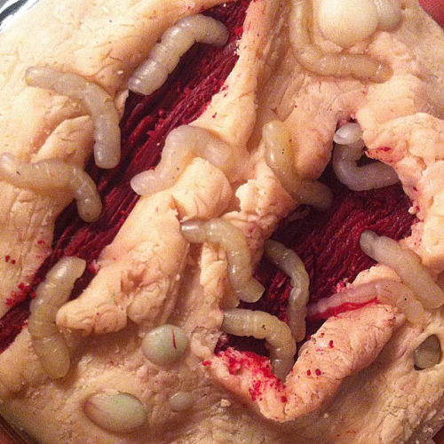
5- Destruction by maggots
* Disappearance the liquefied soft tissues leaving the cartilage, tendons and ligaments attached to the skeleton in one or two years: (bare-bone skeleton)

Slide 69
Factors affecting the rate of putrefaction:
All conditions which help invasion of the body by micro-organisms, or their growth and multiplication affect putrefaction.
1. Temperature.
2. Humidity.
3. Medium.
4. Causes of death.
5. Age and state of the body.

Slide 70
Adipocere formation:
Adipocere formation is alternative to putrefaction. It is a chemical change of the body fat which converts it by hydrolysis and hydrogenation to a waxy compound.
Requirements:
* Wet conditions
* Some warmth? occurs even in deep graves and cold water.

Slide 71
Characters of Adipocere:
• In early stages: adipocere is greasy, resembling pale rancid butter having a ‘disagreeable smell.
•After some years: it becomes grayish ­white and brittle and the smell becomes less evident.
hydrolysis & hydrogenation
body fat ----------------------> adipocere formation
lecithinase enzyme

Slide 72
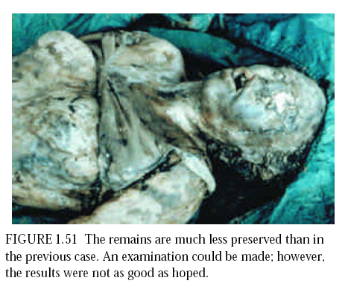

Slide 73
2-Mummification:
A) Natural mummification:
It is a post-mortem change where tissues may desiccate instead of undergoing moist degeneration.
Requirements:
a) Dry environment, with a moving air current.
b) Hot weather? can occur in cold weather.
Characters: The mummified tissue is dry, leathery and brown in color. The tissues are dehydrated and the skin stiffened and stretched over the face like a mask.

Slide 74
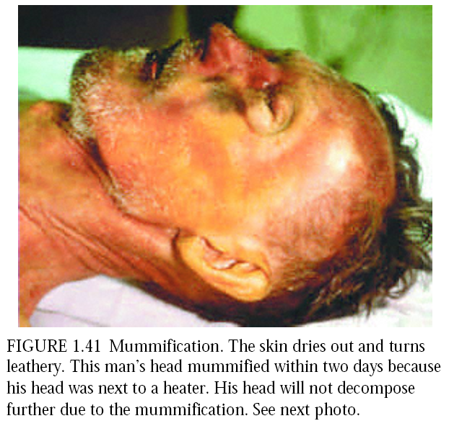

Slide 75
B)Artificial mummification (Embalming):
It is the artificial preservation of the dead body to prevent its decomposition.
· Embalming procedure usually includes:
· The application of cosmetic cream to the face and
hands of the deceased.
· Covering of the eyes under the eyelids.
· Fixation or wiring of the jaws.
· Injection of embalming fluids in the neck (carotid), axilla (axillary) and groin (iliac and femoral) arteries.

Slide 76
Embalming fluids contain various mixtures of formaldehyde, glutaraldehyde, alcohols and other preservatives (e.g. hexylresorcinol, phenol, methylsalicylate, sodium benzoate and EDTA).
Drawbacks of embalming.

Slide 77
Medico-legal importance of mummification
1. It gives an idea about the place in which the body has been found (dry places).
2. It helps in personal identification.
3. It gives information about the cause of death (as in adipocere formation).
4. It indicates the time passed since death.

Slide 78
3-Maceration:
Maceration is an autolytic process (self-disintegration)
The macerated fetus is characterized by:
• Reddish-brown coloration of the skin which is changed to greenish-brown.
• Peeling of the skin.
• Flaccidity, separation and overlapping of the cranial bones.
• Dislocation of the tempromandibular joints
Accumulation of haemolyzed blood and fluid in the body cavities.
• Spalding sign.

Slide 79
Cremation.
disposal of the dead body by burning. It is done in some parts of the world, such as India, only in natural undoubtful causes of death.

Slide 80
Exhumation:
Getting a previously buried body out of its grave for post-mortem examination to declare the actual cause of death. It is usually applied to a body buried in a legitimate fashion when there are new information.

Slide 81
Estimation of the Time Passed Since Death
The postmortem interval
I— Postmortem changes:
Response of the muscles to electric stimulation.
Ocular changes Rate of cooling.
Extent of hypostasis. Extent of rigor mortis.
Extent of putrefaction. Adipocere formation,
Mummification.

Slide 82
2- Entomology of the dead body:
3- Bicohemical changes :
a.) Rate of increase of lactic acid and non-protein nitrogen in C.S.F.
b.) PH and lactic acid in the muscles.
c.) Changes in the chemical composition of the vitreous and aqueous humour.
d.) Lactic dehydrogenase in the cardiac muscle decreases gradually until it disappears at the end of one month.
e.) PH of the blood, its glucose level and haematocrit value.

Slide 83
4- Physiological changes:
Phagocytic activity and death rate of
leucocytes.
5- Histological changes:
Changes in the hepatic cells and their nuclei.

Slide 84
6- Gastric and intestinal content (Time since last meal):
-Type of the ingested meal
-The gastric tone
- The pyloric function
- The psychological condition
- Stomach: 2 to 4 hours.
- Hepatic flexure: 6 hours.
- The splenic flexure: 9 to 12 hours.
- The pelvic colon: 12 to 18 hours.

Slide 85
Sudden and Unexpected Death From
Natural Causes in Adults

Slide 86
The WHO definition of a sudden death is someone who dies within twenty four hours of symptoms appearing. Causes of sudden and unexpected death.

Slide 87
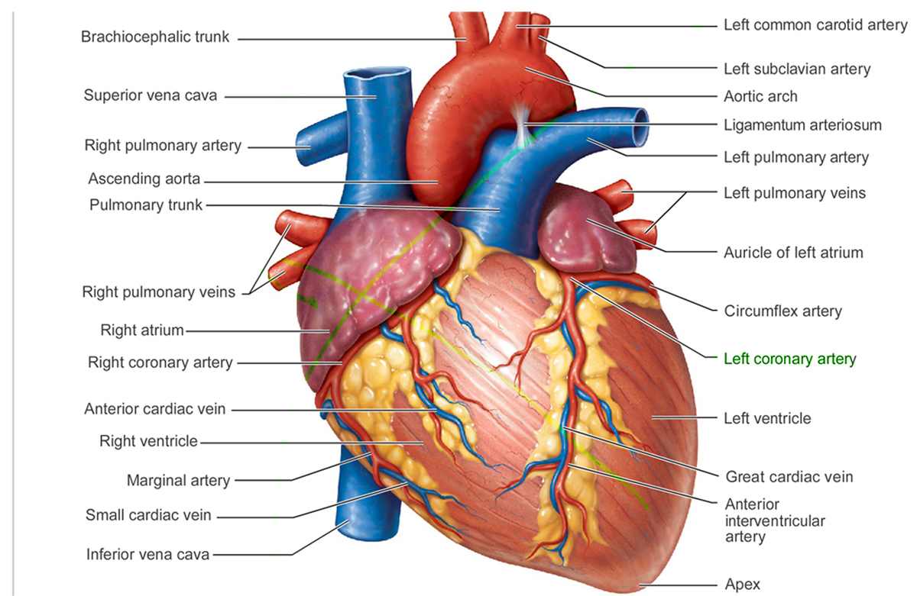

Slide 88
1-Sequelae of coronary occlusion:
a) Coronary insufficiency
b) Complications of atheroma
i) Rupture of ulcerative atheromatous plaques.
ii) Sub-intimal hemorrhage.
iii) Mural thrombus.

Slide 89
2- Hypertensive heart disease
3- Aortic stenosis
4- Myocardial disease:
Primary myocardial disease:
- Myocarditis.
- Myocarditis of unknown aetiology
5- Diseases of arteries

Slide 90
II- Causes in the C.N.S.:
1- Intracranial hemorrhage ‘apoplexy’.
2- Fulminating infection.
3- Tumors or abscess.
4- Epilepsy.

Slide 91
Ill- Causes in respiratory system:
1- Pulmonary embolism.
2-Acute oedema.
3- Acute fulminating infection.
4- Bronchial asthma.

Slide 92
IV)- Causes in gastro-intestinal tract:
Acute hemorrhagic pancreatitis, biliary or intestinal obstruction, acute appendicitis, rupture gut, hemorrhage due to carcinoma or varices.
V)- Causes in uro-genital system:
Ruptured ectopic gestation, twisted ovarian cyst, uremia and eclampsia.
VI) Miscellaneous causes:
Metabolic disorders, fevers, blood diseases.

Slide 93
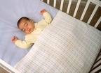
Sudden Infant Death Syndrome
(SIDS)

Slide 94
Definition:
Sudden infant death syndrome ‘SIDS’ is defined as, the sudden death of an infant which is unexpected by history and in whom a thorough autopsy fails to reveal an adequate cause of death. ‘Cot death’ or ‘Crib death’.

Slide 95

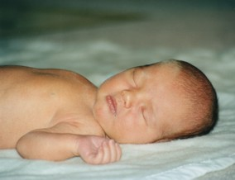

Slide 96
1- The accepted age range is between 2 weeks and 2 years.
2- More common in males.
3- The incidence is markedly greater in one of a twin pair, whether identical or not.
4- ‘SIDS’ is far more common in the colder and wetter months.
5- A higher incidence occurs in low socioeconomic classes.
6- The great majority of these infants are found dead between midnight and 6 a.m.

Slide 97
Theories:
- Allergy to cows milk or house-mites.
- Prolonged sleep apnea.
- Botulism.
- Spinal hemorrhages.
- Muscle hypotonia.
- Liver enzyme, selenium or vitamin E deficiencies.
- Carbon monoxide or dioxide poisoning.
- Hyperthermia or hypothermia.
- Various metabolic defects and many others.

Slide 98
Thank you

