Slide 1

NEURO PRATCICAL
Section 1
Histology Department
Sohag University
Faculty of Medicine
Block 213-NEU
Neuroscience system

Slide 2
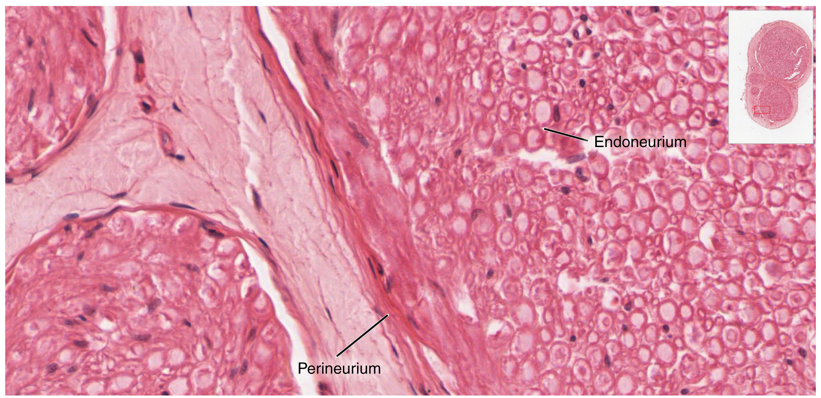
Nerve trunk H&E

Slide 3
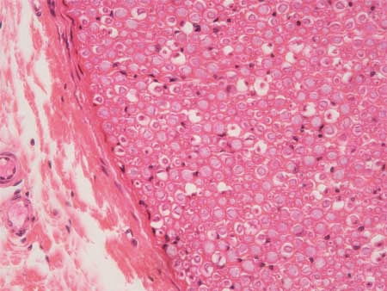
Nerve trunk H&E

Slide 4
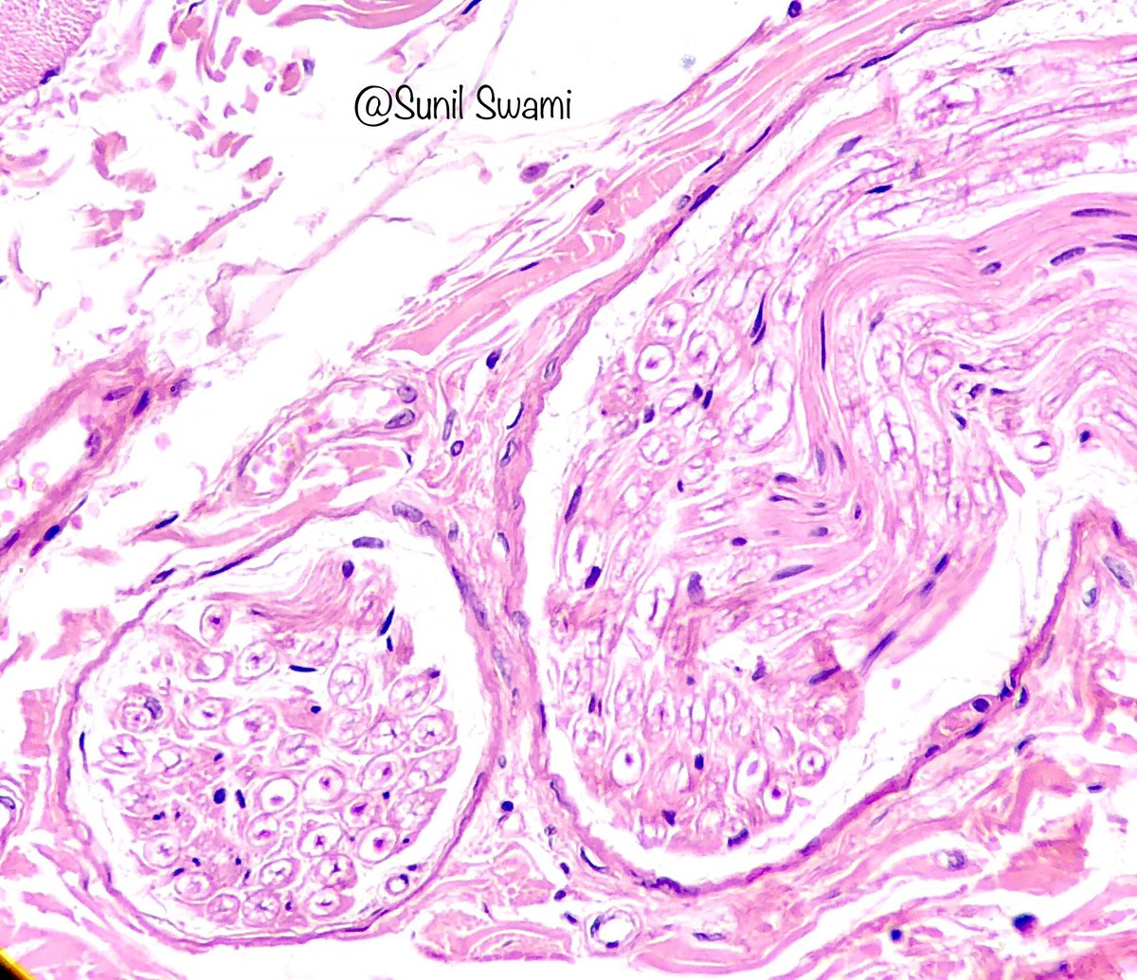
Nerve trunk H&E
Axon
Schwann cell
Myelin sheath

Slide 5
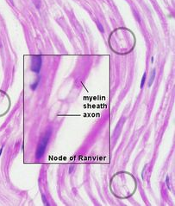
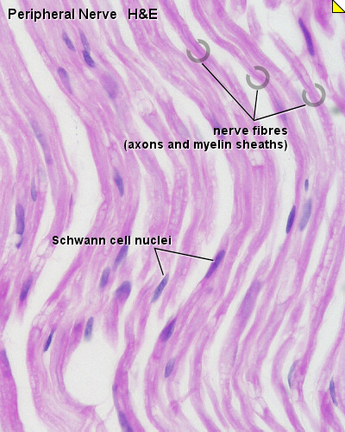
Nerve trunk H&E
Node of Ranvier

Slide 6
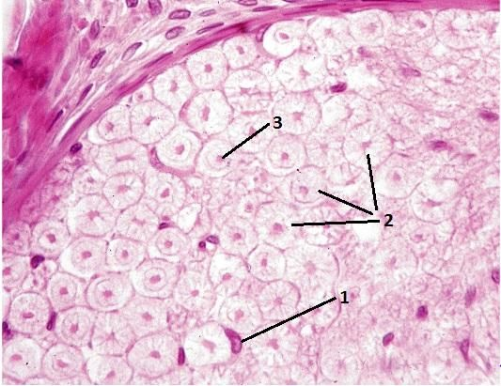
Axon
Myelin sheath
Schwann cell

Slide 7
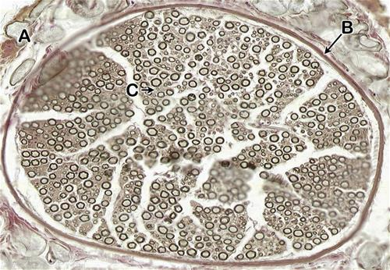
Nerve trunk Osmic stain
Myelin sheath
perineurium
epineurium
endoneurium

Slide 8
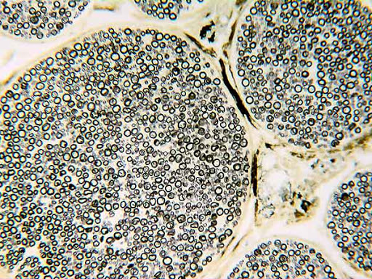
Nerve trunk Osmic stain
Myelin sheath
perineurium

Slide 9
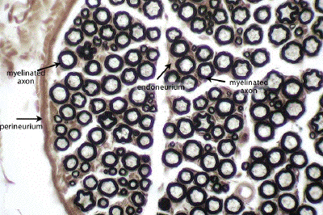
Nerve trunk Osmic stain

Slide 10
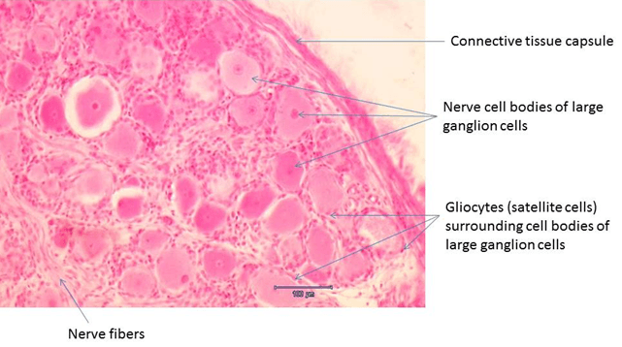
Spinal ganglion

Slide 11
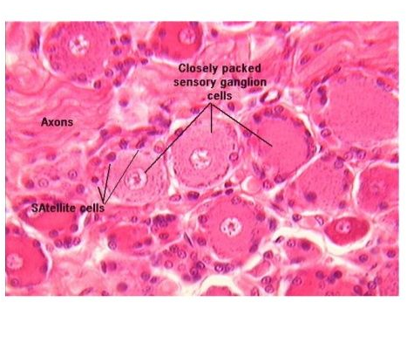
Spinal ganglion

Slide 12
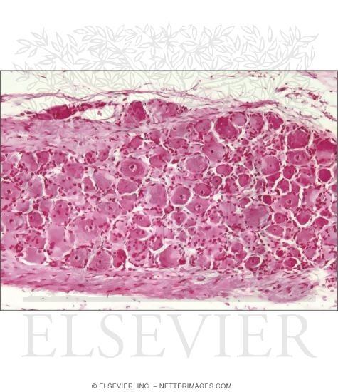
Spinal ganglion
Satellite cells
Sensory Nerve cell
capsule

Slide 13
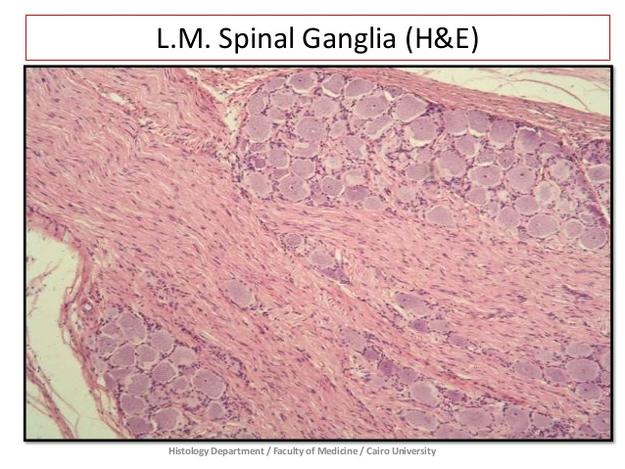
Sensory Nerve cell
Myelinated nerve fiber
capsule

Slide 14
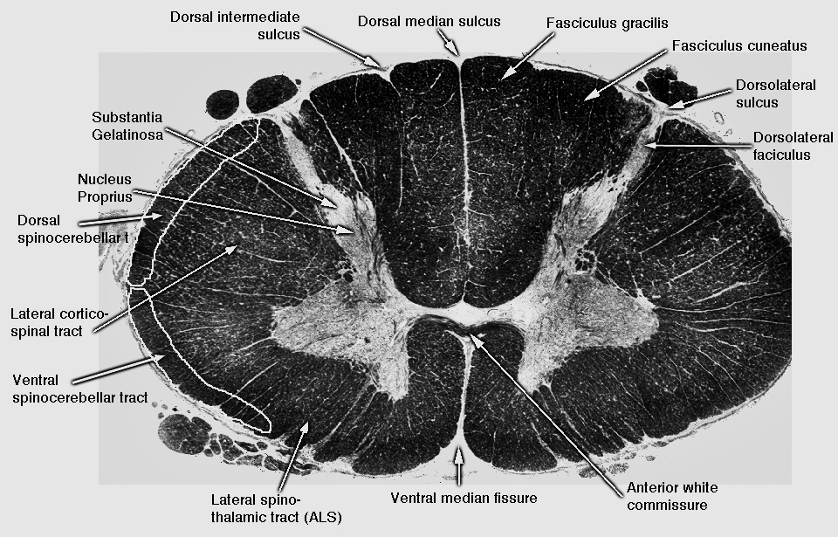
Cervical level of spinal cord

Slide 15
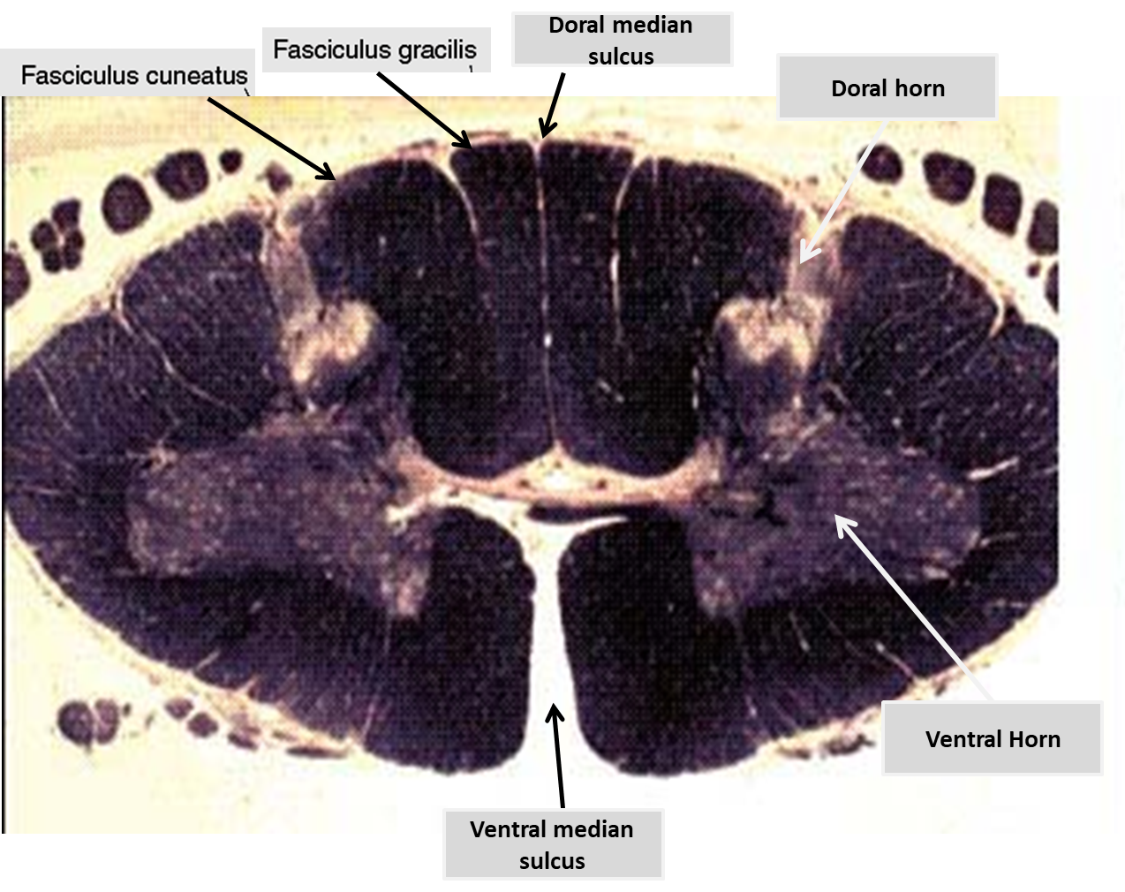
Cervical level of spinal cord

Slide 16


