Slide 1
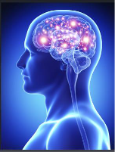
NEURO PRATCICAL
Section 2
Histology Department
Sohag University
Faculty of Medicine
Block 213-NEU
Neuroscience system

Slide 2
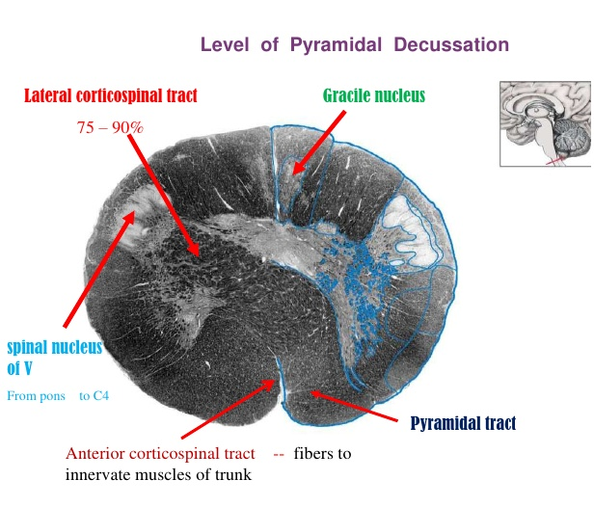
Lower medulla, Motor Decussation
Cuneate tract

Slide 3
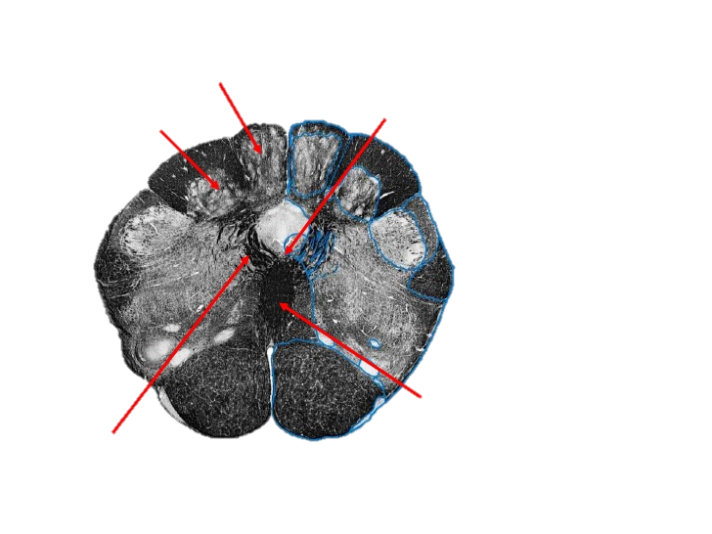
closed medulla, Sensory Decussation
Gracile nuclei and tract
Cuneate nuclei and tract
spinal nuclei and tract of trigeminal
Spinocerebellar
tract
Medial lemniscus
Decussation of arcuate fibers
Internal arcuate fibers
Pyramid

Slide 4
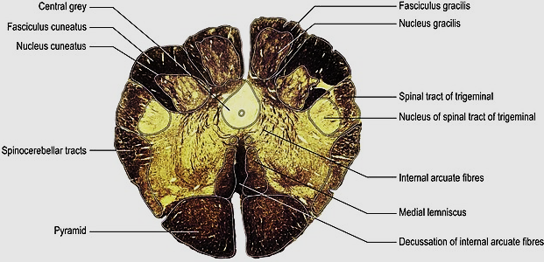
closed medulla, Sensory Decussation
Gracilis tract
Cuneate tract

Slide 5
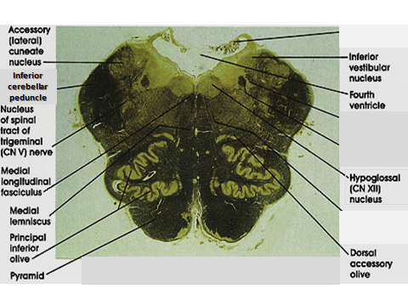
Open medulla

Slide 6
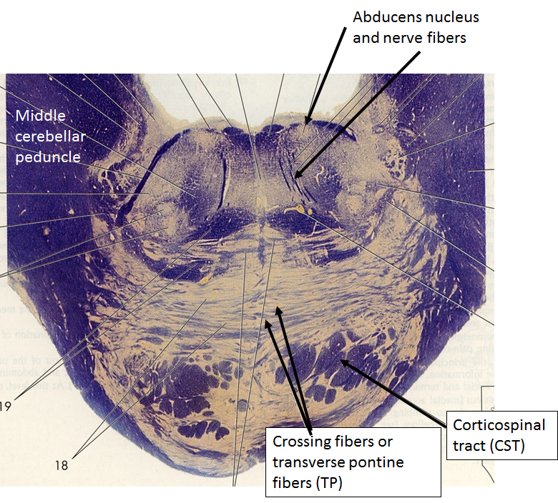
inferior level of pons

Slide 7
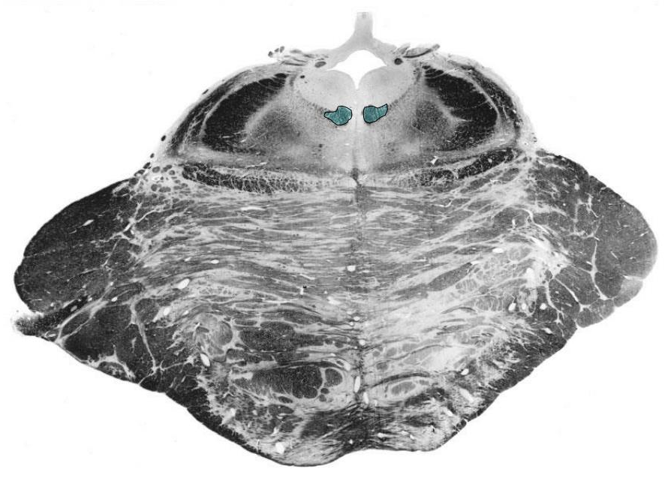
Mid level of pons
4th ventricle
Abducent
nerve N
Superior
Cerebellar
peduncle
Trigeminal
nerve N
Medial
lemniscus
Middle
Cerebellar
peduncle
Pontine
Nuclei
Transverse
pontine
fibers
Cortico-spinal
tract

Slide 8
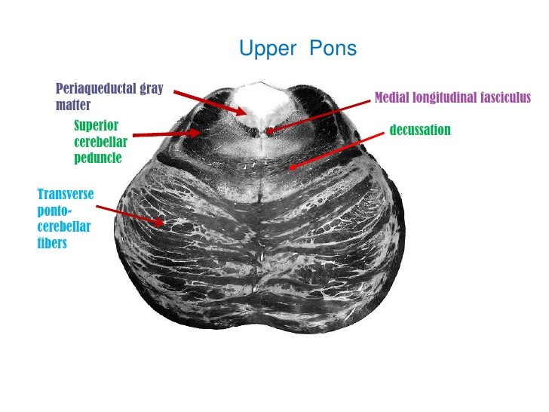

Slide 9
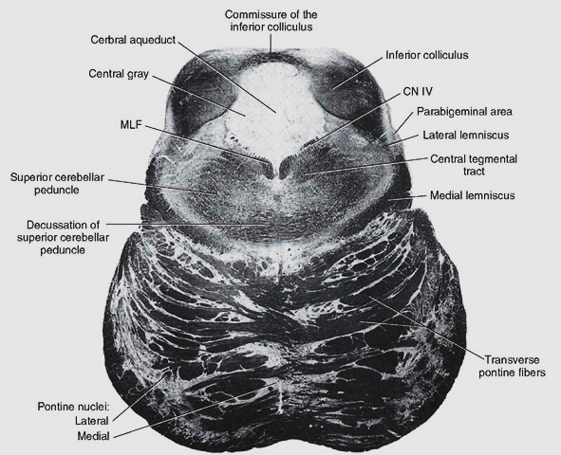
Superior level of the pons
Medial longitudinal bundle

Slide 10
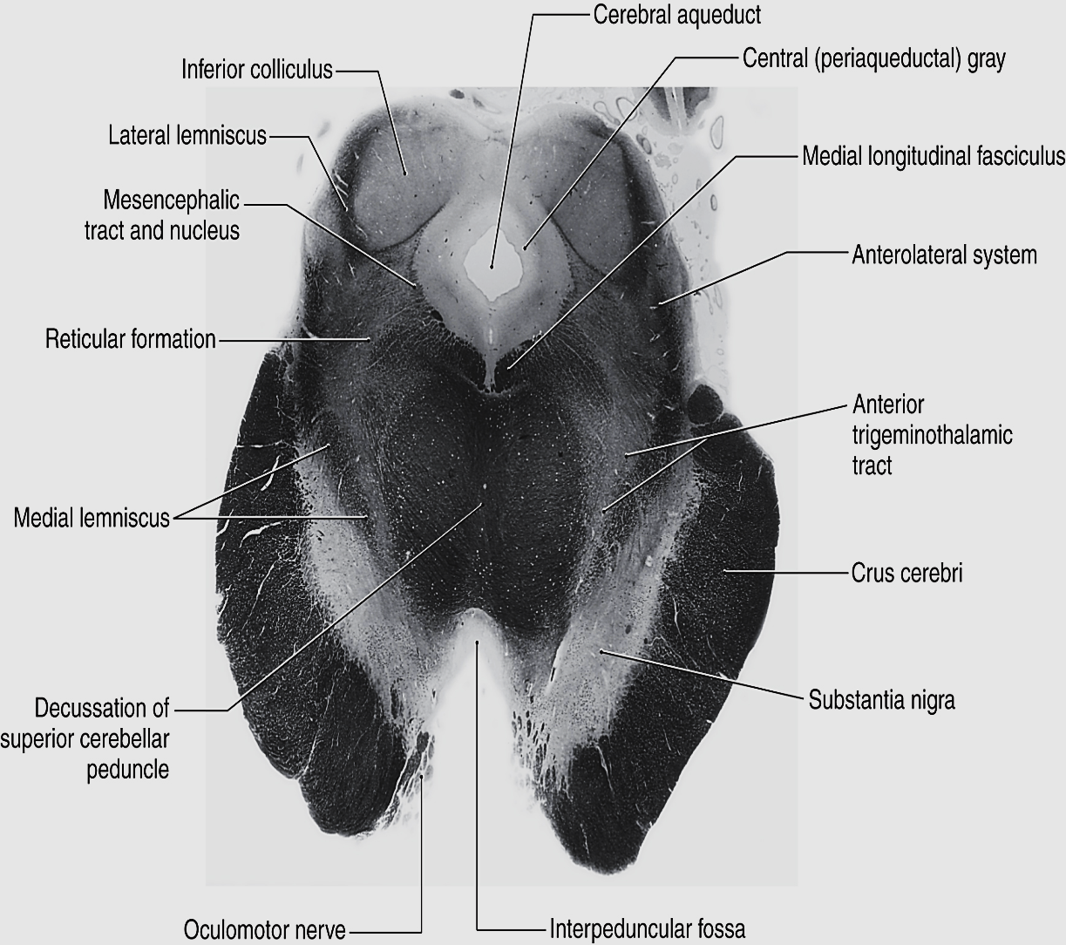
Inferior level of mid brain

Slide 11
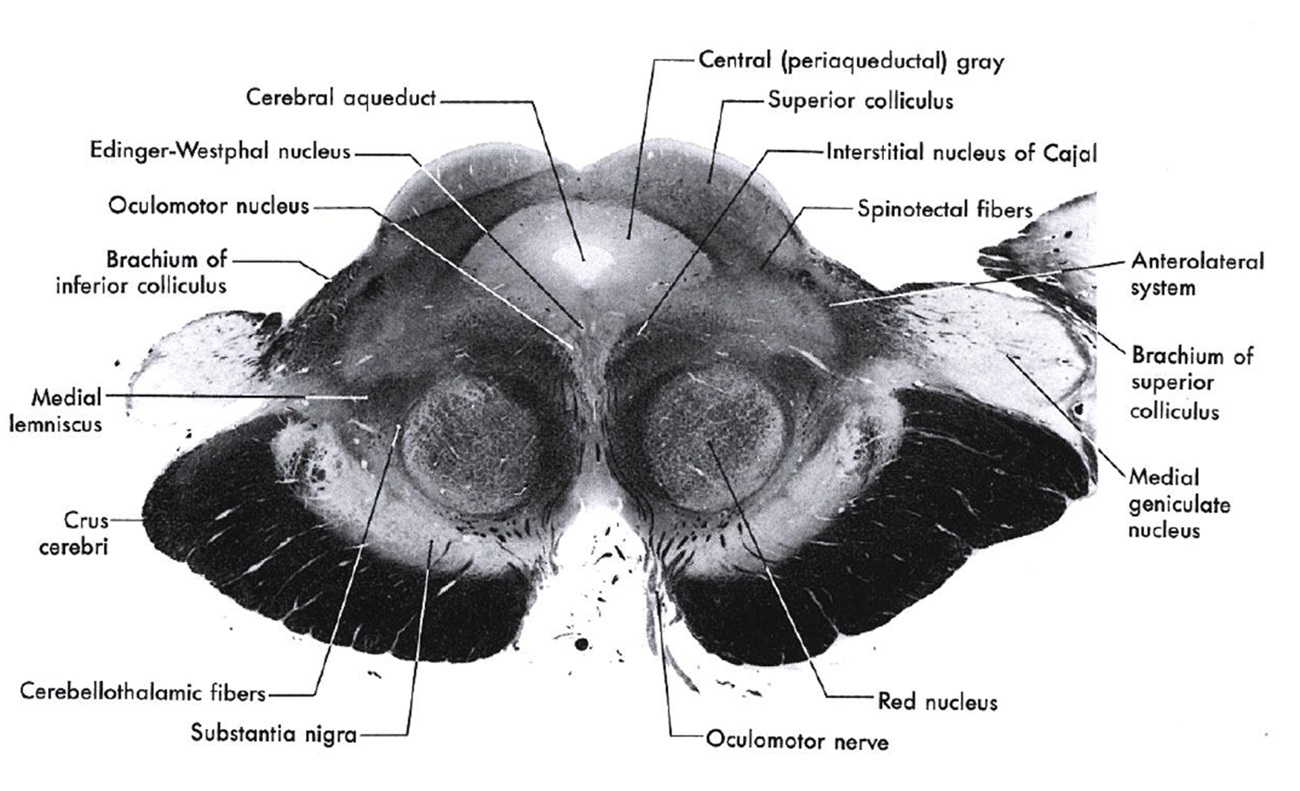
Superior level of mid brain

Slide 12


