Slide 1
PROM AND PPROM
By
Allam M. Abdelmonem, M.D
Professor & Head of Ob/Gyn Dpt
Sohag University, 2020

Slide 2

Objectives
Define premature rupture of the membranes (PROM) and preterm PROM (PPROM).
Describe clinical presentation of patients with PROM.
List the diagnostic tests to confirm PROM.
Describe the etiology and risk factors for PROM.
Compare the risks and benefits of conservative expectant management and immediate delivery.
Describe the methods used for maternal and fetal monitoring during expectant management.
Discuss the drugs used in the management of PPROM in terms of indications, contraindications and side effects (antibiotics, tocolytics, and glucocorticoids).
Describe the management of chorioamnionitis.

Slide 3
Introduction
Amniotic fluid starts to be continuously produced approximately 16 weeks gestation. it is primarily dependant on fetal urine production.
Amniotic fluid allows for fetal movement and breathing which are important for fetal skeletal, lung and chest development.
Decrease or absent amniotic fluid can lead to compression of the umbilical cord and decrease placental flow.
Disruption of the fetal membranes leads to a loss of these protective effects and the developmental roles of amniotic fluid.

Slide 4
Definitions
Premature ROM (PROM) : Amniorrhexis Prior to the onset of labor at any gestation
Preterm ROM (PPROM): PROM prior to 37 weeks gestation
Latency Period: time interval between ROM and onset of labor
Expectant management: management of patients with the goal of prolonging gestation (“watchful waiting” until delivery indication arises)
Notes:
It is important to differentiate between Premature ROM/Preterm ROM/Premature/Preterm ROM.

Slide 5
Premature rupture of the membranes (PROM) and preterm PROM (PPROM)
PROM
PPROM
Preterm premature rapture of membranes occurring before 37 weeks estimated gestational age
Premature rapture of membranes before the onset of labor
labor is defined as progressive dilation and effacement of the cervix in response to regular uterine contractions that occurs at least every 5 minutes and last 30 to 60 seconds.

Slide 6
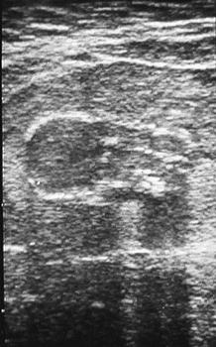
Incidence-Preterm ROM
8 % of pregnancies for PROM
3 % for PPROM
30-40% of Preterm births
PPROM ~25% cases of all PROM

Slide 7
The Etiology and risk factors for PROM
The etiology of PROM remains unclear.
The risk factors for PROM (anything that weakens the strength of the choreo amniotic membrane) including:
  vaginal and cervical infections (An ascending infection from the vagina will weaken these membranes so sexually transmitted infections and other lower genital tract infections such as bacterial vaginosis play a role as risk factors).
  A short cervix or an incompetent cervix.
The risk for PROM is doubled for women who smoke.
A history of prior PROM.
Abnormal membrane physiology.
Polyhydraminios and multiple gestations will basically descend the choreo amniotic membranes.
Other risk factors are similar risk factors for preterm delivery including a prior preterm delivery, bleeding during pregnancy, low socioeconomic status and low body mass index.

Slide 8
Risk Factors
Chorioamnionitis
Vaginal infections
Cervical abnormalities : cervical insufficiency, cervical conization.
Vascular pathology (incl. abruptio)
Smoking
1st, 2nd, 3rd, or multiple trimester bleeding
Amniocentesis
Previous preterm delivery (PPROM)
AA ethnicity
Low BMI
Acquired or congenital connective tissue disorder
Nutritional deficiencies (Vit.C, copper, zinc)
Low socioeconomic status
Illicit drug use
Pulmonary disease in pregnancy
Notes:
Items highlighted in gray are major risk factors.
A portion of patients with PROM have a slightly higher incidence of pathologic microorganisms and a higher rate of histological chorioamnionitis.
The Frequency of PPROM is higher in women with specific lower genital tract infections such as Bacterial Vaginosis, trichomonas.
Small risk of PROM with history of 2 or more spontaneous abortions. Theory that those with shortened or incompetent cervix can allow for bacteria to ascend easier into the uterine cavity and/or weaken membranes.
Vascular Pathology can include (less commonly) vascular or placental abnormalities, and (more commonly) abuptio placenta. Postpartum Histological exam of placentas often have clinical or sub-clinical abruptions.
Differences in research of risk between how much women smoke during pregnancy and PROM, however majority of literature correlates a risk of smoking in pregnancy and PROM.
Vaginal bleeding in any trimester is a major risk factor of PROM. The risk increases as the trimester bleeding increases. Some literature suggests bleeding more than one day and/or multiple bleeding episodes put women at higher risk.
Women who have had a previous PROM have a higher risk of PROM in a subsequent delivery.
Majority of literature suggests increased risk of PROM in African American women and did not find any increase in risk in Caucasians.
Acquired/Congenital connective tissue disorders such as Ehler-Danlos, that interfere with collagen (weak membranes)
Vitamin C deficiency. Vit. C is involved in the synthesis of collagen and plays a role in the maintenance and integrity of membranes. Studies have also shown that Copper and Zinc levels were lower in patients with PROM.
No consistent link reported between sexual intercourse, pelvic exams (SSE).

Slide 9
Diagnosis
Clinical picture:
  Vaginal discharge
  Gush of fluid
  Leaking of fluid
  Oligo/Anhydramnios
  Cramping
  Contractions
  Back pain
The classic clinical presentation of PPROM is a sudden "gush" of clear or pale yellow fluid from the vagina. However, many women describe intermittent or constant leaking of small amounts of fluid or just a sensation of wetness within the vagina or on the perineum.
It can be confusing during pregnancy because there are many fluids that can mimic amniotic fluid (e.g. urine, normal vaginal secretions of pregnancy, increase cervical discharge, semen or perineal sweat).

Slide 10
Diagnosis of PROM is based on the history of vaginal loss of fluid and confirmation of amniotic fluid in the vagina.
Sterile Speculum exam (Pooling): A sterile speculum examination should be performed to visually assess the cervix and swab for cervical gonorrhea and Chlamydia. A group B strep culture should be obtained as well. On examination Pooling of amniotic fluid can be seen (pooling refers to the filling of the speculum with amniotic fluid).
Minimize digital examination to decrease the risk of infection
Nitrazine testing
Microscopic Fern testing
Fetal Fibronectin
AmniSure
Ultrasonography should be performed to assess fetal position as well as to assess the amount of amniotic fluid.
Transabdominal Indigocarmine dye injection

Slide 11
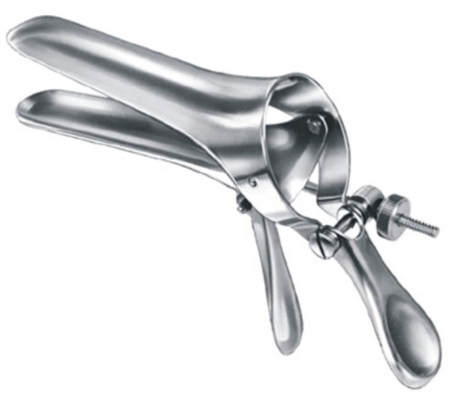
Sterile Speculum Exam
Sterile
No lubricating jelly
Pooling of fluid in posterior fornix
Free flow of fluid from cervix
Cervical dilation
Nitrazine
Collect slide for fern (dry 10 mins)
Consider need to collect other cervical tests/cultures such fetal fibronectin while doing the SSE.
Notes:
Speculum should be sterile as to not introduce microorganisms into the vaginal vault.
The use of lubricating jelly can interfere with Fern results and patient symptoms.
Examine the cervical os for dilation, freeflow of fluid, and pooling of fluid in the posterior fornix.Visualization of fluid coming from the cervical os is diagnostic. When examing cervical os, have pt Valsalva or apply fundal pressure.
While do the SSE, take the opportunity to collect any necessary cultures such as Fetal Fibronectin, Gonorrhea, Chlamydia.
Collect Fluid sample for Fetal Lung Maturity studies and cultures if needed.
Collect Fluid sample for FERN slide and swipe swab on slide and allow to dry for a full 10 minutes. False Positives and Negatives occur with fern slide.

Slide 12


Why not do a digital vaginal exam?
Digital exams are associated with an increased risk of infection and add little information to that available with speculum examination.
Digital cervical examinations should be avoided unless the patient appears to be in active labor or imminent delivery is planned.
Notes:
Digital Vaqinal exams significantly decrease the latency period in patients compared to those who only received a SSE.
In addition, the necessity in doing a digital exam is to determine cervical status, which in Preterm patients rarely alters the POC, unless delivery is imminent.
Studies also show an increase in the incidence of infection in patients with PROM who have had a digital exam, especially a higher incidence of neonatal infection in patients who had a digital exam > 24 hrs prior to delivery.

Slide 13


Nitrazine paper testing
Amniotic fluid has a ph greater than 7.1 while vaginal secretions have a ph between 4.5 to 6). Vaginal pH (3.5-4.5)
Turns blue in presence of alkaline Amniotic fluid
93.3% sensitivity
False positive (1-17%) for urine, blood, semen, BV, Trichomonas, cervical mucus, antiseptic solutions
Notes:
Vaginal pH acidic.
Amniotic fluid pH alkaline at 7.0-7.7

Slide 14

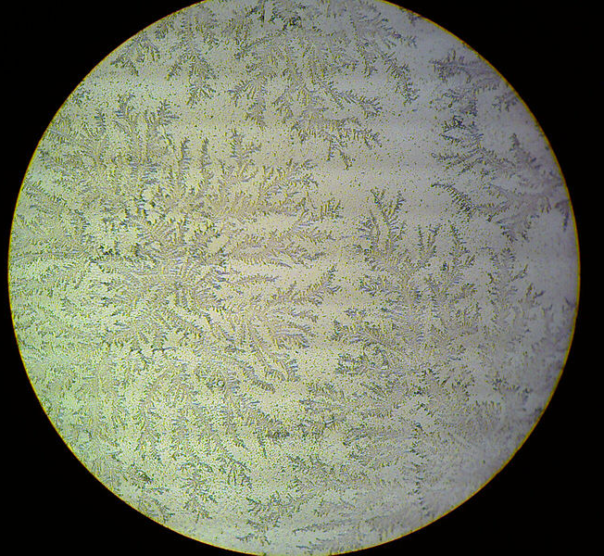

Fern slide
نبات السرخس
  Ferning which refers to the pattern of arborization when amniotic fluid is placed on a slide and is allowed to dry (branching fern leaf pattern caused by sodium chloride precipitates from amniotic fluid).
Must allow slide to dry thoroughly prior to examination under microscope. Assess for arborization of fluid.
Cervical mucous has broad, ferning pattern that is different than the fern of amniotic fluid.

Slide 15

AmniSure
Newer test
Point of Care test
Cost-up to $50 each
Sensitivity-98.7-98.9%
Specificity-87.5-100%
Awaiting further testing prior to recommendations
Notes:
Amnisure tests detect trace amounts of placental alpha microglobulin-1 protein in vaginal fluid.
Test enhanced to eliminate hook effect which caused false negative results in grossly ruptured patients.
Again, once diagnostic tool, Be sure to step back and look at the entire clinical picture.

Slide 16
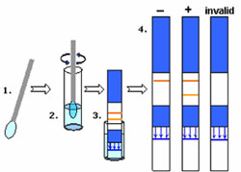
AmniSure
Remove swab and rotate in solvent x 1 min.
Read results after 5-10 mins have passed.
Place Swab 2-3 in. into vaginal canal x 1 min.
Discard swab and place test stick into solvent.
Notes:
Test is easy and quick to complete.
Results in 15 mins or less.
Point of care test can be completed at bedside and completed without SSE and even by trained staff.

Slide 17
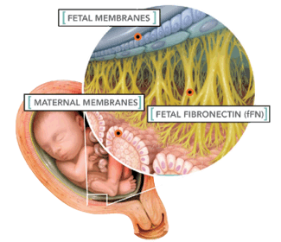
Fetal Fibronectin
fFn present in cervical secretions <22 wks, >34 wks
Used for assessment of potential preterm birth.
Positive result (>50 ng/dl) may be indicative of PROM and represents disruption of decidua-chorionic interface
In PPROM, Sensitivity-98.2%, Specificity-26.8%.

Slide 18
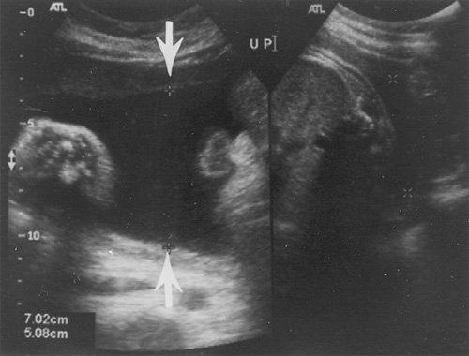
Ultrasonography
50-70% of women with PPROM have low AFV on US
Mild reduction requires further investigation
Rule out other causes (Renal agenesis, utero-placental insufficiency, obstructive uropathy)
Measure for pockets of fluid and quantitate AFV into AFI
Ultrasound showing 7 cm pocket of fluid

Slide 19
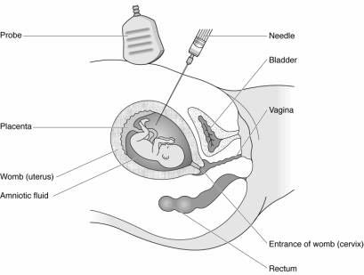
Transabdominal Injection of Dye
Amniocentesis
Collect Fluid samples
Inject dye (Indigo Carmine)
Tampon placed in vagina and checked for blue staining 30-60 mins after procedure
Notes:
Under ultrasound guidance a high-guage long needle is inserted through the abdomen and membranes into the uterine cavity and amniotic fluid can be collected for testing of chorioamnionitis, in addition to fetal lung maturation studies.
After fluid sample collection, 10 cc of mixed Indigo Carmine dye is then injected into the amniotic fluid. The dye is bright blue and if blue is noted on the tampon after 30-60 mins, the diagnosis of ruptured membranes is made.

Slide 20
Risks (complications) associated with preterm PROM
• Maternal risks:
  Chorioamnionitis
  Cesarean delivery for malpresentation and failed induction
  Abruption
• Fetal risks:
  Cord prolapse
  Respiratory Distress Syndrome
  Necrotizing Enterocolitis (NEC)
  Infection (sepsis)
  Intraventricular hemorrhage- The risk for this varies with gestational age.
  Pulmonary hypoplasia especially if < 19 weeks when PROM occurs (rare after 26 weeks gestation)
  Skeletal deformities

Slide 21
Management of PROM patient
It depends on:
Gestational age
Availability of NICU
Fetal presentation
FHR pattern
Active distress (maternal/fetal)
Is she in labor?
Cervical assessment
Notes:
Management is dependent on the following factors.

Slide 22
How we decide an expectant management versus immediate delivery. The patient’s gestational age, presence of clinical infection, placental abruption, labor and fetal status all have to be taken into account.
If the patient is term > 37 weeks :
late preterm patients from 34 to 36 weeks and six days EGA
Approximately 90% of patient will go into spontaneous labor within 24 hours. labor should be induced either at the time of presentation or the patient can be expected managed .induction of labor reduces the time of delivery and the rates of chorioamnionitis and metritis and admission to the neonatal intensive care unit. If the patient does not go into spontaneous labor on her own then labor induction should be performed with oxytocin.
The management is the same as term for the risks of infection outweigh the risks of prematurity .An induction of labor has started for these patients once rupture of membranes is confirmed. If the fetus is breach then a cesarean section will have to be performed.

Slide 23
If PPROM occurs between 24 weeks and 33 and 6 days, the risk of fetal lung maturity from prematurity is very high.
Preterm fetuses without chorioamnionitis should be treated with :
  Corticosteroids which enhance fetal pulmonary maturity.
  Tocolytics to decrease contraction.
  Antibiotics to increase the latency period
Note that antibiotics are administered because they have been shown to increase the amount of time before spontaneous labor, the antibiotics are not to treat an infection.
If there is an infection present diagnosed by uterine tenderness, fever and /or increased WBCs, then delivery needs to be initiated.
If there is no evidence of uterine infection, a patient with PPROM from 24 to 33 and 6 days should be admitted and ultrasounds to assess amniotic fluid volume and antepartum testing such as non-stress test are done.
Delivery will be induced between 32 and 34 weeks, however if the patient develops evidence of uterine infection then delivery will be immediately initiated.

Slide 24
Pre-viable PPROM
Pre-viable PPROM is premature rupture of membranes before the limit of viability (<24 weeks' gestation).
It occurs in less than 1% of pregnancies.
There are important risks of prematurity to discuss with this population:
  Pulmonary hypoplasia rates are approximately 10-20 % .
  Prolonged oligohydraminos can cause fetal deformations and limb contractures because the fetus cannot move freely within the amniotic sac.
  Neonatal death and morbidity rated decrease with a longer latency period and advancing gestational age.
  There are significant maternal complications that can occur with prolonged rupture of membranes with increased risks of systemic infections.
The management for patient with Pre-viable PPROM involves patient counseling and expectant management or induction of labor.
Antibiotics and corticosteroids are not recommended before viability.

Slide 25
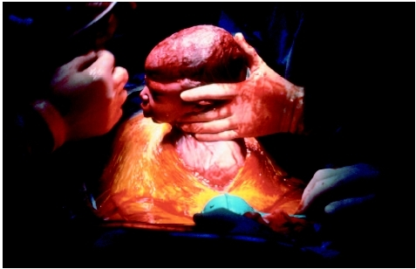
Delivery Indication
Maternal-Fetal Distress
Infection
Abruption
Cord Prolapse
Notes:
Deliver when fetal well-being severely compromised with expectant management and there are no “therapuetic” interventions available other than delivery.
Significant maternal-fetal mortality and morbidity associated with the above and therefore the only therefore the only therapuetic intervention is delivery.
Intraamniotic Infection is associated with neonatal white matter brain injury and cerebral palsy.

Slide 26
Expectant Management
Risks
Benefits
Abruption
Chorioamnionitis
Cord Prolapse
Pulmonary Hypoplasia (<19 weeks PPROM
Skeletal Deformities
Endometritis (1/3)
Mature lung profile
Advancing GA
Reducing risks associated with PTB AS:
  NEC
  IVH
  RDS
  Cesarean Delivery
  Endometritis (1/3)

Slide 27
Expectant Management
Typical for GA 32 weeks or less (32 weeks, document FLM)
Steroids
Tocolysis if indicated for lung maturity
Antibiotics (Ampicillin/EES-Azithro)
Fetal Surveillance
Majority Inpatient Observation
Assess for Chorioamnionitis
Goal: Mature Lung Profile, reduction of PTB risks!
Notes:
Some expectantly manage patients until 34 weeks gestation in the absence of delivery indication.
Betamethasone-may be given 12 mg IM q 12 or 24 hours x 2 total doses. Need at least 48 hours to initiate benefit. May also use Dexamethasone. Steriods may increase WBC’s and therefore baseline CRP should be obtained and consistently monitored.
In the absence of delivery indication, may consider tocolysis x 48 hours to assist with benefit of steriods. Tocolysis can be achieved with magnesium sulfate, terbutaline, and nifedipine.
Infection can be both a cause and a consequence of Preterm Rupture of Membranes.
Prophylactic antibiotics should be obtained after collection of cultures. These cultures may include Group B Strep culture, GC, Chlamydia, Amniotic fluid sample. Broad antimicrobial coverage is recommended. Antibiotic adminstration reduced the incidence of chorioamnionitis, neonatal infection, and the use of neonatal surfactant. Beta-Lactam antiobiotics (Augmentin) has a small potential noted in the research to Necrotizing Enterocolitis in the neonate, which warrented further investigation.
Antibiotic administration for most centers include Ampicillin IV (if no allergy) for 48 hours then a switch to oral amoxillicin for an additional five days. Additional of a macrolide considered necessary for broad coverage. Commonly used is a single dose of 1 gram of Azithromycin, or Erythromycin IV with a switch to oral EES after 48 hours for an additional 5 days.
Most patients require close inpatient observation. Those who might qualify for outpatient management include the extreme previable gestation patients and those who have appeared to have resealed (which is approximately about 5% of PROM patients).
Assessment for chorioamnionitis includes amnioscentesis with high suspicion of chorio (diagnostic), in addition to clinical signs and symptoms and CRP, WBC counts, and other maternal serum infection indices.

Slide 28
Chorioamnionitis
It is an infection of the fetal amnion and chorion membranes.
The characteristic clinical signs and symptoms of chorioamnionitis include the following:
  Maternal fever (intrapartum temperature >100.4°F or >37.8°C)
  Significant maternal tachycardia (>120 beats/min)
  Fetal tachycardia (>160-180 beats/min)
  Purulent or foul-smelling amniotic fluid or vaginal discharge
  Uterine tenderness
  Maternal leukocytosis (total blood leukocyte count >15,000-18,000 cells/μL)
Management:
  includes cervical cultures, supportive care, early delivery, and IV antibiotics administration (ampicillin and gentamicin in combination are the drugs of choice).

Slide 29
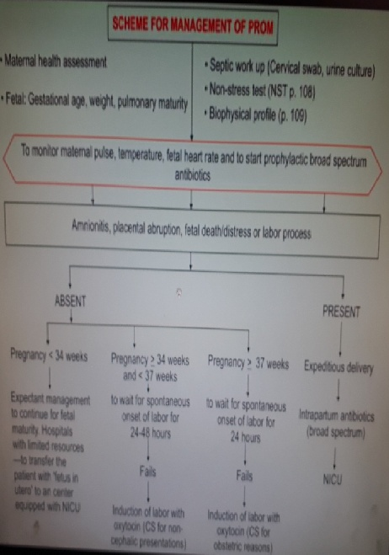

Slide 30
Summary of Management
If uterine contractions occur, tocolysis is contraindicated.
If chorioamnionitis is present, obtain cervical cultures, start broad-spectrum therapeutic IV antibiotics, and initiate prompt delivery.
If no infection is present, management will be based on gestational age as follows:
  Before viability (<24 weeks), outcome is dismal. Either induce labor or manage patient with bed rest at home. Risk of fetal pulmonary hypoplasia is high.
  With preterm viability (24–33 weeks), conservative management, hospitalize the patient, bed rest, administer IM betamethasone to enhance fetal lung maturity
  if <32 weeks, obtain cervical cultures, and start a 7-day course of prophylactic ampicillin and erythromycin.
  At term (≥34 weeks), initiate prompt delivery. If vaginal delivery is expected, use oxytocin or prostaglandins as indicated. Otherwise, perform cesarean delivery.

Slide 31
Conclusions
PPROM is a leading cause of neonatal morbidity and mortality and is associated with 30% of preterm deliveries.
The consequences of PPROM depend on the gestational age at the time of occurrence, persistent oligohydraminos at less than 22 weeks estimated gestational age leads to:
  Incomplete fetal alveolar development.
  Development of pulmonary hypoplasia (infants cannot be adequately ventilated).
When PPROM occurs between 24 and 26 weeks, there is likely to be survival, however there will be possible substantial morbidities from extreme prematurity.

Slide 32
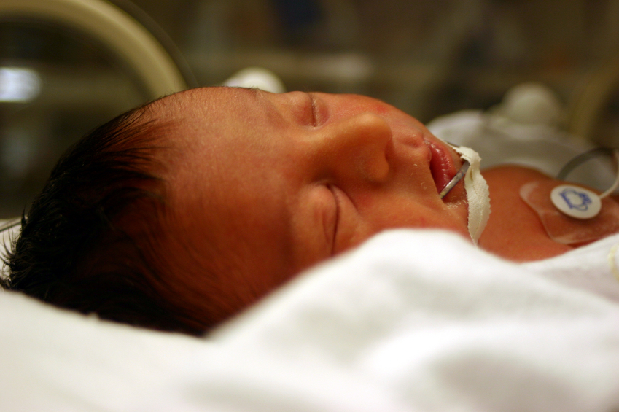

Slide 33


THANK YOU

