Slide 1
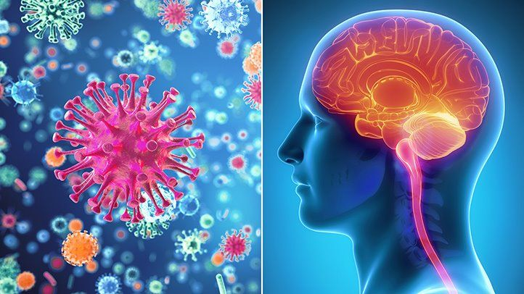
Microbial infection of the CNS

Slide 2
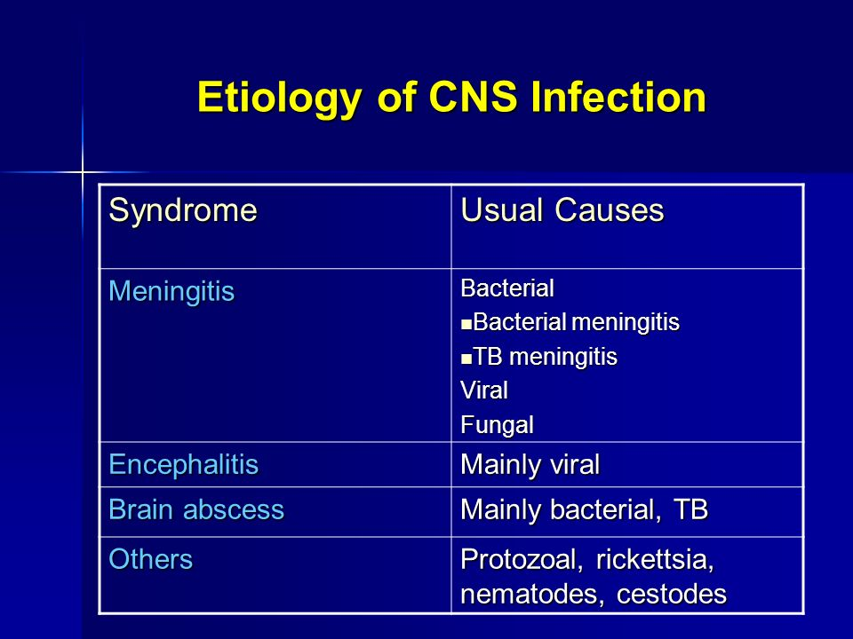

Slide 3
Method of specimen collection
Lumbar puncture (LP), is a medical procedure in which a needle is inserted into the spinal canal.
most commonly to collect cerebrospinal fluid (CSF) for diagnostic testing.
The procedure is typically performed under local anesthesia using a sterile technique. A hypodermic needle is used to access the subarachnoid space and fluid collected. Fluid may be sent for biochemical, microbiological,and cytological analysis.

Slide 4
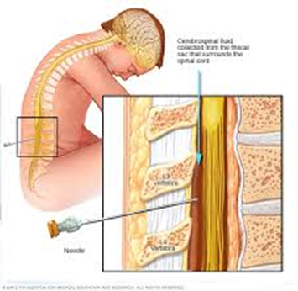
Collection and transport of CSF

Slide 5
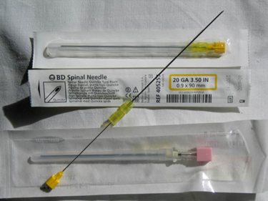
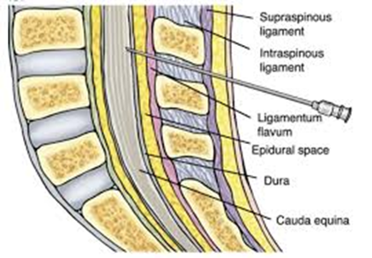

Slide 6
Wear surgical mask and sterile latex
Label the collection tubes with appropriate information: patient’s name, date and time of specimen collection, and Unique Identification Number.
Ensure that the patient is kept motionless during the lumbar puncture procedure, either sitting up or lying on the side, with his or her back arched forward so that the head almost touches the knees in order to separate the lumbar vertebrae during the procedure .
Disinfect the skin along a line drawn between the crests of the two ilia with 70% alcohol and povidone-iodine .
Position the spinal needle between the 2 vertebral spines at the L4-L5 level .

Slide 7
  Accurate placement of the needle is rewarded by a flow of fluid, which normally is clear and colorless.
Remove CSF (1 ml minimum, 3-4 ml if possible) and collect into sterile screw-cap tubes. If 3-4 ml CSF is available, use 3 separate tubes and place approximately 1ml into each tube.
Transport the CSF to a microbiology laboratory within 1 hour for culture and analysis.
  If that is not possible, inoculate CSF into T-I medium.
  If T-I is not available, incubate CSF at 35-37°C with ~5% CO₂ and store in an approved location if the laboratory is closed.

Slide 8
Meningitis
The diagnosis of meningitis is an emergency that requires prompt diagnosis and treatment.
Meningitis is described as septic or pyogenic when CSF contains mainly polymorphonuclear leucocytes as in bacterial meningitis.
It is described as aseptic or lymphocytic when the CSF contains mainly lymphocytes as in viral, tuberculous or fungal meningitis.

Slide 9
Causative Agents
1- Bacterial meningitis caused by:
1- N. meningitidis, H, influenzae and Str. pneumoniae are the commonest cause of pyogenic meningitis.
2- M. tuberculosis meningitis.
3- Staphylococci, streptococci, pneumococci, E. coli, klebsiella, proteus, pseudomonas or anaerobes.
4- Spirochetes; syphilis and leptospirosis are rare causes.

Slide 10
Neonatal meningitis is caused by group B haemblytic streptococci (Strept. agalactia), Esch. coli and other intestinal flora e.g. klebsiella and proteus.
Listeria monocytogenes is a less common cause.
H. influenzae is the commonest cause in infants 2-5 years.

Slide 11
2- Viral meningitis (aseptic meningitis):
Enteroviruses i.e. coxsackie virus, echo virus, poliovirus and mumps virus are the main viral causes.
Arboviruses, herpesviruses, rubella, CMV, rabies and many other viral agents can cause meningitis and encephalitis.
3- Fungal meningitis: Cryptococcus neoformans.

Slide 12
Diagnosis
CSF is obtained by lumbar puncture under complete aseptic conditions in 2-3 sterile tubes. It should be immediately examined as follows:
Physical examination: In septic pyogenic meningitis the CSF is turbid and under tension due to the large number of pus cells. In aseptic viral meningitis it is clear or slightly turbid due to small numbers of lymphocytes. In tuberculous meningitis, a coagulum forms on standing.

Slide 13
Chemical examination: for the level of proteins and glucose.
  In pyogenic meningitis and TB proteins are markedly increased while the glucose is reduced.
  In viral meningitis, proteins are slightly increased while the glucose is normal.
Cytological examination: Normal cell count in CSF is 0-5/cmm.
  In pyogenic meningitis, the number of cells may be 20,000/cmm or higher and are mainly polymorphs.
  In tuberculous or viral meningitis the number of cells does not exceed 1000/cmm and are mainly lymphocytes.

Slide 14
Bacteriologic examination: CSF is centrifuged and the deposit is examined by:
1-Direct smears stained by gram and by Ziehl Neelsen if indicated or by India ink if cryptococcosis is suspected. Due to the need for rapid results to start treatment, a tentative report can be given on the basis of gram stain.
2- Cultures are made on blood and chocolate agar and incubated aerobically and at 5-10% CO₂ atmosphere. Culture for tuberculosis is done if indicated. Cultures for fungi or leptospira may be needed.

Slide 15
Detection of bacterial antigens in CSF by coagglutination and latex agglutination using antisera to the three common organisms i.e. N. meningitides, H. influenzae and Str. pneumoniae. Cryptoccocal antigens can be detected by latex agglutination.
4- Blood cultures should be done at the same time since bacteraemia frequently occurs in pyogenic meningitis.
5- PCR may be used for detection of viral or bacterial nucleic acids in CSF or blood for rapid diagnosis.
6- Serologic diagnosis of viral causes by detecting IgM or IgG rising titre.

Slide 16
Neisseria

Slide 17
Family Neisseriaceae
Gram-negative cocci
2 primary human pathogens:
  Neisseria gonorrhoeae
  Neisseria meningitidis
N.flavescens and N.sicca are commensals

Slide 18
General Characteristics of Neisseria spp.
Morphology
Gram-negative cocci often
arranged in pairs (diplococci) with
adjacent sides flattened (like coffee beans)
In pathological specimens N.meningitidis and N.gonorrheae ocurr intracellulary in pus cells

Slide 19
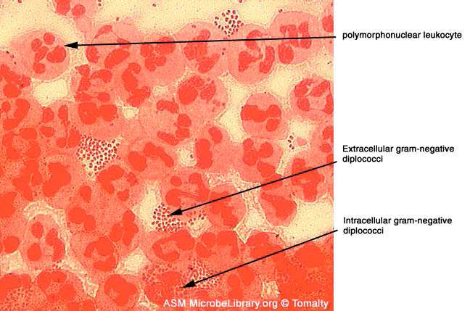

Slide 20
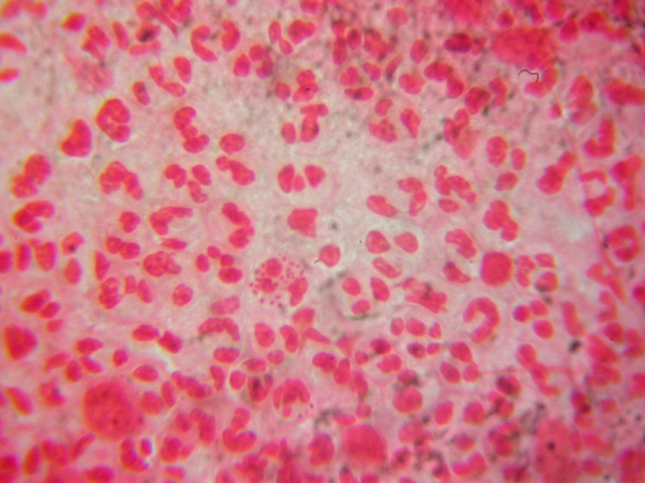

Slide 21
Cultural characters
non-selective media (chocolate agar)
specimen onto selective media., modified Thayer-Martin
Colony is smooth and non pigmented

Slide 22
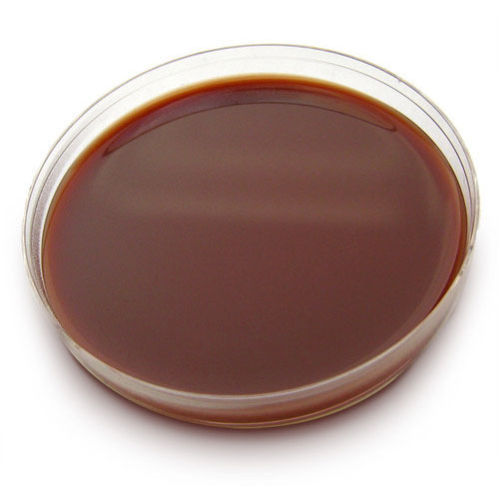
Chocolet agar

Slide 23
Biochemical reactions
Oxidase positive
Most catalase positive
Acid from sugars
differentiate pathogenic and commensals

Slide 24
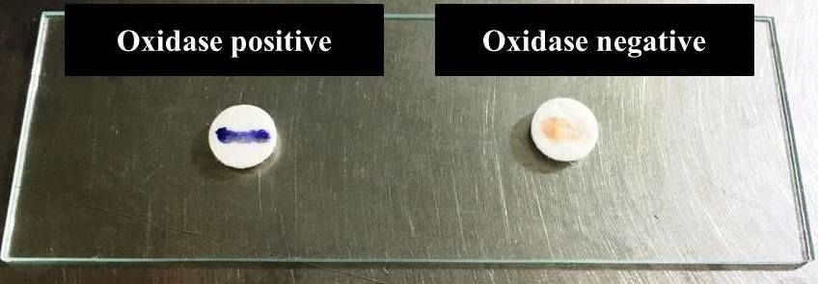

Slide 25
Differential Characteristics of Commonly Isolated Neisseria spp.
 | glucose | maltose | sucrose
N.meningitidis | + | + | -
N.gonorrhoea | + | - | -
N. flavescens | - | - | -
N. Sicca | + | + | +

Slide 26
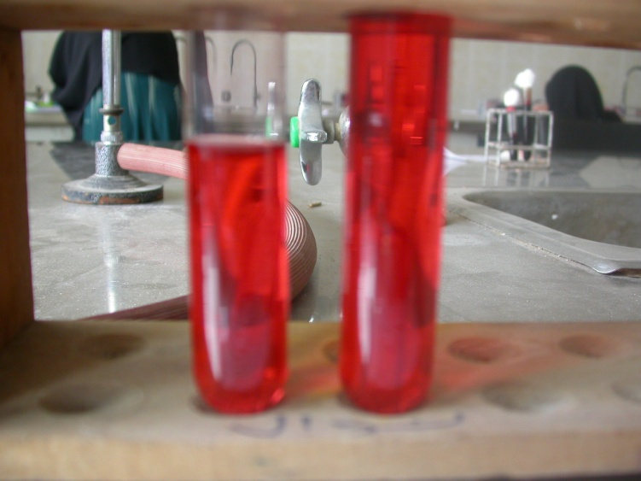
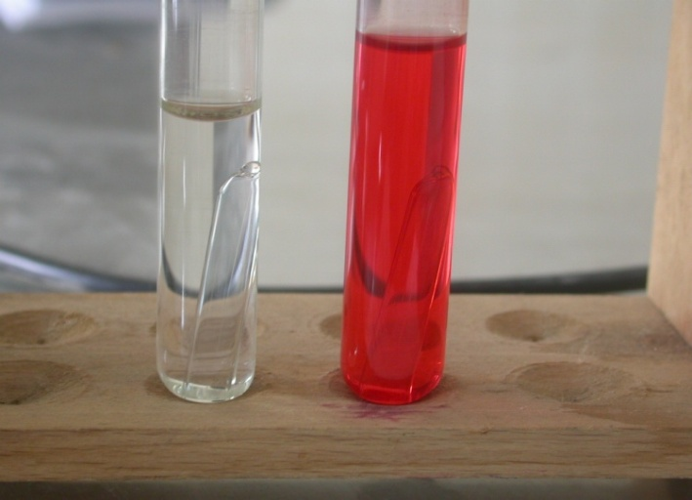
Neisseria( 2 Tubes)
Ferment glucose and maltose with acid prod. only
-2 red tubes
Ferment Glucose with acid prod. Only
-1 red tube & 1 white tube

Slide 27
Neisseria meningitidis
ACUTE BACTERIAL (Pyogenic) MENINGITIS
Person-to-person transmission by aerosolization of respiratory tract secretions ,Commonly colonize nasopharynx of health individuals; highest oral and nasopharyngeal carriage.

Slide 28
lab Diagnosis
Sample: CSF, blood (case), or nasopharyngeal sample (carrier)
CSF is under tension and turbid Due to pus cells 20000/cmm.
Proteins elevated.
glucose is reduced.
A-CSF is centrifuged and deposit is
examined microbiologically.

Slide 29
Gram stain: Gram negative dipliococci intracellulary In pus cells is diagnostic
Rapid tests for capsular polysaccharide Ag by latex agglutination kits if positive start treatment immediately

Slide 30
Culture for differentiation:Colonies are identified morphologically,biochemical reactions.
Blood culture in case of bactermia
PCR
Diagnosis of carriers: nasopharangeal swab cultured on modified thayer martin media
Isolated Gram negative cocci should be differtiated From commensals by biochemical reactions, serologic identification with specific anti meningococcal serum

Slide 31
leptospirae
Leptospira interrogans causes leptospirosis in animals e.g. rats, dogs and field mice. Man is infected by coming in contact with water contaminated with their excreta. Leptospira causes Weil's disease in man.
Morphology: Long thin finely coiled, one or both ends of the organism are hooked. It can be seen in fresh unstained preparation by dark-ground microscopy.
can be stained with silver stains.
Members of the genus are motile with two subterminal periplasmic flagellae.

Slide 32
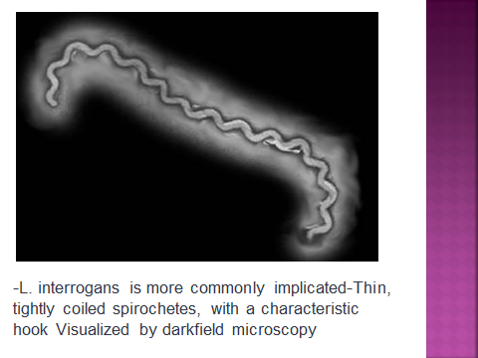

Slide 33
Cultural Characters:
They grow aerobicaly on serum containing semisolid media e.g. Stuart's or Fletcher's media. Optimum temperature is 30°C.

Slide 34
WEIL'S DISEASE (Infectious Jaundice)
Mode of transmission:
Man is infected by coming in contact with water or other materials contaminated with the excreta of animal hosts.
Clinical manifestations:
After an incubation period of 1-2 weeks, there is fever for few days followed by jaundice, haemorrhages and renal failure.
Severe cases may be complicated by meningitis.
The organism is found in the blood during the fever and is excreted in urine from the second week onwards.

Slide 35
Diagnosis:
I- Detection of the Organism in:
a- Blood or CSF during the first week of fever.
b- Urine from the 2nd week of fever.
1- Microscopic examination of films from blood or fresh urine deposit, with the dark-ground microscope, or after staining with silver stains or direct fluorescent antibody assay.
2- PCR based methods for rapid detection of leptospira DNA in specimens.
3- Culture on Fletcher's or Stuart's medium, incubated at 30°C. Growth appears after 1-2 weeks. Cultures are identified by agglutination or PCR.
II- Serologic Diagnosis; by detection of specific antibodies in patients' sera which start to appear during the second week of fever:
1- ELISA for detection of IgM or a rising titre of IgG.
2- Agglutination tests using a killed suspension of the organism is routinely used. The detection of a rising titre is the most convincing evidence.

Slide 36
Haemophilus influenzae
Morphology:
Small Gram negative cocco-bacilli.
H. influenzae type b (Hib) is the most pathogenic .
Capsule can be detected by India ink in wet mount and by swelling with specific antiserum.

Slide 37
Cultural characteristics:
* Facultative anaerobes can be grown on chocolate agar which provide haemin (factor X) and nicotinamide adenine dinucleotide (NAD⁺/factor V) for growth.
On blood agar; (Satellitism):
Around staph aureus colonies , the colonies of H. influenzae are much larger and denser since staphylococci produce V factor.

Slide 38
Diagnosis
Sample:
Blood cultures are positive in more than 50% of symptomatic patients, except those with conjunctivitis.
CSF in cases of meningitis.
Synovial fluid in septic arthritis.
Sputum in lower respiratory diseases.
Procedure:
1.Microscopic examination:
Gram negative pleomorphic small cocco-bacilli may be confused with pneumococci.
Many strains are capsulated.
Capsule can be detected by quelling reaction with specific antisera.
2. Culture:
* They grow on chocolate agar, Colonies are identified by:
a. Their morphology: small, transparent.
b. Their inability to grow in absence of X-V growth factors which is detected by Satellitism

Slide 39
Satellitism
On blood agar; (Satellitism):
Around staph aureus colonies , the colonies of H. influenzae are much larger and denser since staphylococci produce V factor.
X, V, XV discs
Colonies suspected to be H. influenzae are transferred from chocolate agar and inoculated on nutrient agar plate.
Place X, V, XV discs and incubate the plate at 35-37 C in CO2 enriched atmosphere.
H. influenzae grow well around XV disc with little growth around X and V discs.
c. Serology:
Using specific antisera to capsular antigen, diagnosis can be achieved by capsule swelling test (Quelling reaction), IF, latex agglutination.
d. PCR and DNA probes.

Slide 40
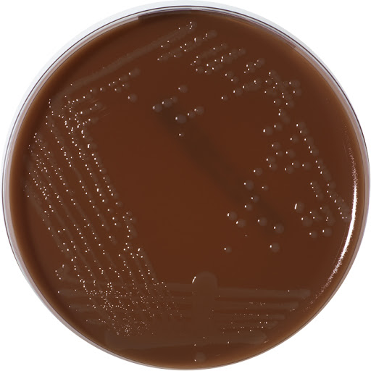
Small transparent colonies of Haemophilus influenzae on chocolate agar .

Slide 41
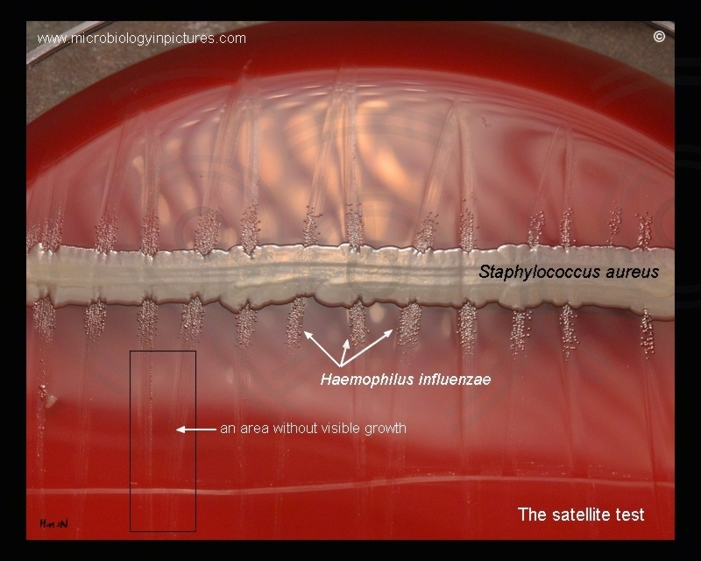
Satellitism of Haemophilus influenzae on blood agar

Slide 42
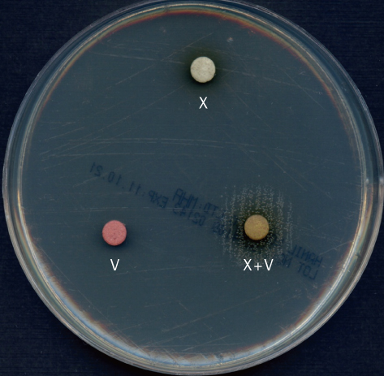
X,V, XV disc test of Haemophilus influenzae on nutrient agr

Slide 43
MYCOBACTERIUM TUBERCULOSIS
The genus Mycobacterium include acid fast bacilli, which are difficult to stain , but once stained , resist decolourization with acid and alcohol.
Morphology:
Thin straight or slightly curved rods Stained by Ziehl – Neelsen stain, appear as thin pink rods arranged in small groups on blue background.
- can be stained also by fluorochrome stain ( auramine- rodamine) , appear as yellow orange fluorescent rods in black background

Slide 44
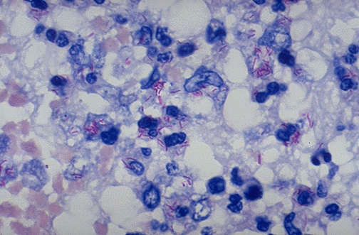
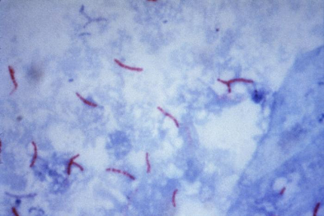
Acid fast smear showing TB bacilli

Slide 45
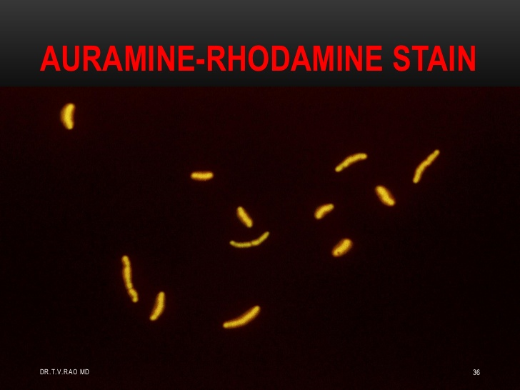

Slide 46
Cultural characters:
- strict aerobic, grow on egg- enriched media as
* Lowenstein – jensen media
* dorset egg.
- No growth appear before 2-4 weeks, incubation at 37ºC.colonies appear irregular dry off white colonies.
Other media include ,Middlebrook 7H10,7H11agar and 7H9 broth.
Virulent strains give characteristic serpentine cord like pattern in fluid media.

Slide 47
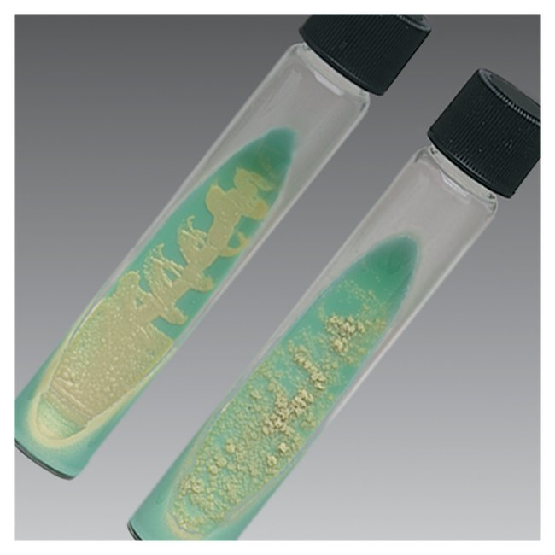
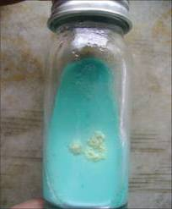
LJ media

Slide 48
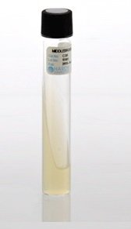
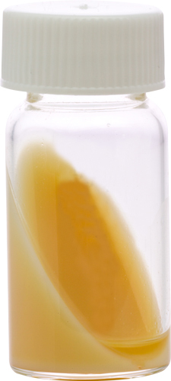
Dorset egg media
Middlebrook agar

Slide 49
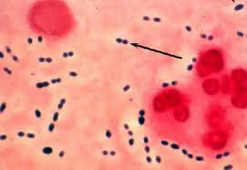
pneumococci
Morphology:
Gram +ve cocci ,slightly elongated arranged in pairs “lanceolate appearance”oval with pointed ends

Slide 50
pneumococci
- morphological features:
they are non motile,non sporing and capsulated
-the capsule appears as un stained halos around the organism
-Culture:
-they grow on blood agar→alpha haemolysis
-Biochemical reactions:
1-inulin fermentation

Slide 51
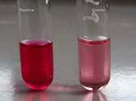
-inulin fermentation

Slide 52
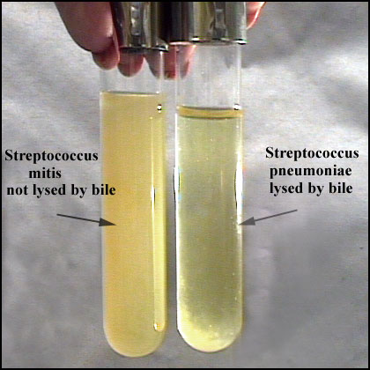
2-Bile solubility
-the test is done by addding 0.1 ml of sodium deoxycholate to 5 ml broth of pneumococci ,incubation at 37⁰c
-clearing of broth occurs at 15 min.

Slide 53
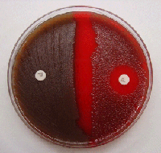
3-Optochin sensitivity
-pneumococci are sensitive to optochin

Slide 54
Diffrence between pneumococci,strept.viridans
Viridans streptococci | pneumococci
Not soluble | soluble | Bile solubility
Not fermented | fermented | Inulin fermentation
Not sensitive | sensitive | Optochin sensitivity
Not pathogenic | pathogenic | Pathogenicity to mice
-ve | +ve | Quellung test

Slide 55
Serological characters:
-there are at least 90 serotypes based on chemical specificity of the capsular polysccharide.
-identification can be done by agglutination or capsular swelling”Quellung test”
Steps:
-mix bacterial suspension with known antiserum
-methylene blue is added
-in the presence of specific antiserum swelling occurs.

Slide 56
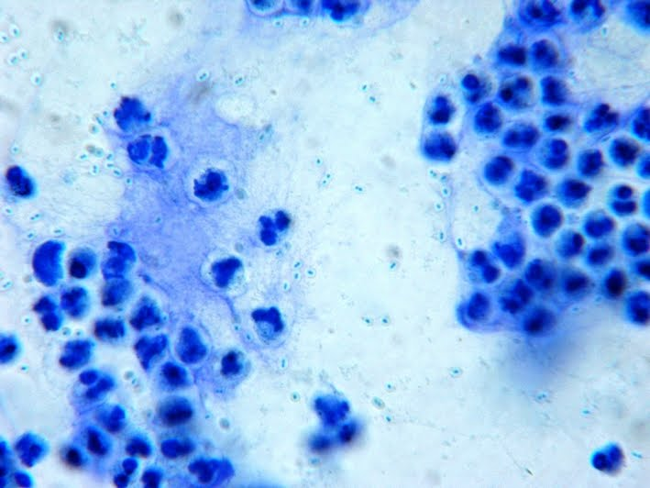
Quellung reaction

Slide 57
Listeria monocytogenes
Morphology:
Small gram positive, non-spore forming bacilli similar in morphology to corynebacteria.
The organism exhibits an unusual tumbling movement at 22-28°C but not at 37°C that distinguishes it from the corynebacteria that are non-motile.
Cultural characters:
Facultative anerobes.
Grow at wide temperature range from 1-45°C. The organism can grow at refrigerator temperature
Can tolerate high salt concentration.
Colonies on blood agar produce of β-haemolysis.
Biochemical reactions:
Catalase positive.
Ferment a variety of carbohydrates with acid production

Slide 58
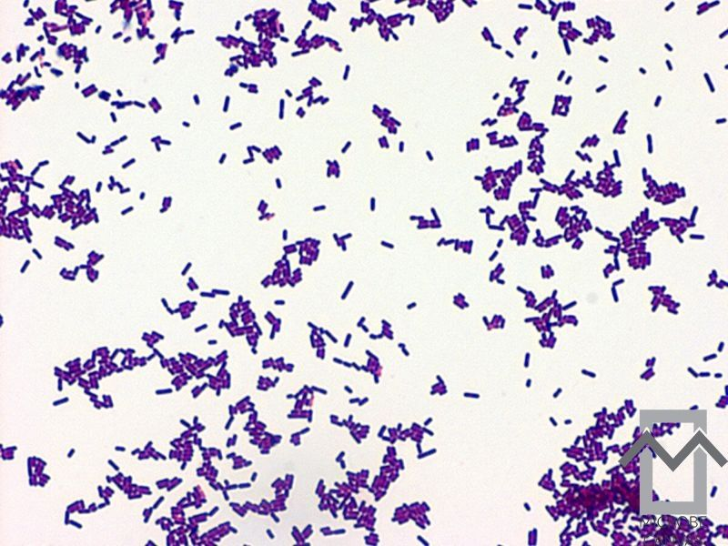
Gram positive bacilli of listeria monocytogenes

Slide 59
Diagnosis:
Isolation:
• Isolation from blood by blood culture and from CSF on blood agar and from stools on listeria selective media.
• Isolation is enhanced if specimens are refrigerated for few days before inoculation "cold enhancement".
Identification:
• Gram stain.
• Detection of tumbling motility.
• Positive catalase.
• It produces B-haemolysis, on sheep blood agar, which is enhanced in the vicinity of a streak of Staph. Aureus, i.e. CAMP test positive.

Slide 60
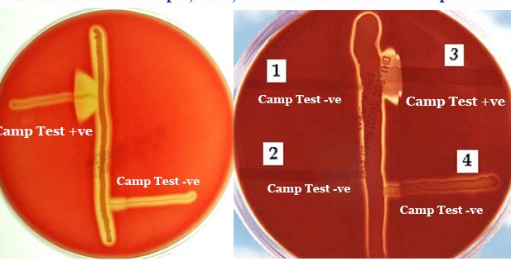
CAMP test

Slide 61
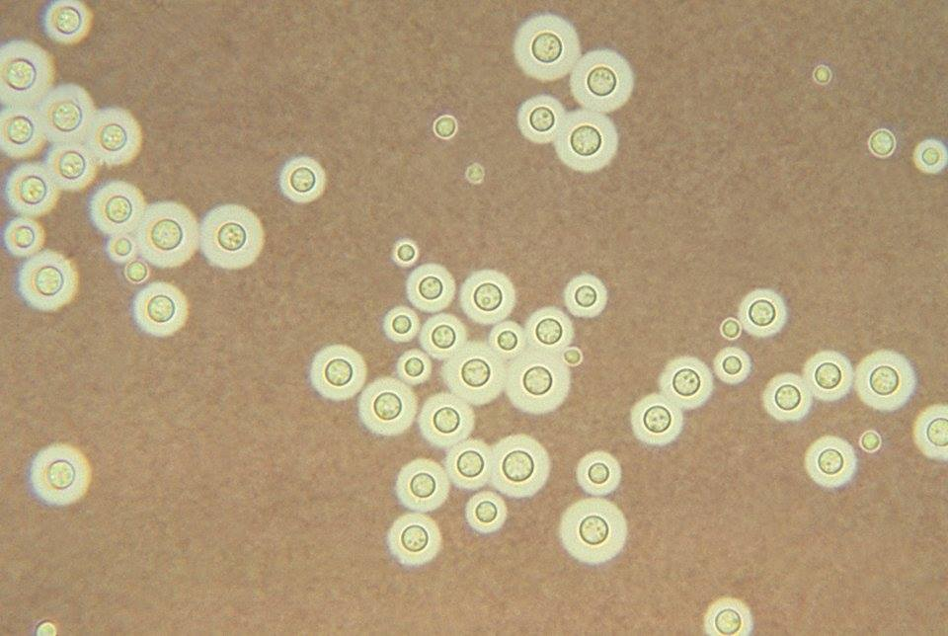
Cryptococcus neoformans
Laboratory diagnosis:
Examination of CSF:
Physical examination: CSF is turbid and under tension.
Chemical examination:Protein level is increased, glucose level is decreased and the number of leukocytes is increased (mainly mononuclear cells).
Microbiological examination:
microscopic examination:
India ink wet mount of CSF
sediment for demonstration of
encapsulated yeast cells
(gelatinous capsule around
budding yeast cells).

Slide 62
Culture:
Performed on cyclohexamide free sabouraud’s dextrose agar. Colonies are creamy mucoid (because of the capsule). Organism is identified by
  Urease production (+ve).
  Direct immunoflourescence.
  DNA probes.
Latex agglutination test:
for detection of the capsular antigen in CSF, serum , urine.
Serology:
Indirect immunoflourescence for antibody detection.

Slide 63
Case study
A 7-year-old female was transported to the emergency department because of coma. She complained of fever over 39 °C and severe occipital headache the night before her family found her unconscious. Physical examination revealed that her Glasgow coma scale was 6. Neurological examination found nuchal rigidity. A head CT scan revealed no focal region, but diffuse swelling of the brain. Her blood tests showed elevated leukocytes (21,100 cells/μL). A lumbar tap was performed and turbid yellow spinal fluid was collected. Spinal fluid examination revealed elevated protein level, glucose 0 mg/dl and a cell count of 10112/mm3 (96 % polymorphonuclear leukocytes), which confirmed the diagnosis of bacterial meningitis.
Mention the possible causative organisms?
How to confirm your diagnosis?
What is the criteria of CSF in cases of aseptic meningitis?
Mention the mode of transmission of infection?

