Slide 1
Infections of eye &ear

Slide 2
Infections of eye
Causative organisms:
Bacteria
Streptococcus pneumoniae
Haemophilus infleunza
Haemophilus aegyptius
Moraxilla
Gonococci
E.coli
Staphylococci
Streptococci
Chlamydia trachomatis
pseudomonas
Viruses: adenoviruses, coxsackievirus, herpes simplex virus
Fungi: candida, aspergillus
Eye lid: Plephritis, Stye
Conjunctiva: conjunctivitis, inclusion conjunctivitis
Cornea: Keratitis
Retina: retinitis
endophthalmitis.
Trachoma.
Ocular herpes

Slide 3
Infections of ear
Otitis externa
Otitis media
Otitis interna
Otomycosis
Pericondritis
Causative organisms:
Bacteria
Streptococcus pneumoniae
Haemophilus infleunza
Pseudomonas aeruginosa
Moraxilla catarrhalis
proteus
E.coli
Staphylococcus aureus
Streptococcus pyogenes
Chlamydia trachomatis
Viruses: adenoviruses, infleunza, parainfleunza, measles, respiratory syncital virus

Slide 4

Chlamydia

Slide 5
Chlamydia are obligate intracellular parasites differ from viruses and simulate bacteria in;
  Contain DNA and RNA.
  Contain ribosomes.
  Have cell wall
  Multiply by binary fission
  Have metabolically active enzymes
  Sensitive to antibiotics
  Chlamydia are gram negative bacteria lack mechanisms for production of metabolic energy can not synthesize ATP, so they multiply intracellularly as host cells provide energy and metabolites.

Slide 6
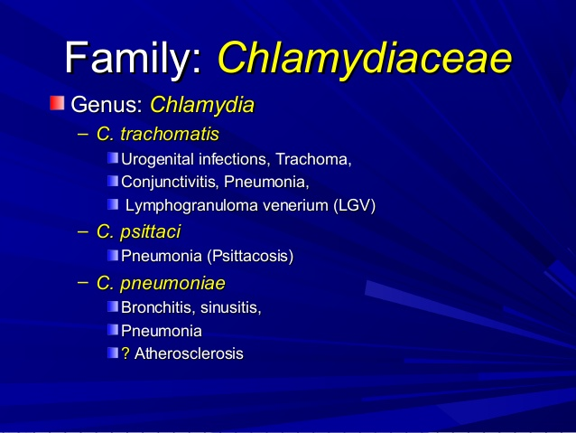

Chlamydia

Slide 7
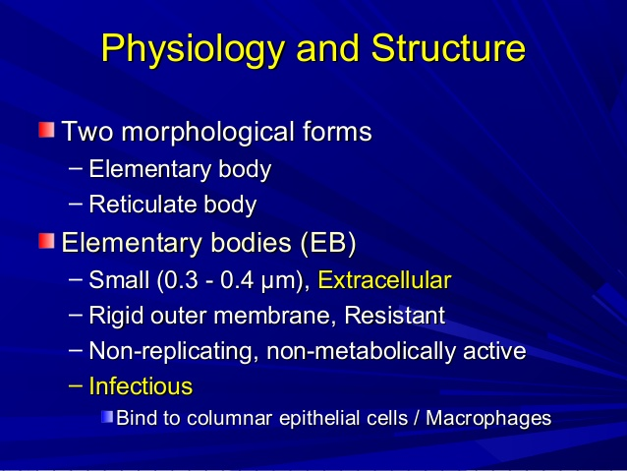
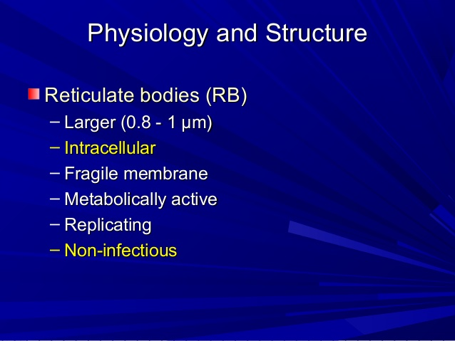
Chlamydia
Obligate intracellular coccoid parasites
contain DNA and RNA, and ribosomes
lack ATP, biosynthetic pathways
cell wall but peptidoglycan absent -

Slide 8
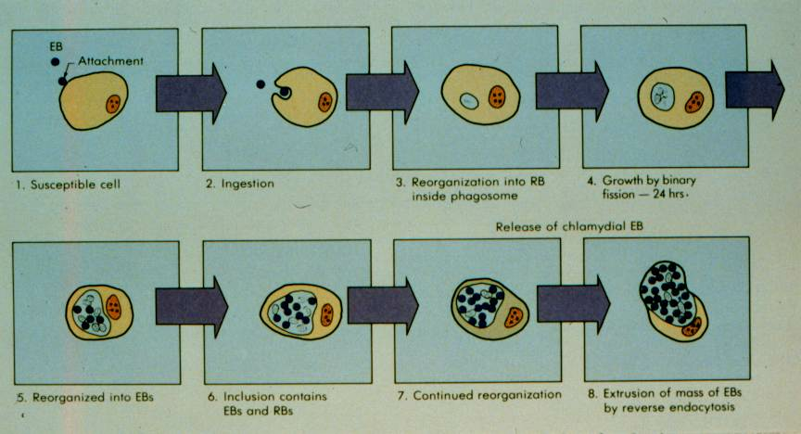
Elementary bodies are taken into the cell by a phagocytosis like process in which it passes to the larger form “Reticulate bodies” which grows in size and divide by binary fission forming large number of elementary bodies that are seen in the host cells as intracytoplasmic inclusion bodies these are released to infect new cells

Slide 9
Characters of chlamydia
They are stained by Geimsa or Macchiavello stain
They grow in tissue culture and in yolk sac of chick embryo
C. trachomatis has 15 serotypes
CLASSIFICATION
C.trachomatis;
  Biovars;
    TRIC (trachoma, inclusion conjunctivitis)
    LGV (lymphogranulomab venerium)
serotypes;
    TRIC= 12 serotypes (A,B,Ba,C,D,E,F,G,H,I,J,K)
    LGV= L1,L2,L3

Slide 10
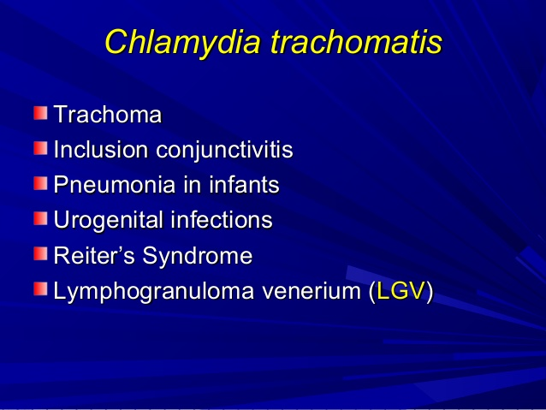
C. trachomatis infect only humans
Transmitted by close contact, sexually, from birth canal during delivery

Slide 11
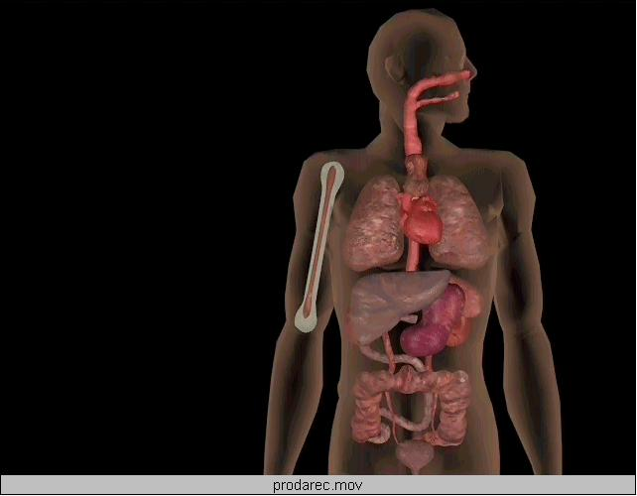
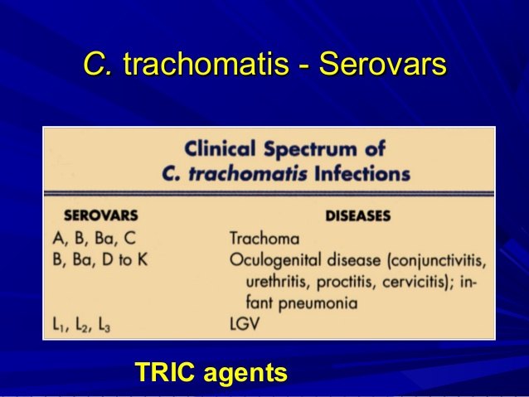
C trachomatis
Trachoma
conjunctivitis
proctitis
urethritis
salpingitis
Lymphogranuloma venereum
C psittaci & C pneumoniae
Upper respiratory infection
Bronchitis
Pneumonia

Slide 12
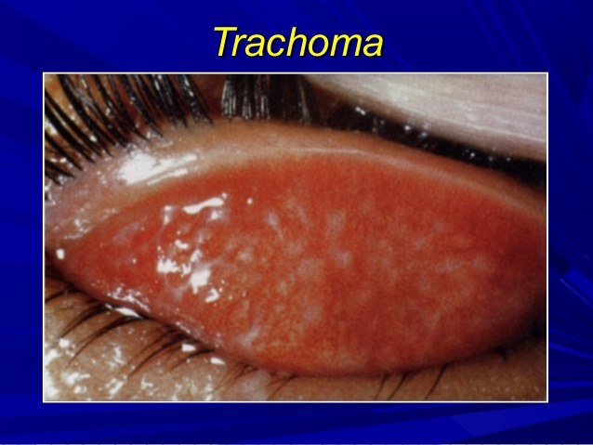
Ocular infections
Trachoma;
- Chronic keratoconjunctivitis ; acute infection of conjunctiva and cornea progress to scarring and blindness
  Endemic in egypt
  Transmitted from eye to eye by fingers, flies
  Caused by biovar TRIC serotypes A,B,C
Inclusion conjunctivitis’
  Mild
  Cornea not involved
  Healing without scar formation
  Affect adults, neonates acquire infection from birth canal of infected mothers
  It is caused by Serotypes D-K

Slide 13
Respiratory infections
Upper respiratoryinfections ;
  otitis media, pharyngitis occur in patients with inclusion conjunctivitis
Pneumonitis in immunocompromised patients
Neonantal pneumoniae;
  acquired from birth canal of infected mothers.
genital infections
Caused by serotypes D-K
Males; Non gonococcal urethritis, epididymitis.
Females; cervicites, salpingitis, PID, sterility, ectopic pregnancy
Transmitted sexually
Lymphogranuloma venereum LGV
Sexually transmitted.
Caused by Serotypes L1, L2 , L3.
Painless papule on gentalia ulcerate

Slide 14
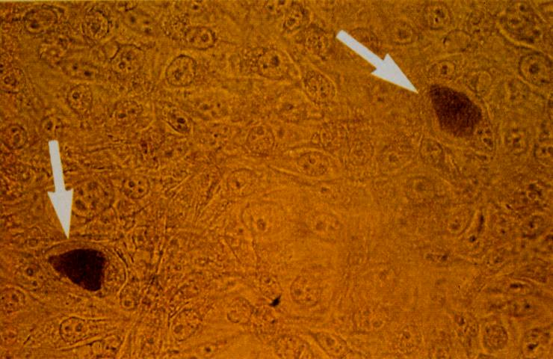
Diagnosis of Chlamydial infections
Sample; conjunctival , urethral discharge, cervical scraping, sputum, urine, pus
Direct detection of
  Intracytoplasmic inclusions by Giemsa, immunofluorescent staining
  Chlamydial antigens in exudate, urine ELISA, fluorescent antibody staining
  Nucleic acid in specimen by DNA probes PCR diagnose sexually transmitted diseases
Isolation on MacCoy cells for C.trachomatis, detection of inclusion bodies in cell culture
Notes:
Reiter syndrome urethrritis conjunctivitis, polyarthritis and mucocutaneous lesions

Slide 15
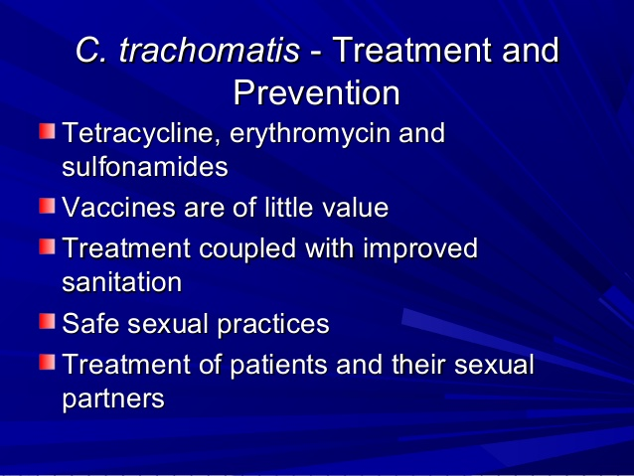
Chlamydia: Rates by Gender

Slide 16
Adenoviruses
properities:
It is a non enveloped double stranded DNA virus with an icosahedral nucleocapsid
There are about 51 human antigenic types.
Type 12, 18. 32 induce tumors in newborn hamsters, but adenovirus carcinogensis has never been observed in humans
In humans. Adenovirus can cause in several organs, trhe virus causes latent infection in adenoid . Tonsils. Lymphoid tissues

Slide 17
Diseases caused by adenoviruses
Transmission:
Respiratory droplets, faeco oral. Direct contact
conjunctivitis., epidemic keratoconjunctivitis.
Pharyngoconjunctival fever occur in outbreaks in summer camps “swimming pool conjunctivitis”
Acute febrile pharyngitis, pneumoni9a
Gastroenteritis, intussusception
Acute hemorrhagic cystitis
In immunocopromised patients:
  AIDS patients; sever GIT infections, fatal pneumonia
  Transplant patients: hepatitis, myocarditis in transplant organs guo to endogenous reactivation of latent virus

Slide 18
Diagnosis:
Body secretions are examined
  Electron microscope
  Immunofluorscence
  Antigen detection by ELISA
  PCR
  Isolation of the virus in cell culture
  4 fold increase of antibody titre is diagnostic of infection
  Prevention:
  Three monovalent live nonattenuated vaccine against types 4,7,21 available as enteric coated capsules

Slide 19
Gene therapy
Adenoviruses are used as gene delivary vehicles for cancer therapy, gene therapy
A novel anticancer therapy utilizes an attenuated replication competent adenovirus engineered to replicate only in targeted cancer cells
This oncolytic therapy is aimed at directly killing tumor cells duo to viral lytic replication

