Slide 1
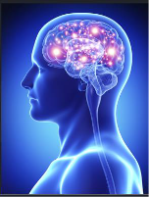
NEURO PRATCICAL
Section 3
Histology Department
Sohag University
Faculty of Medicine
Block 213-NEU
Neuroscience system

Slide 2
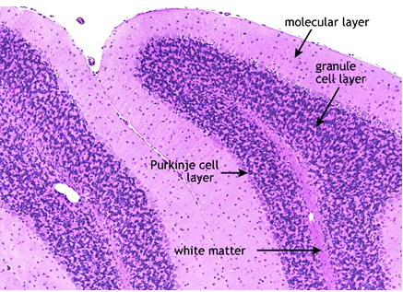
Cerebellar cortex

Slide 3
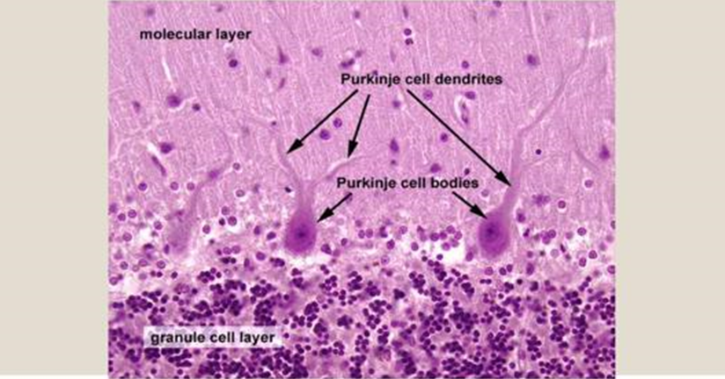
Cerebellar cortex

Slide 4
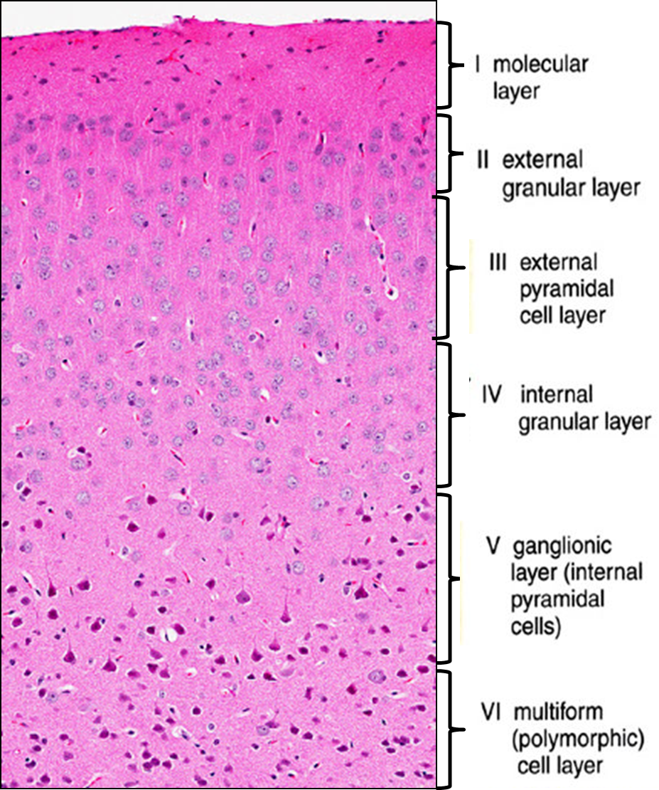
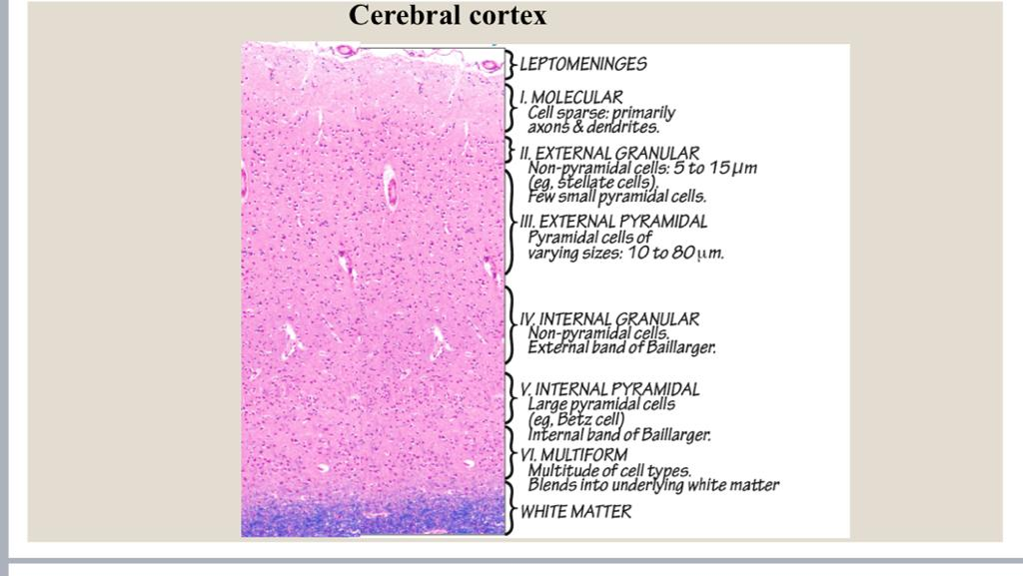
Cerebral cortex

Slide 5
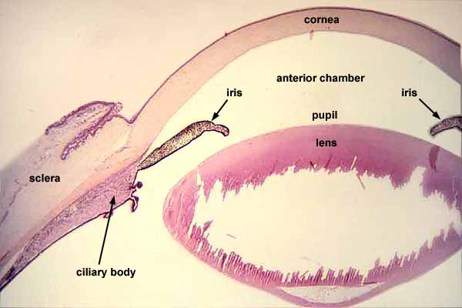
Eye
Notes:
eye

Slide 6
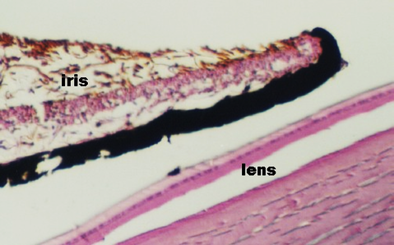
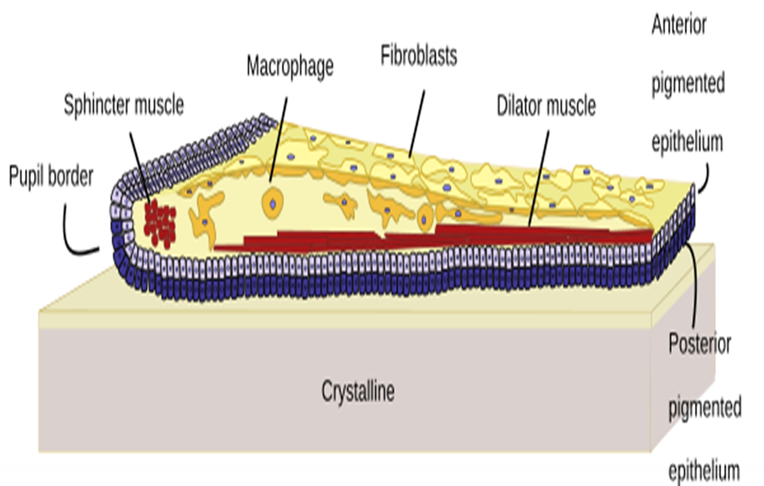
iris

Slide 7
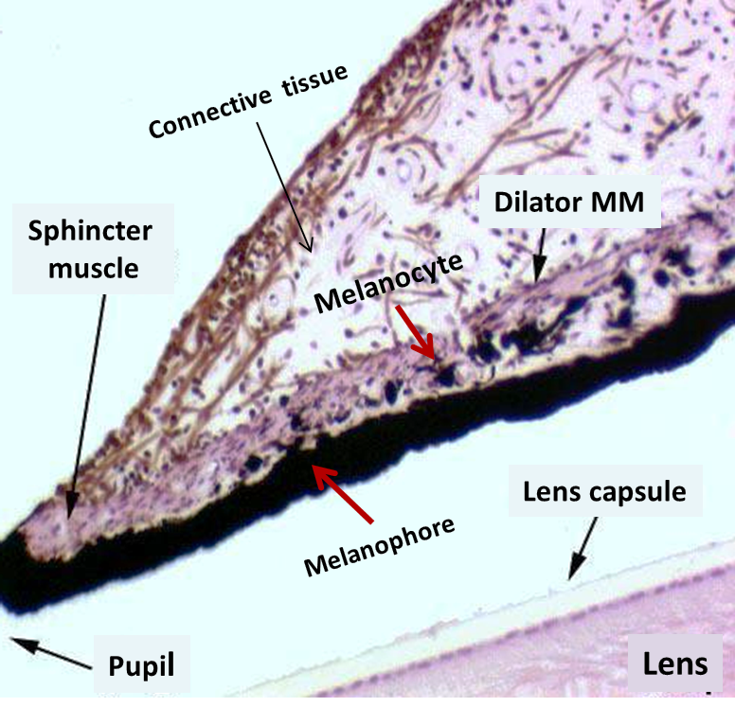
iris

Slide 8
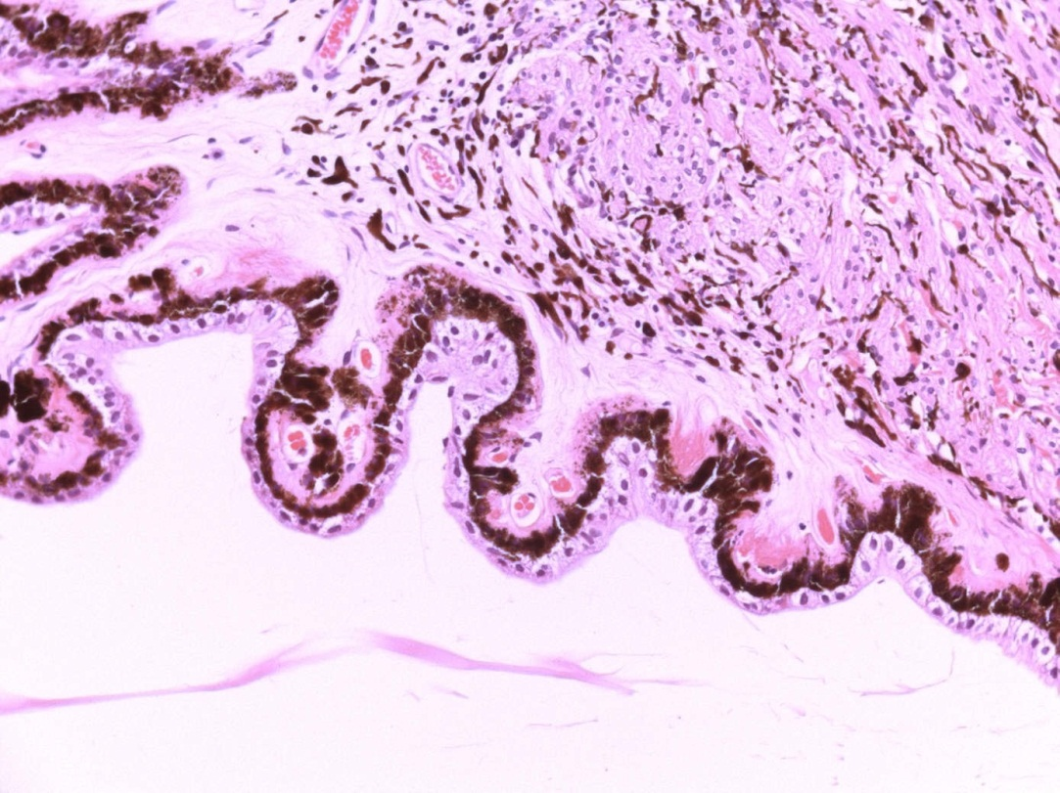
Ciliary body
melanocyte
Ciliary muscle
Ciliary processes
outer pigmented cells
inner non pigmented cells
Notes:
Ciliary processes

Slide 9
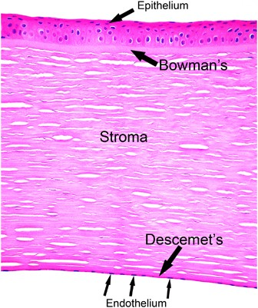
Cornea

Slide 10
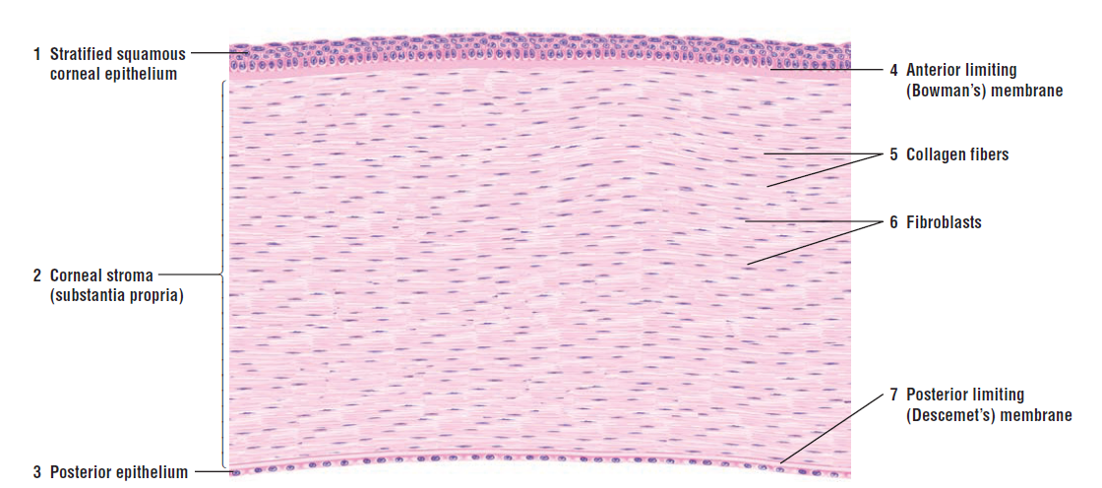
Cornea

Slide 11
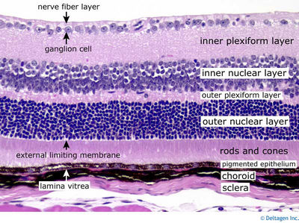
Retina
Notes:
retina

Slide 12
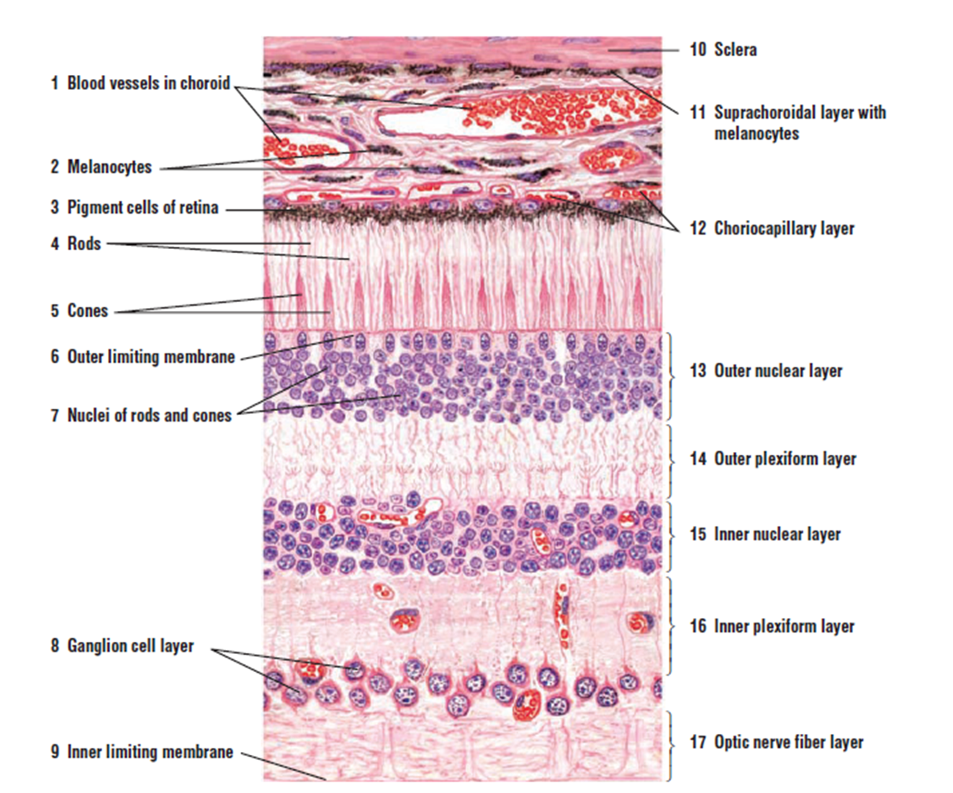
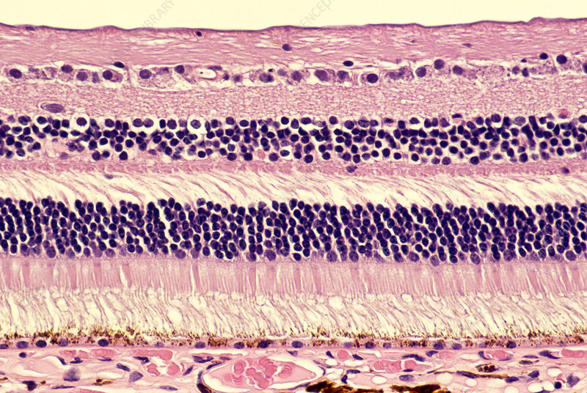
Retina
Notes:
retina

Slide 13
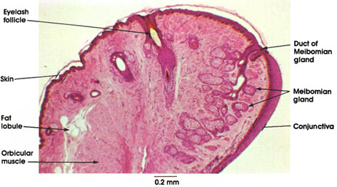
Eye lid
keratin

Slide 14
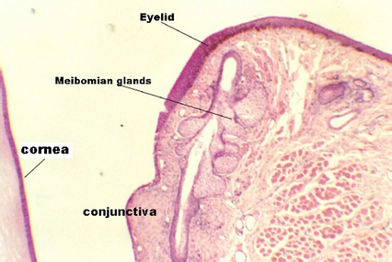
Eye lid
Thin skin
Muscle

Slide 15
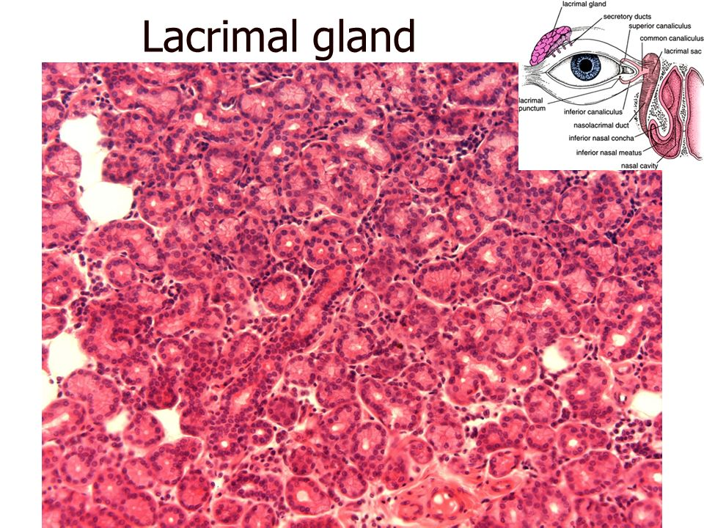
Secretory acini

Slide 16
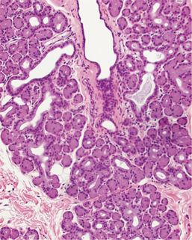
Lacrimal gland
Interlobular duct
Intralobular duct
Secretory acini

Slide 17
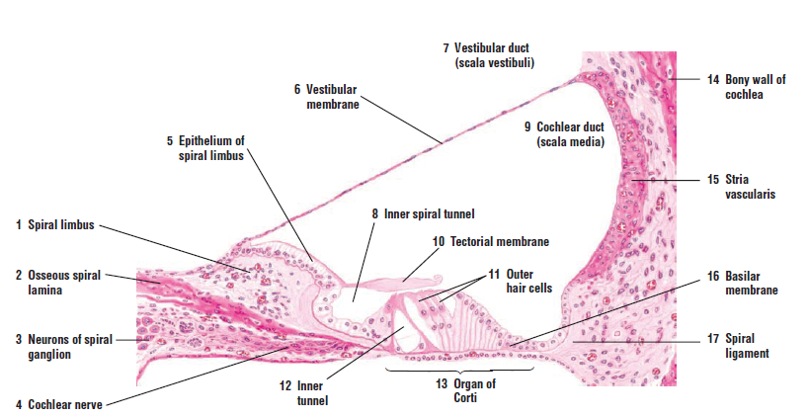
Organ of Corti

Slide 18
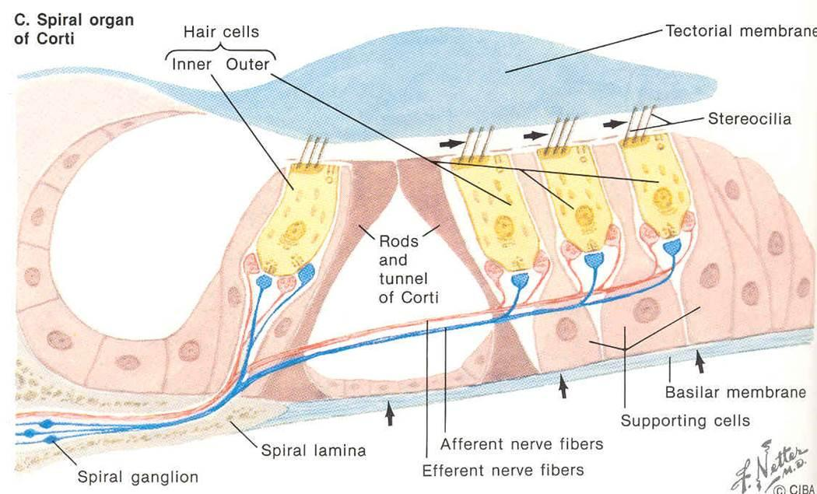
Organ of Corti

Slide 19
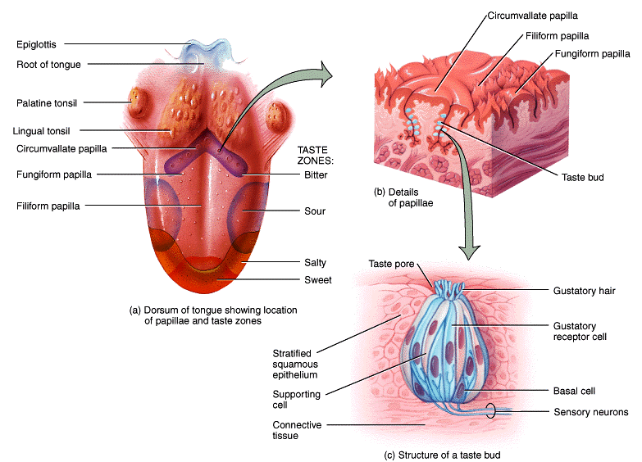
Taste bud

Slide 20
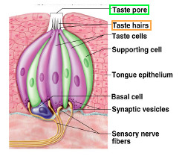
Taste bud

Slide 21


