Slide 1
Anatomy of Pharynx
By W.A.M
MD

Slide 2
It is fibromuscular tube, about 10 cm in adults.
Extends from base of skull to level of 6th cervical vertebra.
It is divided into 3 parts:
-Nasopharynx.
- Oropharynx.
- Laryngopharynx.

Slide 3
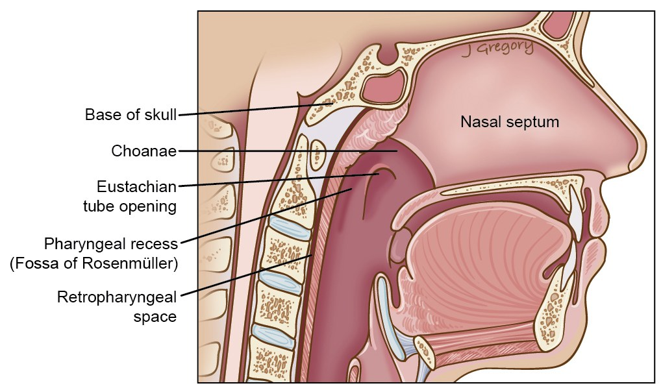
Nasopharynx
Eustachian tube opening in lateral wall.
Nasopharyngeal tonsil (Adenoid) at junction of roof and posterior wall.

Slide 4
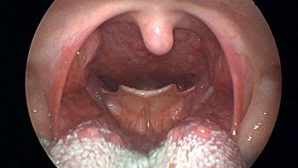
Oropharynx
Bounded above by soft palate, below by epiglottis.
2nd and 3rd cervical vertebrae lie behind.
- palatine tonsil in lateral wall.

Slide 5
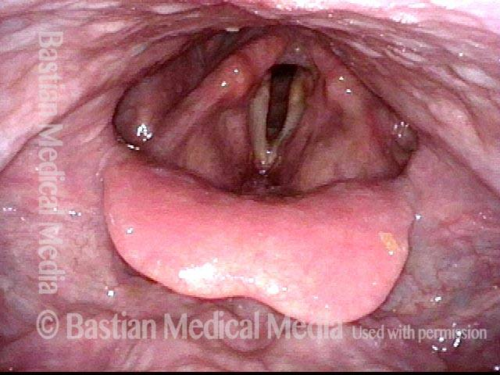
Laryngopharynx
Bounded above by epiglottis, below by lower border of cricoid cartilage.
3rd,4th, 5th, 6th cervical vertebrae lie behind.
Pyriform fossae.
Valecullae.

Slide 6
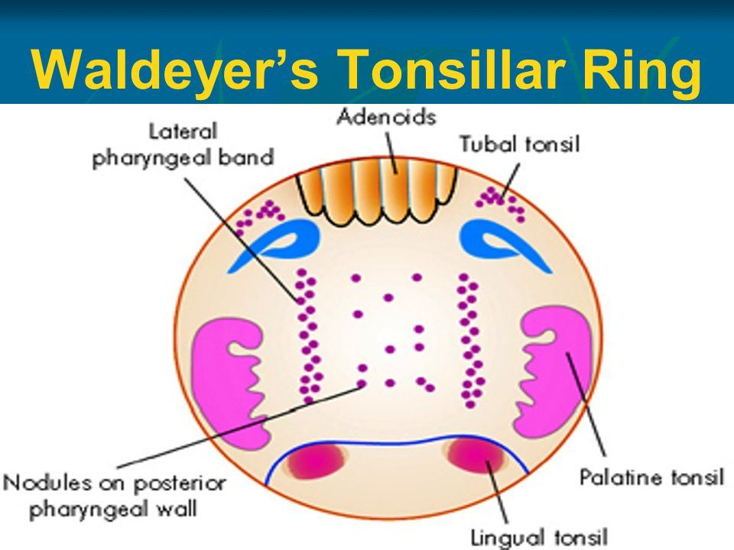
Layers of Pharynx
1.Mucous membrane
ciliated columnar epith.in upper ½ of nasopharynx.
St.squamous epith.lines oro and laryngopharynx.
Subepithelial lymphoid tissue form Waldeyer`s ring, have efferent lymph vs.but no afferent ones.
Palatine tonsils ( has 15-20 crypts, CT capsule)
Nasopharyngeal tonsil (has 5 vertical furrows, no capsule)
Lingual tonsil…. Continuous with lower end of P.T
Tubal tonsil
Lateral Pharyngeal band….. Descend from tubal tonsil

Slide 7
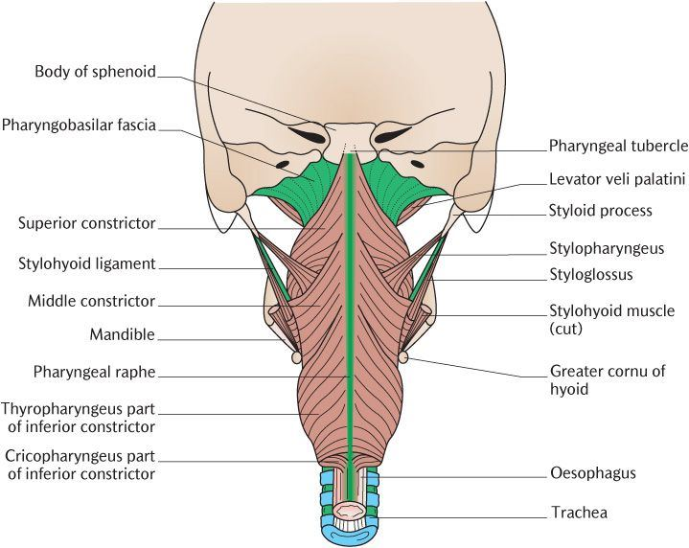
2. Pharyngeal Aponeurosis.
It is an incomplete CT coat in lateral and post.walls
Pharyngobasilar fascia…. The thickened upper part where muscle is deficient. Posteriorly is strengthened by strong band (Median raphe).
Tensor, Levator Palati muscles, ET pass through.

Slide 8
3. Muscular Coat
External coat , 3 constrictors, each is overlapped by fibres of one below.
Sup.Constrictor…palatopharyngeal sphincter is formed from it and tensor palati .
Middle Constrictor….. Stylopharyngeus and( ix) pass between sup.and midd.constrictors. Int.branch of Sup. Lary.n and laryngeal branch of sup.thy.ar pass between middle and inf.constrictors.
Inferior Constrictor…. Has 2 parts (Thyropharyngeus) and (Cricopharyngeus).
Killian dehiscence…. Is potential gap between oblique thyroph.and transverse Cricoph.
Internal…. Has 3 muscles (Stylopharyngeus,Salpingopharyngeus,Palatopharyngeus) all are inserted in post.border of thyroid cartilage and median raphe

Slide 9
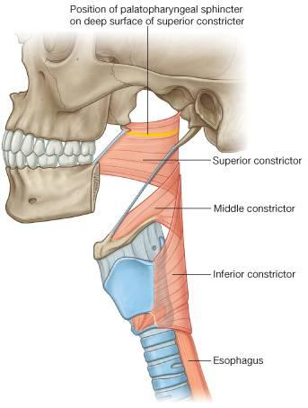
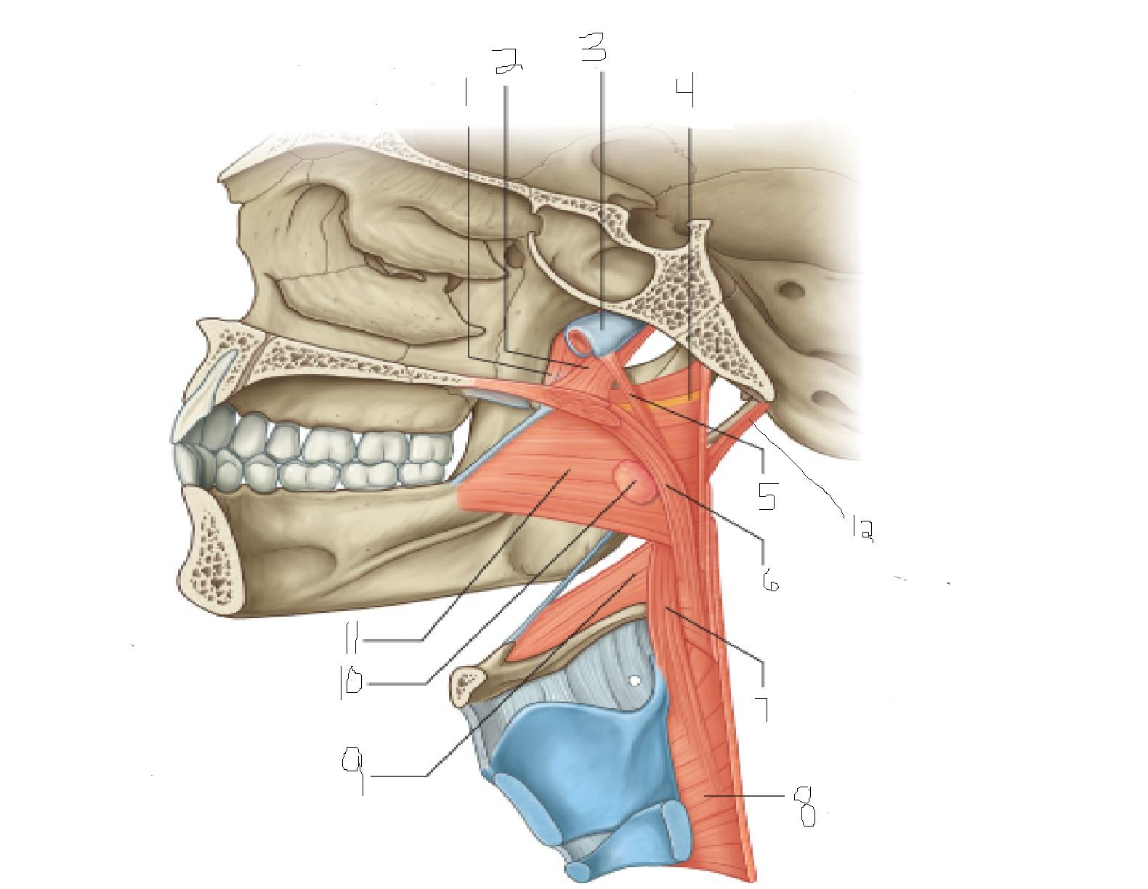
Muscles of Pharynx

Slide 10
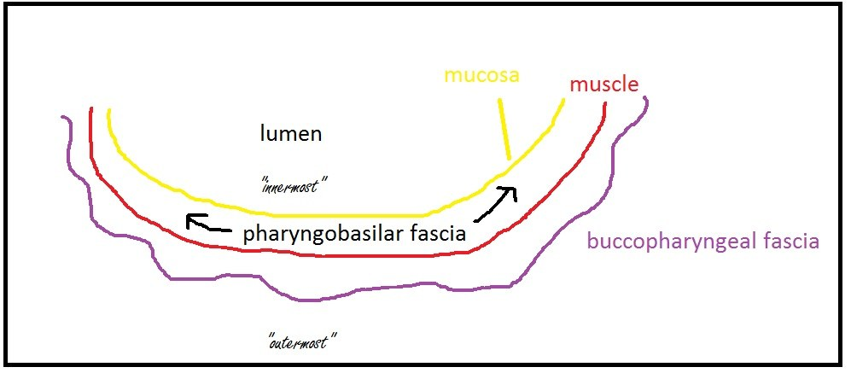
4. Buccopharyngeal Fascia
Covers the constrictor ms. Extend over prevertebral fascia.
Above sup.constrictor ms., is firmly united with pharyngobasilar fascia.

Slide 11
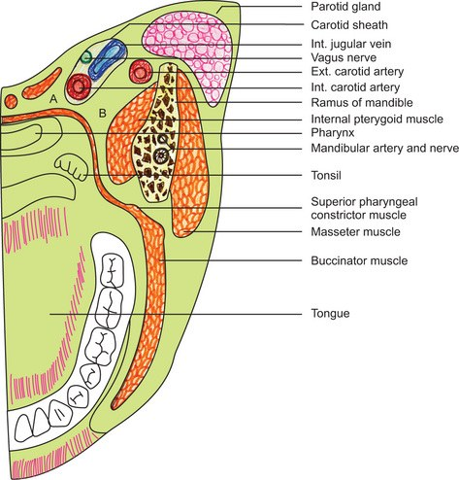
Parapharyngeal space
It is triangular space outside pharynx, extends from base of skull to sup.mediastinum.
Contents:
Great vs of neck.
Ascending palatine and ascending pharyngeal a.
Deep cervical L.N
Last 4 cranial ns. And cervical sympathetic trunk.

Slide 12
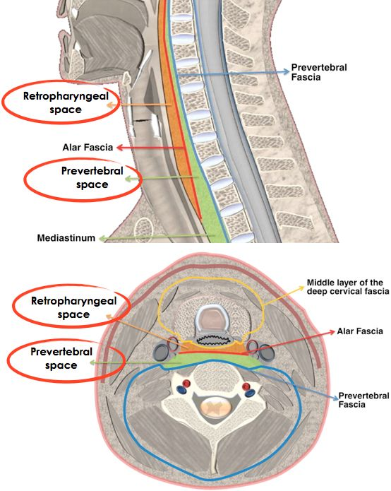
Retropharyngeal space
Lies behind pharynx, in front of cervical vertebrae and covering ms. and fascia.
It contains retropharyngeal L.Ns, usually paired, seperated by median partition, disappear by age of 4ys.

Slide 13
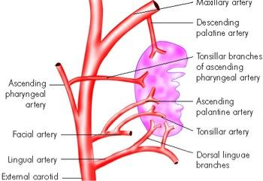
Blood supply of pharynx
From branches of Ext.Carotid artery.
Ascending Pharyngeal.
Ascending palatine a.
Maxillary a.branches.
Dorsalis linguae.
Veins form plexus communicates with pterygoid plexus above and drains into common facial and IJV

Slide 14
Nerve supply of Pharynx
Derived chiefly from pharyngeal plexus (XI) cranial part, distributed through pharyngeal branches of (X).
Supplying all muscles of pharynx except stylopharyngeus (IX) and tensor palati (V).
- The main sensory nerves are (IX) , (X), nasopharynx is supplied largely by (V).

Slide 15
Stages of Deglutition
Oral stage: Voluntary, closure of mouth, tongue elevation.
Pharyngeal stage: Involuntary, contraction of nasopharyngeal sphincter, closure of laryngeal inlet, cessation of respirartion, contraction of constrictors.
Esophageal : food is carried down by esophageal peristalsis

