Slide 1
Inflammations of Larynx
By: WAM, MD.

Slide 2
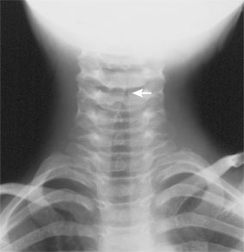
Paediatric Laryngitis
Laryngotracheitis:
Viral in origin, Parainfluenzae virus in 50%.
Affects children less than 3ys.
Air way obstruction and stridor.
On exam. Erythematous and oedematous mucosa.
Sec. bacterial infection……. Membranous croup
due to Heaemophilus influenzae.
Treatment: Hydration, humidified oxygen and corticosteroids.

Slide 3
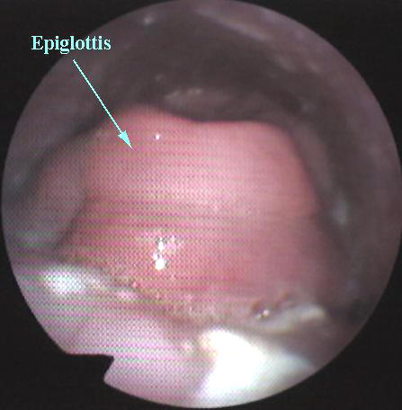
2. Supraglottitis ( Epiglottitis):
Life threatening infection of supraglotic larynx caused by H.influenzae type B.
Affects children above 3ys.
Rapid onset, fever, sore throat, inspiratory stridor, child is generally ill, drooling.
Treatment: - secure safe air way.
- antibiotics ( 2nd or 3rd generation cephalosporin).
- supportive care.

Slide 4
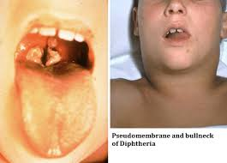
3. Diphtheria:
Caused by Corynebacterium diphtheriae.
Febrile illness, slow onset,followed by progressive air way obstruction.
Thick greyish membranous exudate over tonsils, pharynx and laryngeal structures.
Treatment: - establish safe air way.
- antitoxin.
- penicillin.

Slide 5
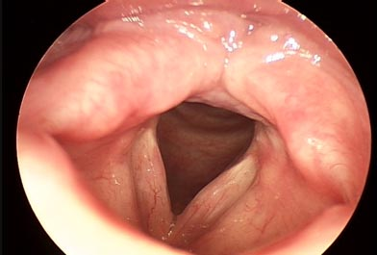
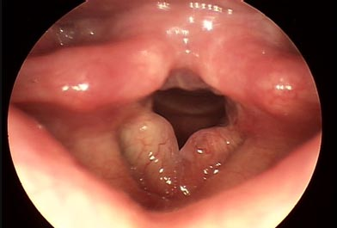
Chronic non specific Laryngitis.
Arises due to faulty use of voice, irritation by dust and fumes.
Laryngeal appearances:
hyperaemic: cords are injected.
Hypertrophy: thickening of all tissues of larynx.
Oedematous: true cords are swollen and pale.
Treatment: - vocal rest - antibiotics.
- elimination of irritating factors.
- stripping of vocal cords in resistant oedematous cases.

Slide 6
Chronic Specific Infections of Larynx
T.B:
Today is frequently unassociated with active pulm.disease.
Nowadays true vocal cords to be most commonly involved.
Clinically……. Dysphonia and odynophagia.
Laryngeal mucosa may be diffusely oedematous, hyperaemic, hypertrophic.
Or the process may be nodular or ulcerative.
If left untreated………cicatricial laryngeal stenosis or fixation of vocal folds.

Slide 7
2. Scleroma:
Caused by K.rhinoscleromatis
Three stages of disease……catarrhal, granulomatous and sclerotic.
Involve subglottic region and trachea.
Diagnosis……..Mikulicz cells, Russel bodies.
Treatment……….. Qunilones antibiotics
Laryngeal dilatation.
Endoscopic resection.
Tracheostomy.

Slide 8
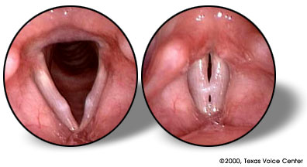
Voice induced disorders
Vocal nodules:
Due to excessive use of voice.
Common in singers, teachers and mothers of young children.
Pathology: Localised hyperkeratosis at junction of ant.1/3 and post.2/3 of the free edge of one or both cords.
C/P: dysphonia, nodules are bilateral and symmetrical.
Treatment: -voice rest.
-endoscopic removal.
-speech therapy.

Slide 9
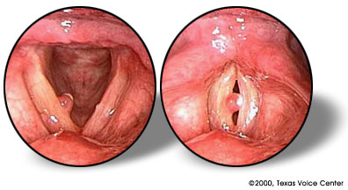
2.Vocal Fold Polyp
Caused by vocal trauma.
Usually unilateral.
Sessile or pedunculated.
ttt: removal through direct laryngoscopy.

Slide 10
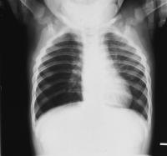
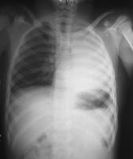
F.B Inhalation
F.B passed larynx may lodge anywhere in trachea or bronchi, more commonly in Rt.main bronchus.
Initial symptoms: cough, dyspnoea, choking followed by latent period.
Cough returns if object changes its position
Atelectasis if lobe of lung is completely obstructed
Emphysema in case of partial obstruction.
Vegetable F.B……intense inflammatory reaction in mucosa.
Ttt: removal through bronchoscope

