Slide 1
Anatomy of Larynx
By: WAM, MD.

Slide 2
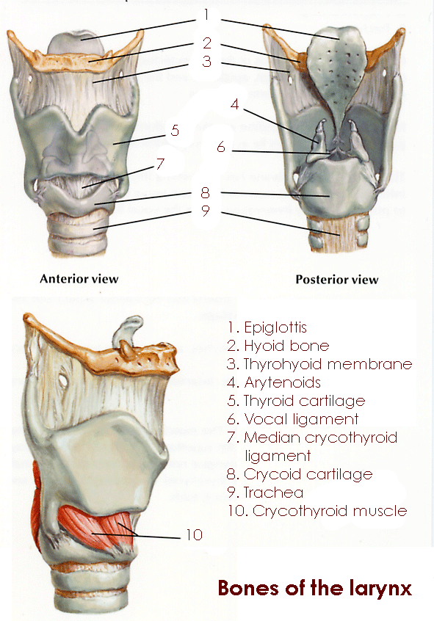
Laryngeal cartilages
Epiglottis
Thyroid
Cricoid
Arytenoids
Corniculate and Cuneiform

Slide 3
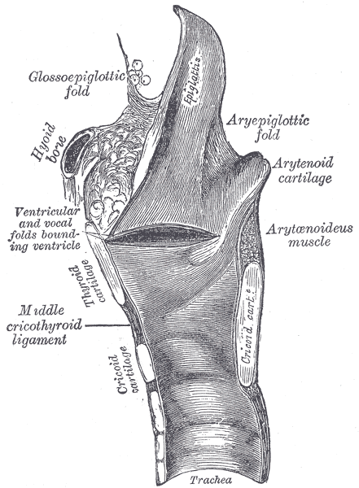
Elastic Tissues of Larynx
Intrinsic
Quadrangular membrane of supraglottic
Conus Elasticus of glottic and subglottic
Extrinsic
Thyrohyoid m.
Cricotracheal m.

Slide 4
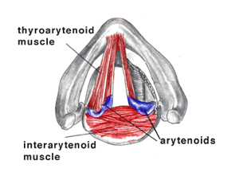
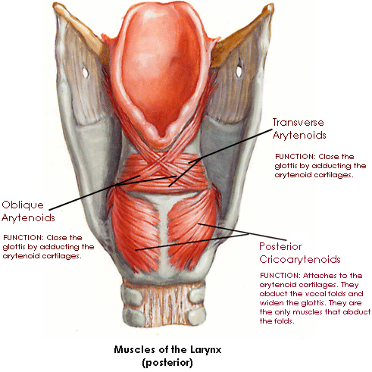
Muscles of Larynx
Extrinsic: Elevators and depressors of larynx
e.g Thyrohyoid, stylohyoid and
Sternohyoid, sternothyroid.
Intrinsic
Cricothyroid
Post.cricoarytenoid.
Lat.cricoarytenoid.
Interarytenoid and Aryepiglottic muscles
Thyroarytenoid

Slide 5
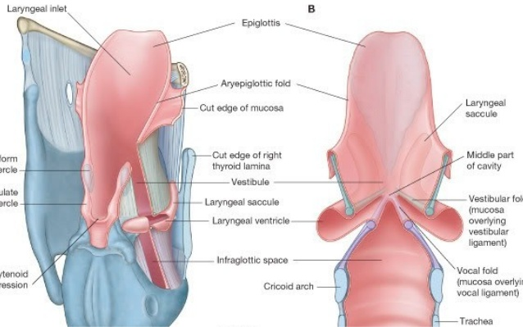
Internal Anatomy
Vestibule: from tip of epiglottis to ventricular bands.
Ventricle: Space between false and true cords.
Infraglottic cavity
Mucosa: Pseudo stratified ciliated columnar.

Slide 6
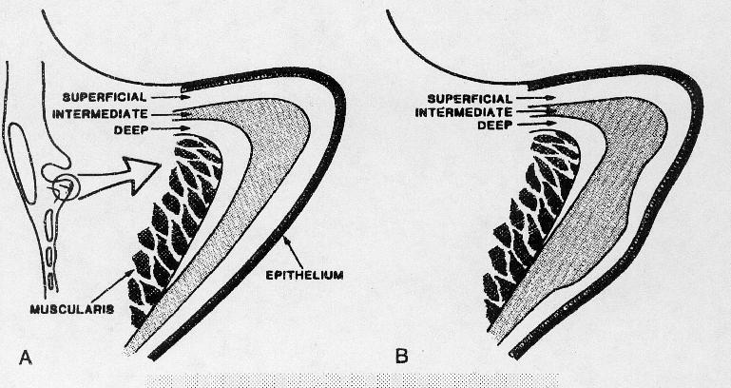
Vocal fold Structure

Slide 7
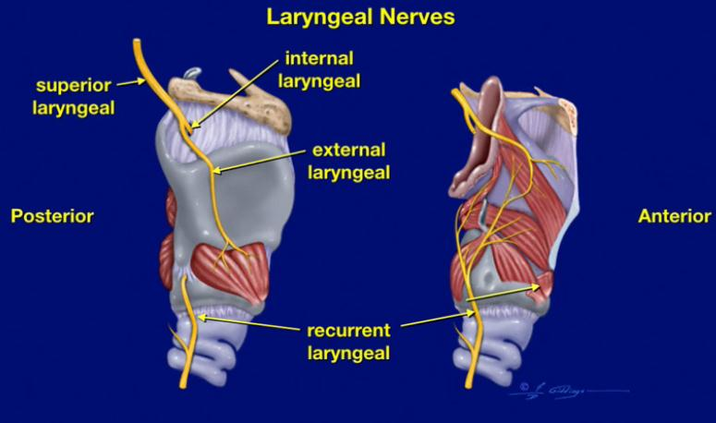
Nerve supply

Slide 8
Symptoms of Laryngeal diseases
Stridor:
Noisy breathing due to airway obstruction
May be cong… laryngomalachia, inflammatory……… croup.
Traumatic……laryngeal paralysis, Neoplastic……carcinoma.
2. Dysphonia:
Any abnormality of voice
Inflammtory……..laryngitis, GERD
Growths over vocal folds….nodules, polyp, cyst, tumours.
VF paralysis.

Slide 9
3. Cough and expectoration
Post nasal drip, Allergy, GERD, Infections…..laryngitis, TB.
COPD, aspiration in laryngeal paralysis.
4. Refered pain
Laryngeal cancer and GERD through irritation of superior laryngeal nerve.

Slide 10
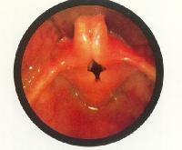
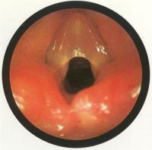
Congenital Anomalies
Laryngomalachia:
Produces partial obstruction to supraglottic airway.
ttt: Reassurance or piglittopexy.
2. Laryngeal web:
consists of fibrous tissue covered by epithelium in the anterior ½ of the glottis. may be complete or partial

Slide 11
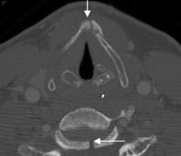
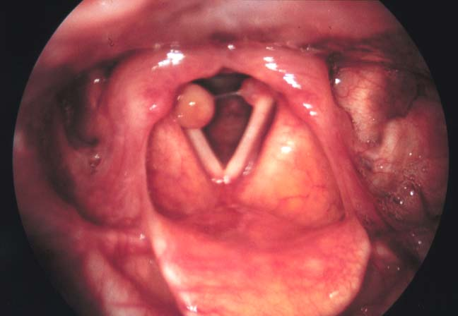
Trauma to larynx
1.Blunt: due to motor car accidents, assults and strangulation.
2. Penetrating: results from stabbings or gunshot.
3. Intubation injury: contributing factors include, large diameter tubes, excessive movement, over inflated cuff,
and prolonged intubation.
May result in ulceration and G.T formation.
Also arytenoids dislocation .

Slide 12
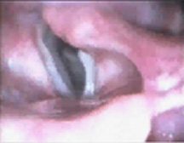
Initial management:
Secure airway, control bleeding, immobilize cervical spines.
Definitive treatment:
In mild cases…. observation of air way, humidified air, voice rest, antibiotics in case of mucosal breaks, steroids.
surgical treatment is indicated in:
Massive endolaryngeal edema.
-Lacerations involving ant.commissure or edge of vocal fold.
-Displaced or comminuted fractures.
-Vocal fold immobility.
-Arytenoid dislocation.

Slide 13
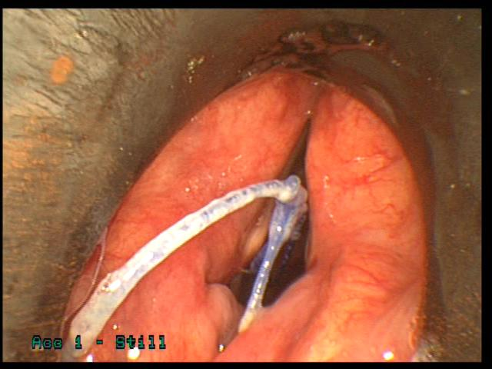
F.B in Larynx
- Sharp F.B as pin or glass.
- C/P: Dyspnoea, Cough, Hoarseness later on.
-Treatment: removal by direct laryngoscopy.

