Slide 1
Oesophagus
By WAM
MD

Slide 2
Anatomy
It is a muscular tube 25 cm in adults.
Has three constrictions
At its commencement (15 cm from upper incisor)
Site of crossing by aortic arch, and lt.main bronchus.
Where it pierces diaphragm (40 cm from upper incisors).
Upper oesoph.sphincter: is continuously in state of tonic contraction.
Lower oesoph.sphincter: measures 3-4 cm, at time of swallowing it relaxes for 5 seconds, pinchcock action of diaphragm is important to protect against reflux.

Slide 3
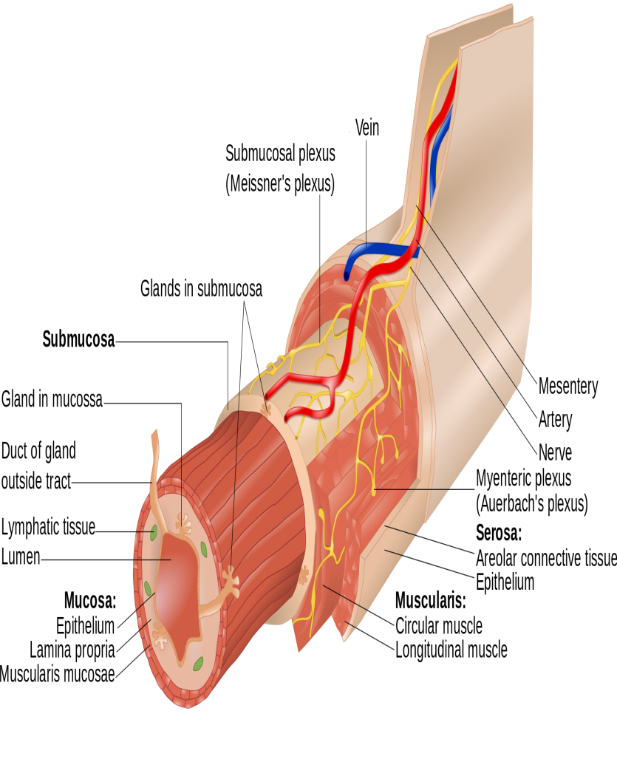
Anatomy
It has 4 coats.
1. Mucosa: St.sq epithelium.
2. Submucosa.
3. Muscular: Int.circular continuous above with cricopharyngeus.
Ext.longitudinal…. Forms complete investment except at upper 1/3.
4. Fibrous cover.
Relations: In cervical part
Ant. Trachea, lt.lobe of thyroid.
Post. Vertebrae with prevertebral ms.
On each side: carotid sheath, lobe of thyroid gland, RLN in groove between oesoph. And trachea

Slide 4
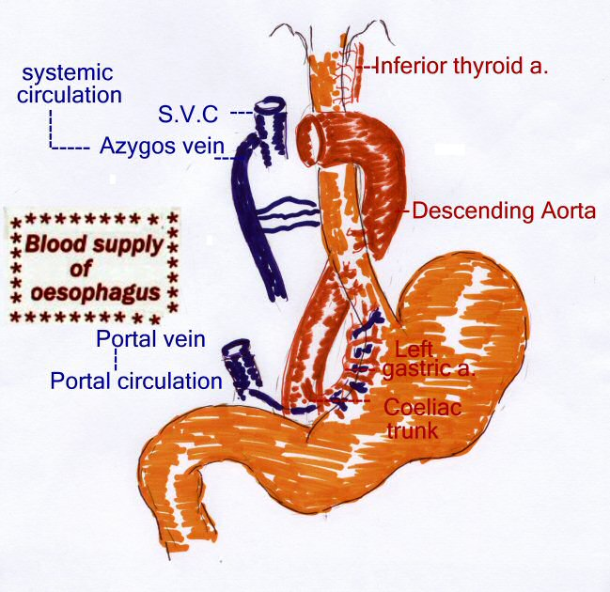
Bl.Supply of oesophagus
Inf.thyroid a. in cervical part.
Descending thoracic aorta in thoracic part.
Lt.gastric a.in abdominal part.
Veins drain to
Inf.thyroid v.
Azygos v.
Lt.gastric v. tributary of portal vein.

Slide 5
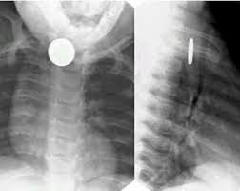
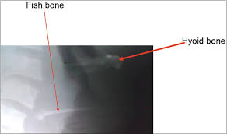
FB Swallowing
Common site of impaction is at cricopharyngeal sphincter.
most common objects are coins, meat bones
CP:dysphagia, some objects may be impacted for weeks.
Occasionally regurgitation, excessive saliva in pyriforms.
Inves. Plain x ray, Barium swallow, endoscopic examination.
Treatment: endoscopic removal
Ext.approaches in difficult cases.

Slide 6
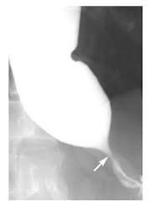
Achalasia
AE is unknown, degenration of Auerbach plexus has been documented with loss of postganglionic inhibitory neurones…….insufficient relaxation.
affects males more
CP: dysphagia more to solids, regurgitation, heartburn.
Investigations: Barium swallow, esoph.manometry.
Treatment: Non surgical, Surgical.

Slide 7
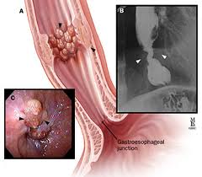
Esophageal Cancer
Sq.cell carcinoma (90%).
Affects elderly more.
Precancerous lesions: Achalasia, caustic ingestion,PVS, GERD.
CP: Dysphagia first to solids then to fluids.
Wt.loss, pain with swallowing, respiratory symptoms (regurgitation and aspiration) , dysphonia.
Invest. Barium swallow, Endoscopy, CT scan
Treatment: Esophagectomy.
Palliative measures.

