Slide 1
Pharyngeal Suppuration
By WAM
MD

Slide 2
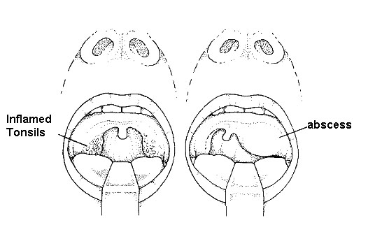
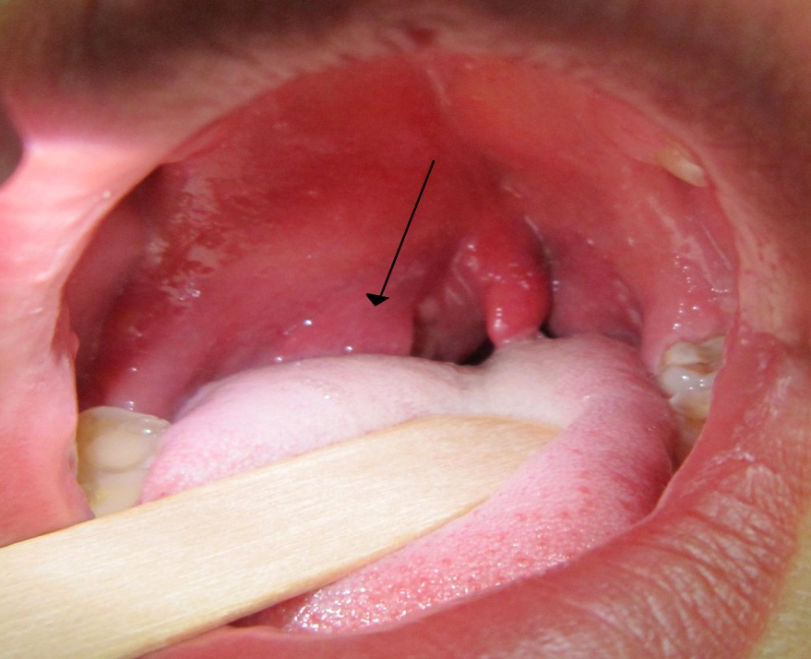
Peritonsillar Abscess (Quinsy)
Abscess between tonsilar capsule and lat.pharyngeal wall.
Follows attack of AT, is unilateral, above tonsil near soft palate, 1st cellulitis then frank pus.
CP: pain, fever, trismus, dysphagia.
complications: laryngeal oedema, Paraph.abscess

Slide 3
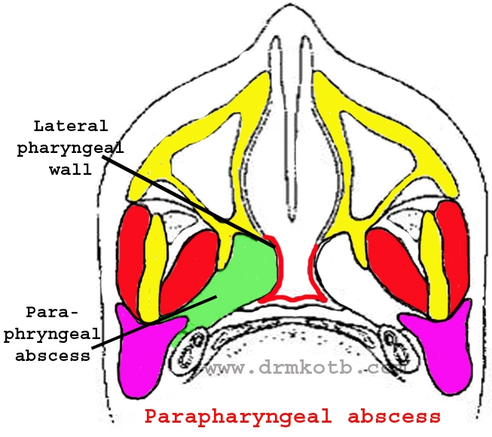
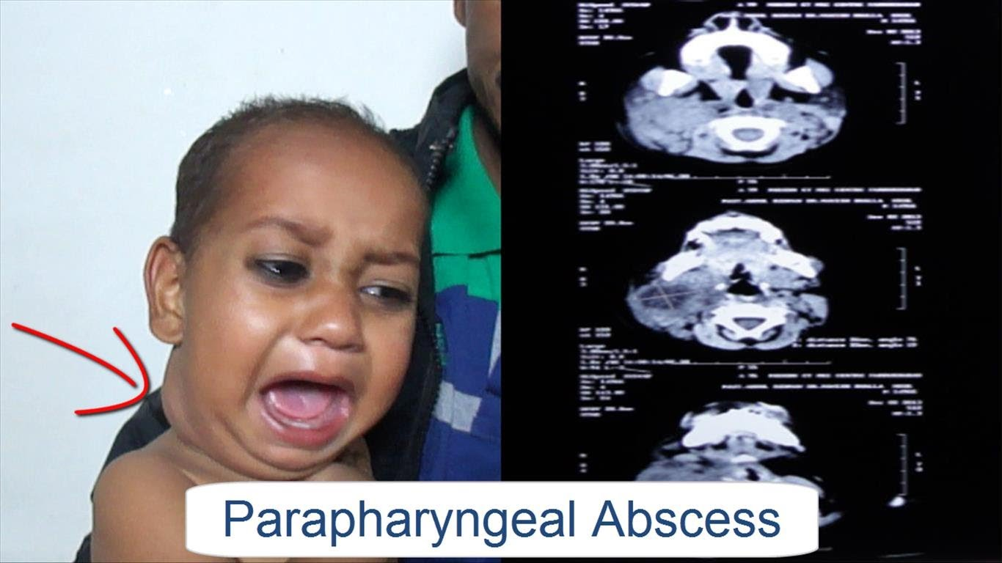
Parapharyngeal Abscess.
Spread from tonsils, lower wisdom tooth.
CP: pain, trismus, fever, neck swelling, pharyngeal wall and tonsils pushed medially.
Complications: laryngeal oedema, IJV thrombophlebitis, mediastinitis.
Treatment: systemic antibiotics.
Incision of abscess through neck.

Slide 4
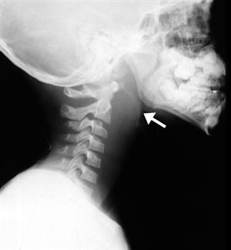
Retropharyngeal Abscess
1. Acute: limited to one side of midline, due to suppuration of retropharyngeal LNs.
CP: often in infants, difficulty in breathing and suckling, torticollis, nasal obstruction, oedema of larynx.
ttt: Incision of abscess.
2. Chronic: caused by TB infection of cervical vertebrae, abscess lies centrally behind prevertebral fascia.
Seen in older children, adolescents, slight dysphagia.
ttt: incision of abscess through neck+ antituberculous drugs.

