Slide 1
Pharyngeal Diseases
By WAM
MD.

Slide 2
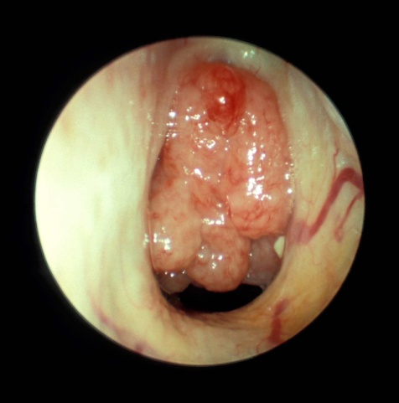
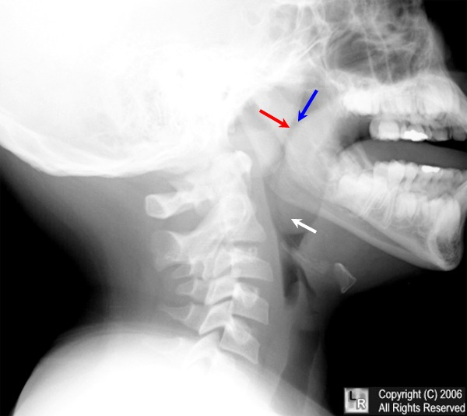
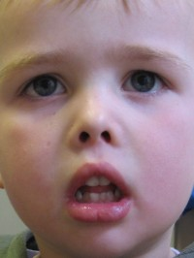
Adenoids
A hypertrophy of nasopharyngeal lymphoid tissue sufficient to produce symptoms, common between 3-7ys.
C/P: - Nasal obstruction.
ET obstruction.
Symptoms and signs due to inflammation.
Generalized disturbances.
Investig. Nasoendoscopy,
X ray.
ttt: Adenoidectomy

Slide 3
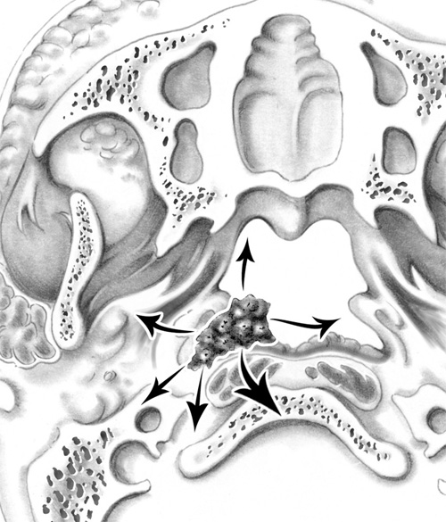
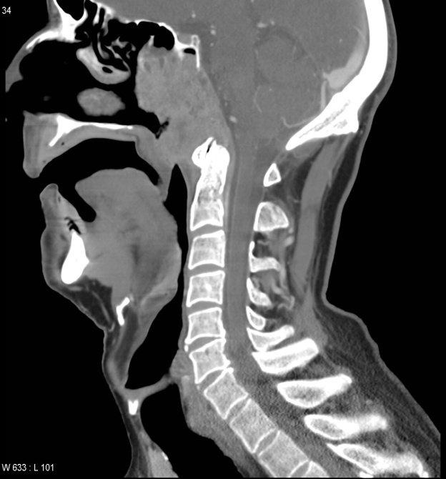
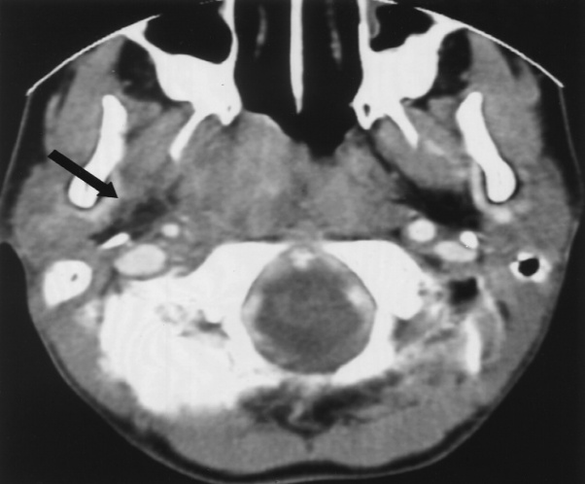
NPC
Common in chinese, genetic background, high titre of EBV.
Spread: Ant. Post. Lat. Sup and Inf.
C/P: LN enlargement (60%)
Epistaxis and nasal symptoms (40%), Otologic (30%), Neurologic (20%) frequently (v,vi, ix,x) nerves are affected.
Pain and headache.
Trotter`s triad
Invest. CT scan, blind biopsy.
ttt: radiotherapy

Slide 4
Oropharyngeal Diseases

Slide 5
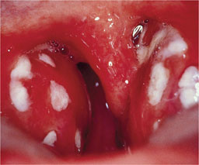
Acute Tonsillitis
Infection due to haemolytic streptococci.
Pathology: Parenchymatous, Follicular.
C/P: sore throat, dysphagia, fever, earache, enlarged and tender jugulodigastric LNs.
Complications: Quinsy, para and retropharyngeal abscesses, acute rheumatic fever, acute nephritis, oedema of larynx, Ch.T.
DD: scarlet fever, Diphtheria,IM,Agranulocytosis.
ttt: Antibiotics, analgesics,rest.

Slide 6
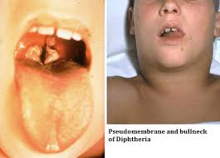
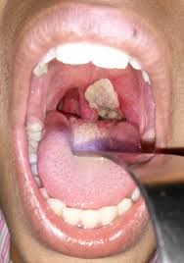
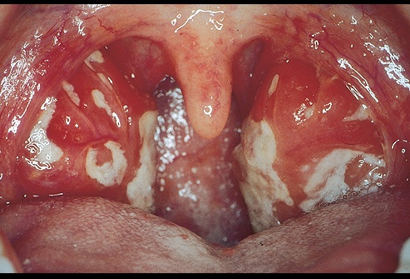
Other Membranous Lesions
Diphtheria: sore throat, cervical LNs enalrgement, toxaemia, False membrane formation.
Infectious Mononucleosis:
Caused by EB virus, pseudo membrane in mouth and pharynx, LNs + spleen enlargement.
Rare complications: jaundice, meningitis.

Slide 7
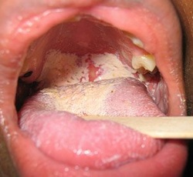
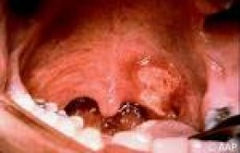
Other Membranous Lesions
3. Agranulocytosis:
Caused by drugs containing benzene ring.
Marked reduction of neutrophil count.
Ulceration with false membrane in tongue, buccal mucosa, pharynx.
It is grave disorder.
4. Vincent angina: gm-ve fusiform bacillus + spirocheta denticola
CP: pain, foetor oris, cervical adenitis, membrane sloughs leaves deep ulcers.

Slide 8
Oro-pharyngeal Ulcerations
1.Traumatic: due to ill-fitted denture, thermal ,chemical.
2.Inflammatory: Bacterial……Vincent angina, TB, Syphilis.
Viral….. Herpes, AIDS, Coxsackie A virus.
3. Idiopathic…….Aphthous stomatitis, Behcet syndrome.
4. Autoimmune…… Pemphigus.
5. Blood diseases…..Agranulocytosis, Acute lymphatic leukaemia.
6. Vitamin deficencies: Pellagra, Scurvy.
7. Malignant: Squamous cell carcinoma.

Slide 9
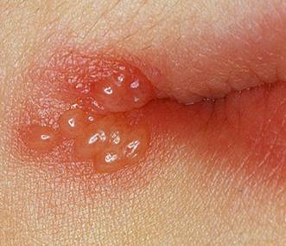
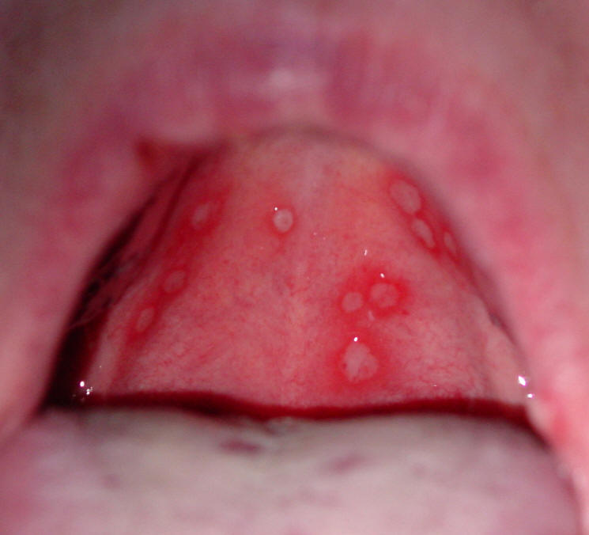
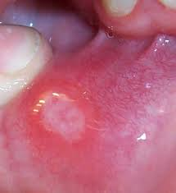
Ulcerative lesions

Slide 10
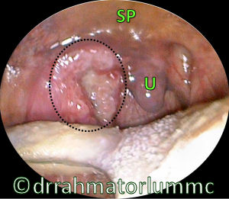
Oropharyngeal Tumors
1.Sq.cell carcinoma: common in tonsillolingual sulcus.
Spread to tongue, palate, alveolus and mandible, CLNs.
CP… sore throat, dysphagia, pain in the ear, hge. from ulcerated lesions
ttt…. Radiotherapy, Radical surgery.
2. Lymphoma: most cases non Hodgkin , B cell type
Staging by BM biopsy, chest x ray, CT scan, skeletal survey.
ttt: radiotherapy, chemotherapy.

Slide 11
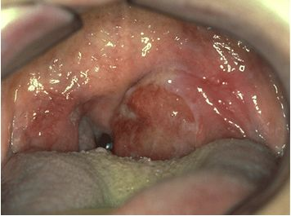
Unilateral Tonsilar enlargement
Inflammatory: Ch.T, Quinsy.
Neoplasms: Sq.cell carcinoma, Lymphoma.
Parapharyngeal causes: Abscess, Parapharyngeal space neoplasms.

Slide 12
Hypopharyngeal Diseases

Slide 13
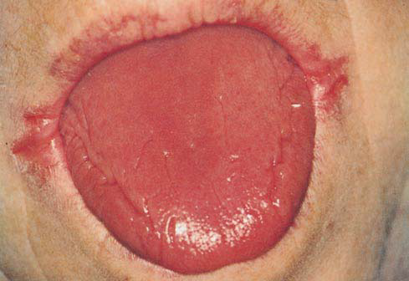
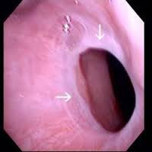
Plummer Vinson Syndrome
Chronic atrophic type of inflammation of MM, Iron def.is probably the cause.
Exclusively in females.
Pathog. Subepithelial fibrosis…web formation.
H.M anaemia is severe.
Achlorhydria…pernicious anemia.
1/3-2/3 of PCC had preceding PVS.
ttt: Iron and vitamins, endoscopic dilatation, regular follow up.

Slide 14
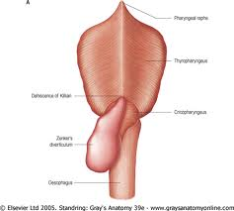
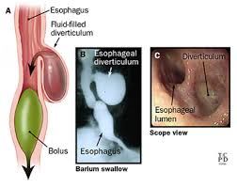
Hypopharyngeal pouch
Herniation of pharyngeal mucosa through Killian dehiscence, probably result from neuromuscular incoordination.
CP: usually in elderly, long dysphagia, regurgitation of undigested food, neck swelling, carcinoma rarely occur in pouch.

Slide 15
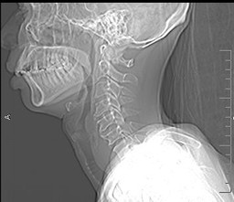
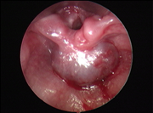
Post Cricoid Carcinoma
Between upper border of cricoid and esophageal opening below.
Mostly occurs in females, may be preceded by PVS.
CP: longstanding dysphagia.
Manifestations of PVS.
LN metastasis, often bilateral.
Diag…endoscopy, x.ray, barium swallow.
ttt: Pharyngolaryngectomy, palliative

