Slide 1



Integration of metabolism
Dr. Marwa Shaaban Hashim
Lecturer of Biochemistry
Sohag faculty of Medecine

Slide 2

Objectives
Metabolic response on feeding
Metabolic response on fasting and starvation
Metabolic response to exercise

Slide 3

Integration of Metabolism
The coordination between three metabolites ( carbohydrates, lipids, protein) is called the integration of metabolism.
Blood glucose levels vary widely over a day as periods of food consumption alternate with periods of fasting.
Insulin and glucagon are the two hormones primarily responsible for maintaining homeostasis of blood glucose levels.
The thyroid, glucocorticoids, and epinephrine hormones
mediate an additional regulation.

Slide 4
Significance of integration:
It ensures a supply of suitable fuel for all tissues;
Under positive caloric balance, a significant proportion of the food energy intake is stored as either glycogen or fat.
Under negative caloric balance, fatty acids are oxidized in preference to glucose, to spare glucose for those tissues (brain & RBC) that require it under all conditions.
Dr Marwa shaaban

Slide 5
Integration of major metabolic pathways of energy metabolism
Glycolysis:
Degradation of glucose
anaerobic) generates ATP.
to pyruvate (Lactate under
Fatty acid oxidation:
Fatty acid (FA) oxidizes to Acetyl CoA.
Energy is trapped in the form of NADH and FADH₂
Amino acid degradation:
When amino acids are consumed more than required, are
degraded to meet the fuel demands of the body. The glucogenic amino acids can serve as the precursor for the synthesis of glucose via pyruvate or intermediates of the TCA cycle. The ketogenic amino acids form the precursor for acetyl CoA. Are

Slide 6
Citric acid cycle:
Acetyl CoA is the common metabolite, produced from different fuel sources. It enters citric acid cycle and gets oxidized to CO₂.
Most of the energy is trapped in the form of NADH and FADH_{2.}
Oxidative phosphorylation:
The NADH and FADH_{2,} produced in different metabolic pathways, are finally oxidized in the electron transport chain,
which is coupled with oxidative phosphorylation to generate ATP.
Hexose monophosphate shunt:
Concerned with the liberation of NADPH, which is utilized for
biosynthesis of several compounds, including fatty acids and ribose sugar, which is an essential component of nucleotides.

Slide 7
Gluconeogenesis:
Many non-carbohydrate compounds serve as precursor for gluconeogenesis.
Glycogen metabolism: Glycogen is the storage form of glucose, in liver and muscle. Glycogen serves as a fuel reserve to meet body needs for a brief period.
The metabolic pathways, in general are controlled by four different mechanisms:
The availability of substrates
Covalent modification of enzymes
Allosteric regulation
Regulation of enzyme synthesis

Slide 8
Organ specialization and metabolic Integration in a
well-fed state
The various tissues and organs of the body work in a well-coordinated manner to meet its metabolic demands (usually 2-4 hours after food consumption)
Liver
It is specialized to serve as the body’s central metabolic clearing house. After a meal, the liver takes up the carbohydrates, lipids, and amino acids, processes them, and routes them to other tissues. The major metabolic functions of the liver, in a post-absorptive state are:
1. Carbohydrate metabolism:
Increased Glycolysis, glycogenesis, and HMP shunt
Decreased gluconeogenesis

Slide 9



Lipid metabolism:
  Increased fatty acid and triacylglycerol synthesis
3. Protein metabolism:
Increased catabolism of amino acids
Increased protein synthesis.
Adipose tissue
It is regarded as the energy storage tissue. 1.Carbohydrate metabolism:
Increases uptake of glucose, glycolysis and HMP shunt
Lipid metabolism:
  Increased FA and TG synthesis
  TG breakdown inhibited.

Slide 10
Skeletal muscle
Carbohydrate metabolism:
Uptake of glucose is higher and glycogenesis increased.
Lipid metabolism:
Fatty acids are of secondary importance as a fuel for muscle in the
well-fed state in which glucose is the primary source of energy.
Protein metabolism:
Incorporation of amino acids into proteins is higher.
Brain
  Carbohydrate metabolism:
Glucose is the only source of fuel in an absorptive state. About 120 g
of glucose is utilized per day.
  Lipid metabolism:
Free fatty acids cannot cross the blood-brain barrier; hence their contribution for the supply of energy to the brain is insignificant.

Slide 11


Heart muscle differs from skeletal muscle in three important ways:
The heart is continuously active, whereas skeletal muscle contracts intermittently .
The heart has a completely aerobic metabolism.
The heart contains negligible energy stores such as glycogen or lipid . Thus, any interruption of the vascular supply results in rapid death of myocardial cells .
  Heart muscle uses glucose, free fatty acid and ketone bodies as fuels.
Dr. Marwa Shaaban

Slide 12
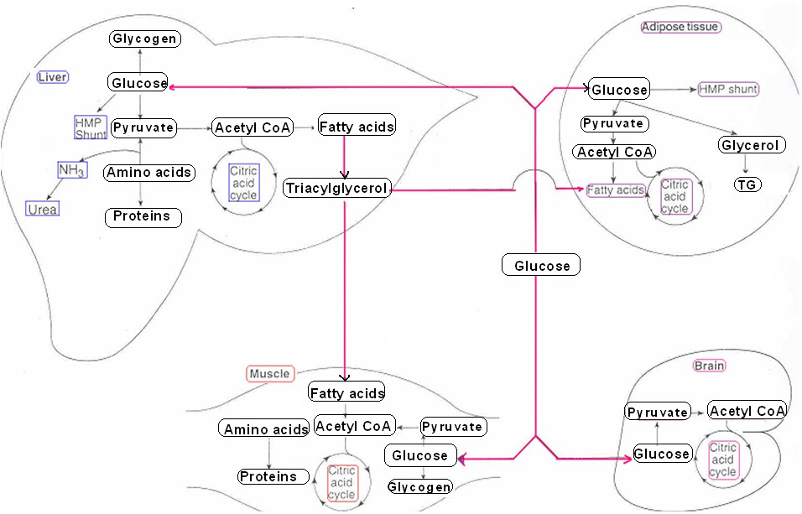

Slide 13
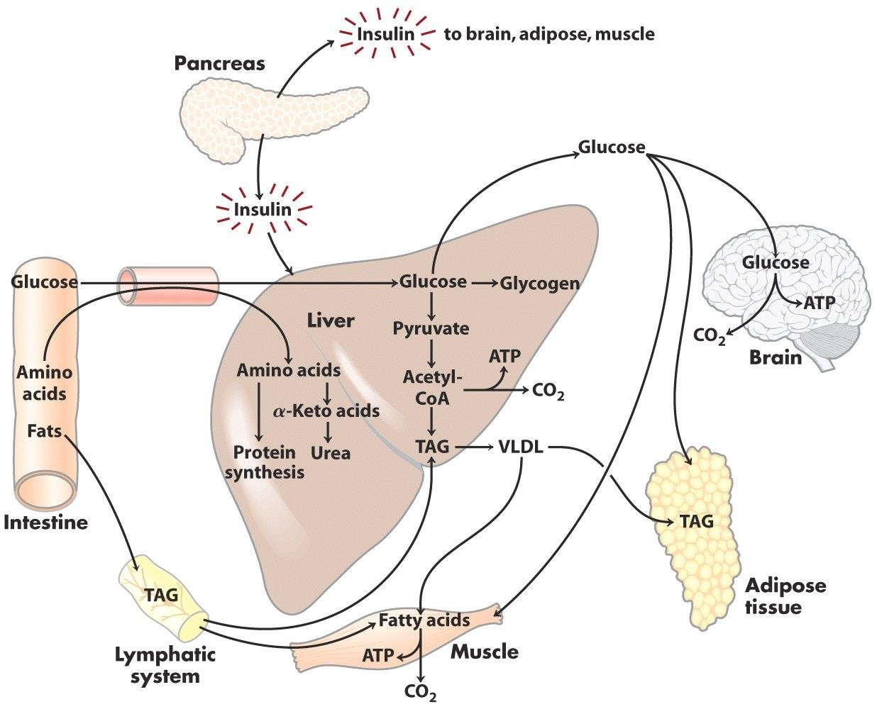
POSTABSORPTIVE STATE -> AFTER A MEAL

Slide 14
Metabolism in Starvation
Starvation may be due to food scarcity
Desire to rapidly lose weight
During surgery and burns.
It is a metabolic stress, which imposes certain metabolic compulsions on the organism.

Slide 15
The metabolism is reorganized to meet the new demands of starvation.
Glucose is the fuel of choice for brain and muscle. During starvation the carbohydrate is not sufficient to meet the requirements.
The triacylglycerol (TG) of adipose tissue is the predominant energy reserve of the body.
Protein can also meet the fuel demands of the body
Starvation associated with decreased insulin and increased glucagon.

Slide 16
Liver in starvation
Carbohydrate metabolism:
  Increased gluconeogenesis and glycogen degradation
Lipid metabolism:
  FA oxidation increased and the TCA cycle cannot cope up with the excess production of acetyl CoA, so it is diverted to ketone body formation.The fuel demands of the brain are met by ketone bodies.
Adipose tissue in starvation
1.Carbohydrate metabolism:
Glucose uptake and its metabolism are lowered

Slide 17
2.Lipid metabolism:
Degradation of TG increased which leads to increased release of FA from the adipose tissue, which serves as fuel for various tissues (brain is an exception). Glycerol liberated during lipolysis is used for glucose synthesis by the liver.
FA and TG synthesis completely stopped here.
Skeletal muscle in starvation
Carbohydrate metabolism:
Glucose uptake and its metabolism are lowered.
Lipid metabolism:
FA and ketone bodies are utilized as fuel by the muscle. Prolonged starvation adopted to utilize FA.

Slide 18
3.Protein metabolism:
Muscle proteins are degraded and the amino acids are utilized for glucose synthesis by liver. Protein breakdown is reduced if the starvation is prolonged.
Brain in starvation
During the first two weeks of starvation, the brain mostly dependent on glucose, supplied by liver gluconeogenesis. This, in turn, depends on the amino
acids released from the Starvation beyond three
muscle protein breakdown. weeks results in increased
plasma ketone bodies and the brain adopts itself to depend on ketone bodies for the energy.

Slide 19
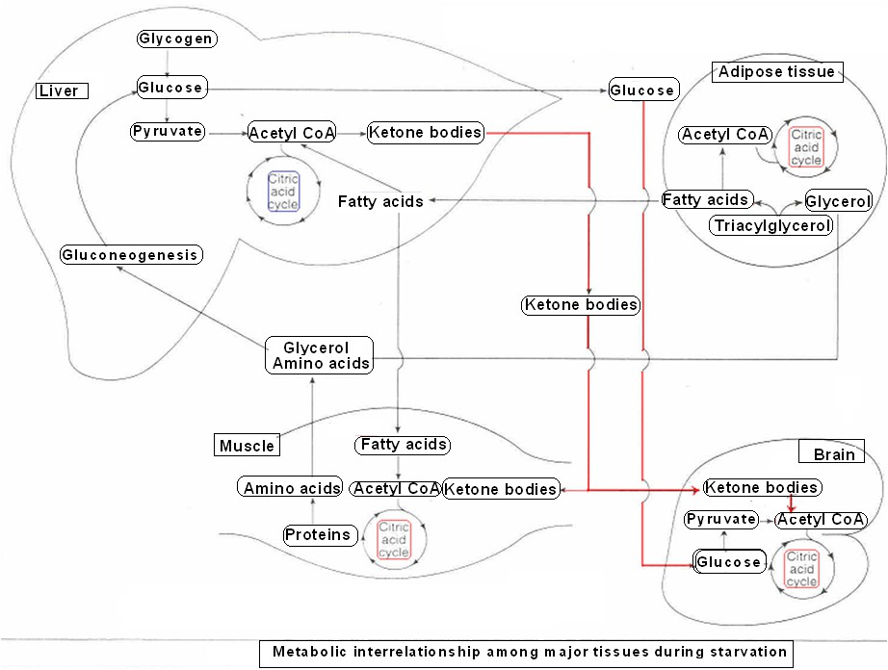
Dr. Shivananda Nayak

Slide 20

Wish you all the best

